Slide 1

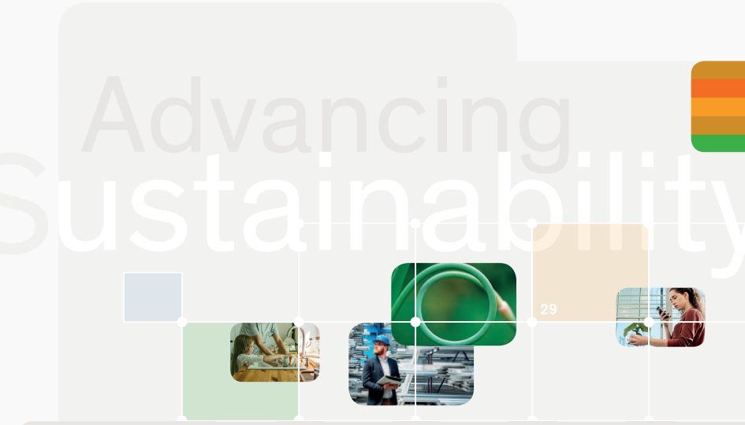

Introduction to NRP 73
Sustainable Economy
A learning module for the tertiary level

Slide 2
Introduction to NRP 73 - Sustainable Economy
The economy, alongside the environment and society, is the third target dimension of sustainable development. Sustainable development meets people’s needs within planetary boundaries.
The NRP 73 aims to generate scientific knowledge on a sustainable economy that uses natural resources sparingly, increases prosperity, and enhances the competitiveness of Switzerland as a business location.

Slide 3
Learning Objectives
The learner …
  understands the importance of the economy for sustainable development
  recognizes the contribution of research to sustainable development
  becomes familiar with the SNSF and its priority areas
  gains an overview of the objectives and focus areas of NRP 73
  reflects on relevant and interesting research questions in the field of “Sustainable Economy”

Slide 4

Introductory Questions
Please try to answer the following questions. Ideally, discuss your answers with a fellow student or colleague:
  What influence does the economy have on sustainable development?
  What contribution can science make to sustainable development?
  If you could launch a National Research Programme on “Sustainable Economy,” which priority areas would you set and why?

Slide 5
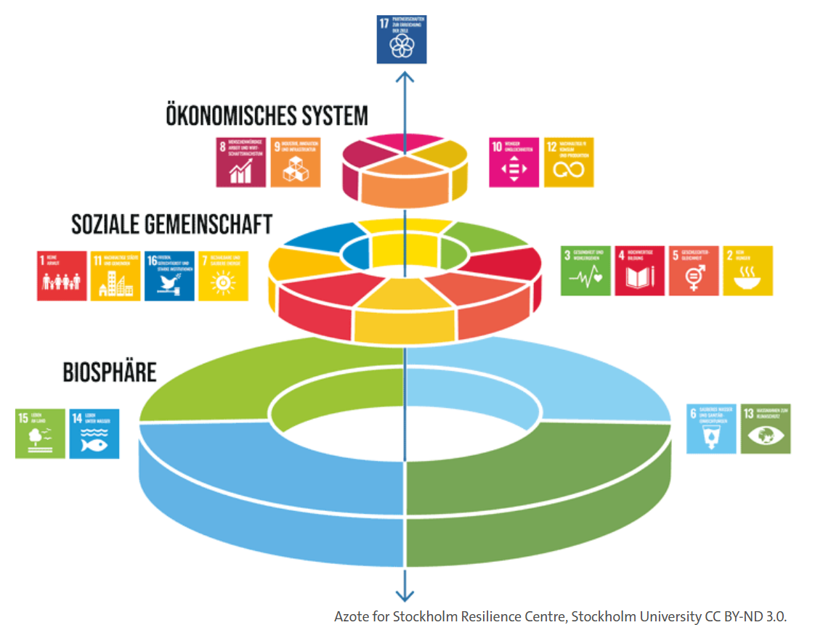
Sustainable Development:
The UN Sustainable Development Goals

Slide 6
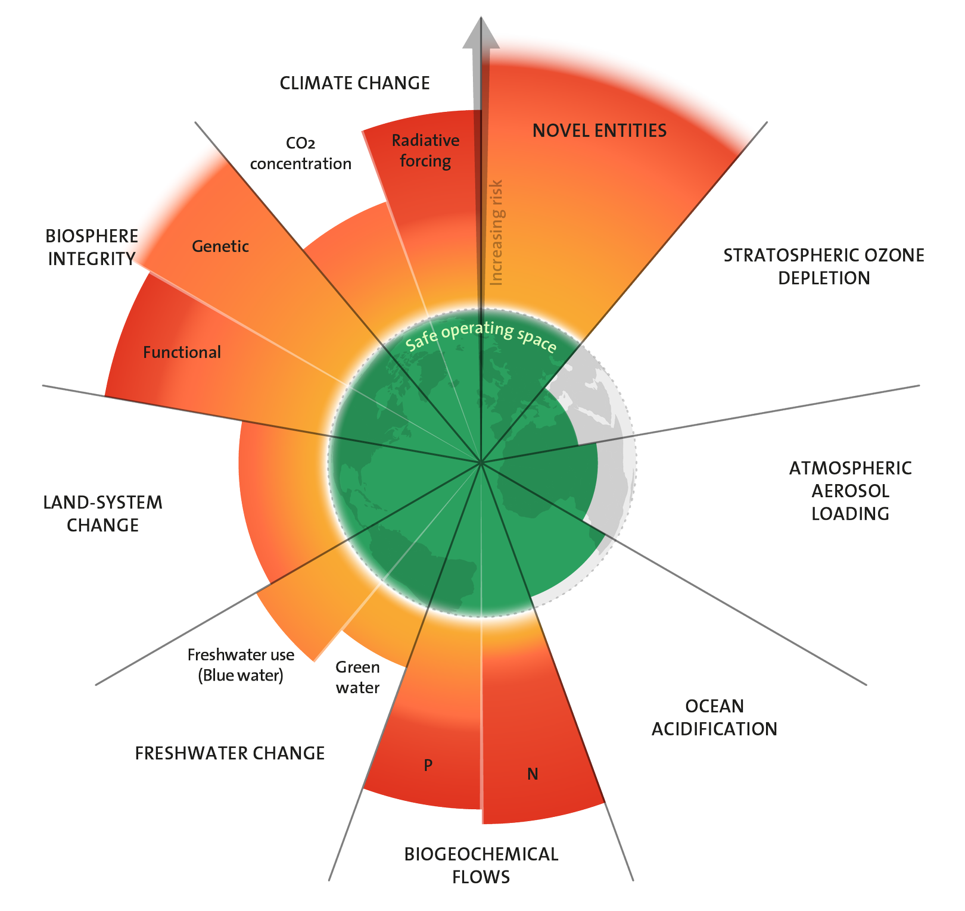
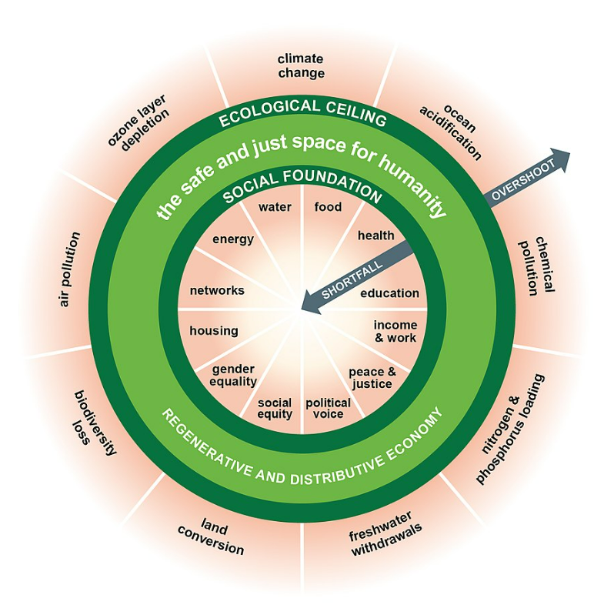
From exceeded planetary boundaries … to the doughnut economy
Stockholm Resilienc Centre (2023) and Donut-Model by Kate Raworth

Slide 7

The role of the economy in sustainable development
Global gross domestic product amounted to USD 110 trillion in 2024, meaning it has increased tenfold since 1980.
This immense economic growth has contributed to high levels of prosperity for many people in the Global North and to a significant reduction in poverty, hunger, and disease in the Global South.
However, it has also been responsible for severe environmental degradation, climate change, and rapid biodiversity loss.
https://de.statista.com/statistik/daten/studie/159798/umfrage/entwicklung-des-bip-bruttoinlandsprodukt-weltweit/
In addition, inequality between people and countries has been increasing in recent years.
The transformation of the economy is essential for sustainable development.
SDG 8 aims to promote decent work and inclusive, sustainable economic growth, particularly in the Global South.

Slide 8
The contribution of research to sustainable development
Research can generate knowledge, develop solutions, and stimulate dialogue for sustainable development.
In principle, all disciplines can contribute—from the humanities and social sciences, through economics and medical sciences, to the natural and engineering sciences.
Research itself should also transform in the direction of sustainable development.
Solutions that deliver real benefits for sustainable development are usually designed in an interdisciplinary and transdisciplinary manner, involving collaboration with a range of partners both within and outside research institutions.

Slide 9
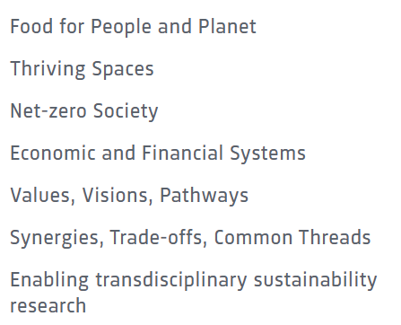
Sustainability research: Priority themes of the Swiss Academies of Sciences
https://sustainability.scnat.ch/en/prioritythemes/uuid/i/3a621ee4-193d-5a5b-a272-cc40a34cbfdd-Priority_Themes_for_Swiss_Sustainability_Research

Slide 10
The Swiss National Science Foundation (SNSF)
The Swiss National Science Foundation (SNSF) promotes research in all scientific disciplines on behalf of the Swiss Confederation.
Legal status: Private-law foundation
Year of establishment: 1952
Annual budget: CHF 1,167 million (2023)
Activities:
Research programmes and priority research areas
Promotion of innovation (together with Innosuisse)
Scientific awards and image competitions
Public outreach and dialogue with society

Slide 11
Sustainability-relevant National Research Programmes
National Research Programmes (NFPs) with a strong link to sustainable development:
NFP 69 "Healthy Nutrition and Sustainable Food Production"
NFP 70 "Energy Tournararound"
NFP 71 "Managing Energy Consumption"
NFP 73 «Sustainable Economy"
NFP 81 "Baukultur»
NFP 82 "Biodiversity and Ecosystem Services"

Slide 12
NFP 73 Sustainable Economy: resource-efficient, future-oriented, innovative
The aim of NFP 73 is to generate scientific knowledge on a sustainable economy that uses natural resources sparingly, increases prosperity, and enhances the competitiveness of Switzerland as a business location.
Framework:
29 research projects in 9 priority areas
Duration: 2016–2023
Research period: 5 years
Funding volume: CHF 20,000,000

Slide 13
Objectives of NFP 73
The NFP pursued the following objectives in particular:
to generate scientific knowledge in order to better understand and promote a sustainable economy;
to identify opportunities and risks in the context of a globally interconnected Switzerland;
to understand dependencies and uncertainties resulting from the chosen measures and instruments; and
to identify future fields of research and recommend specific areas for implementation.

Slide 14

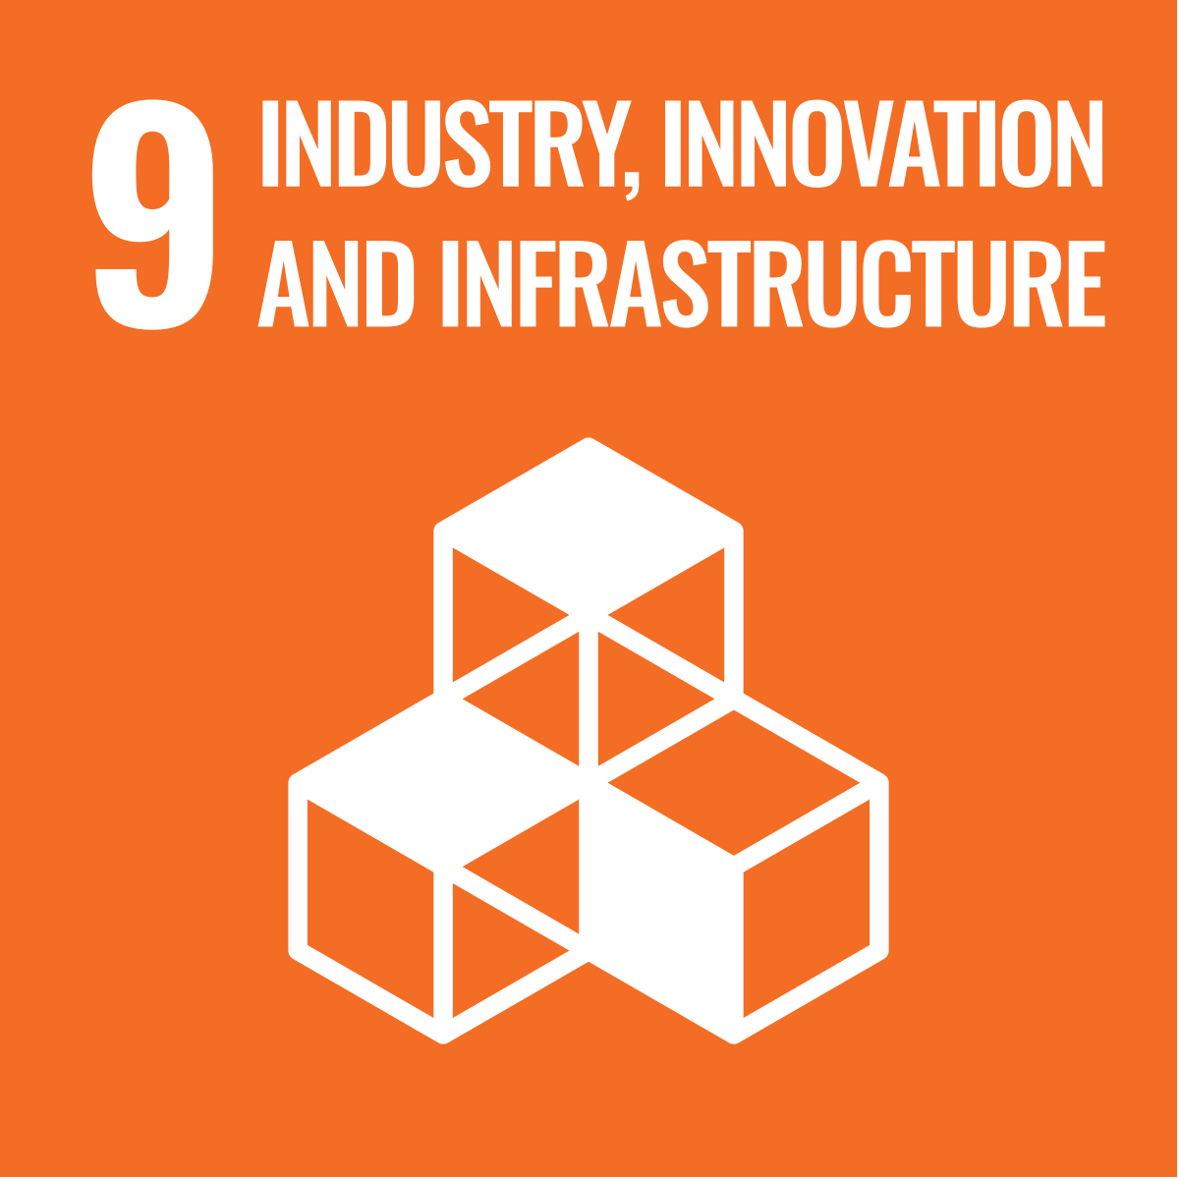
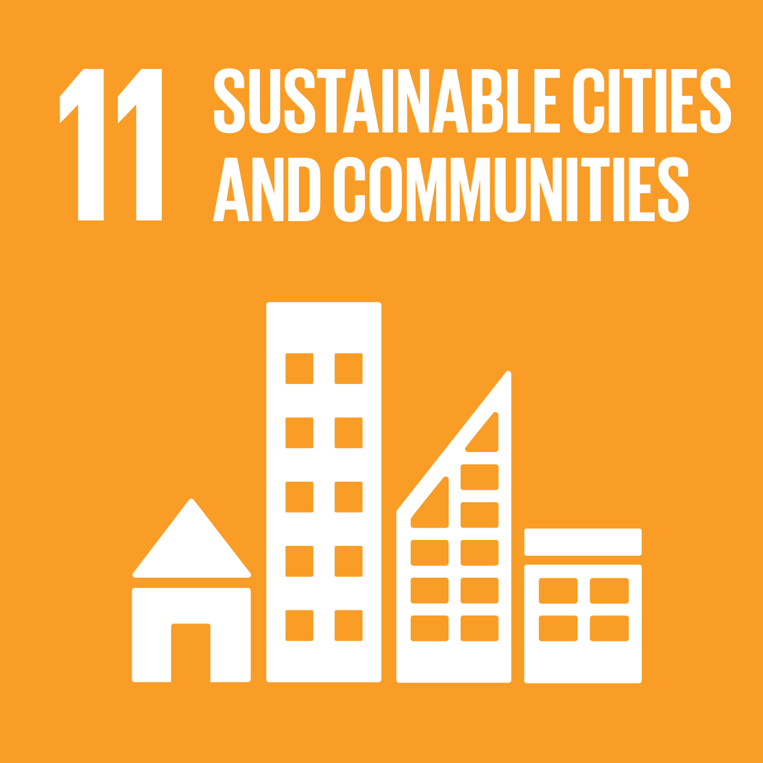
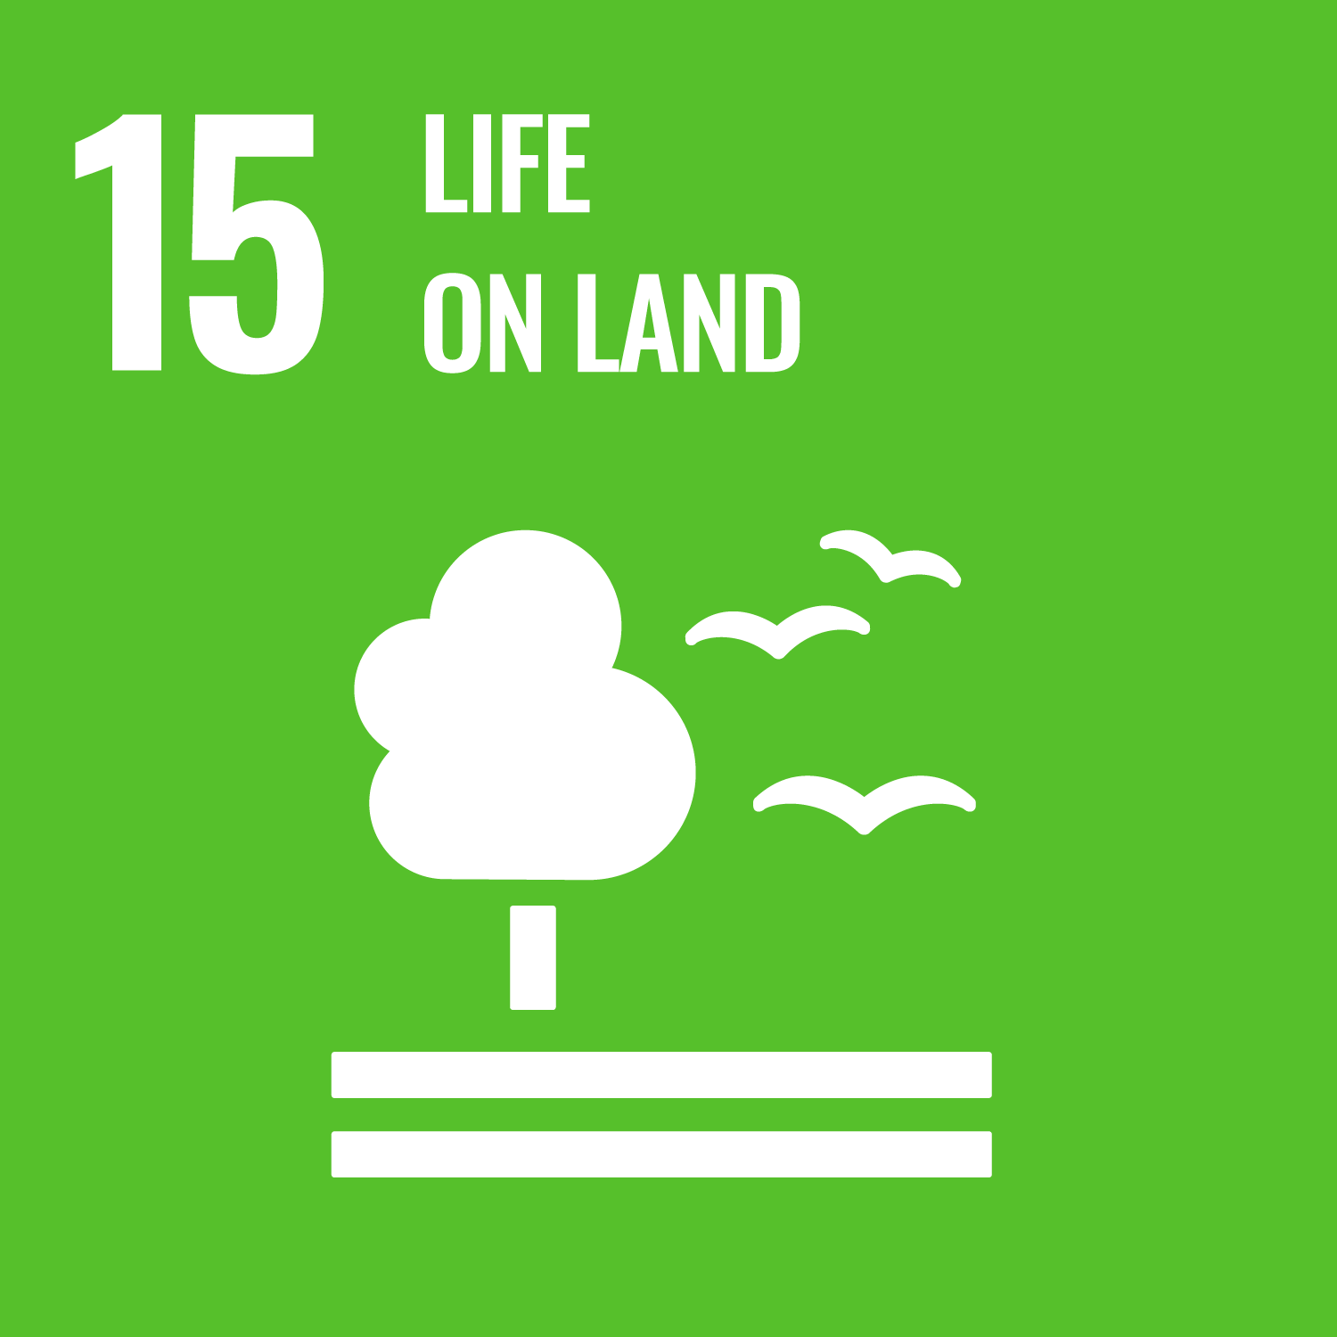
Links to the United Nations Sustainable Development Goals
Main contribution of NFP 73

Slide 15
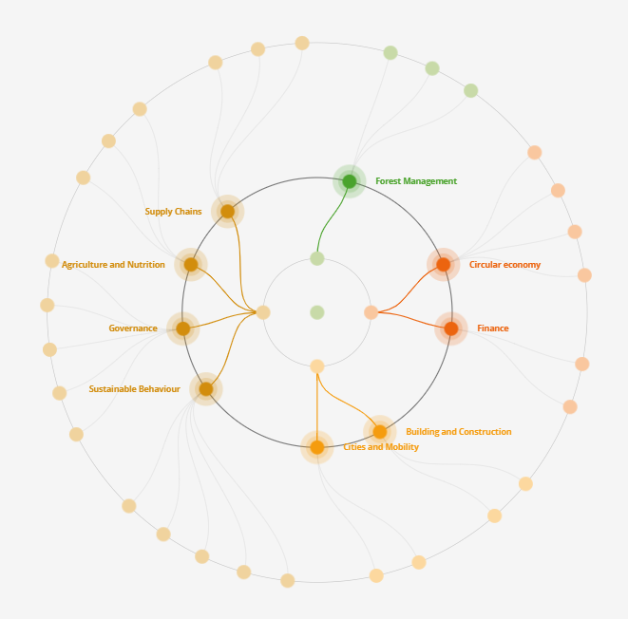
Nine priority areas with 29 research projects

Slide 16
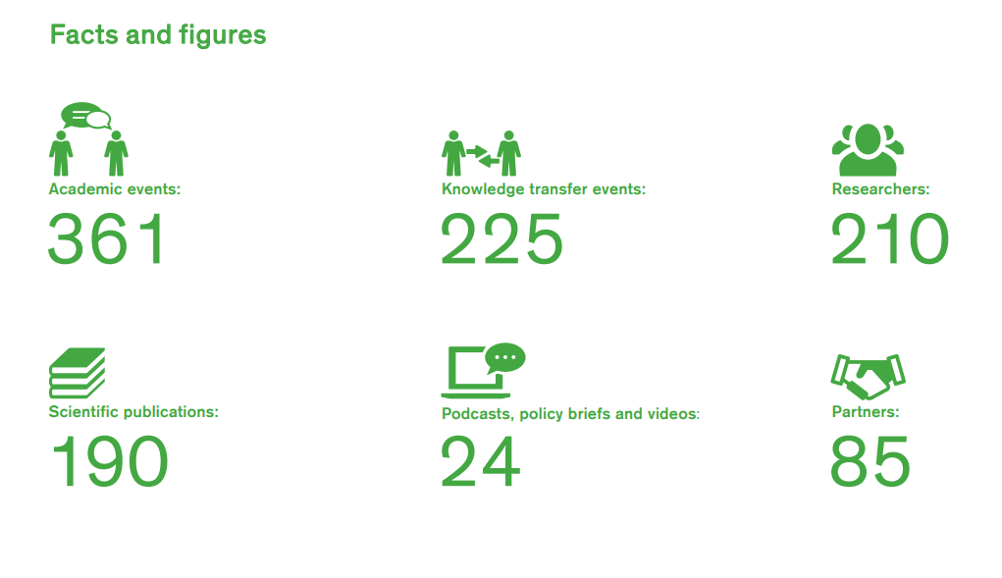
Activities of NFP 73

Slide 17
Concluding discussion
Conclude by discussing the following questions in pairs or small groups of three:
Which global challenges are currently the most pressing?
What is the main objective of sustainable development?
What is the role of the economy in sustainable development?
What are the objectives of NRP 73 “Sustainable Economy”?
To which SDGs is a significant contribution intended to be made?
Which other sustainability-relevant research areas are being supported in Switzerland?

Slide 18
Further reading / in-depth sources
Schweizerischer Nationalfonds
NFP 73 Nachhaltige Wirtschaft
UNO – Sustainable Development

Slide 19
Use of the learning module
Suitable for use in Bachelor’s degree programmes at Swiss higher education institutions
Also suitable as an introduction for Master’s and continuing education programmes at Swiss higher education institutions
Suitable for self-study; can also be used in face-to-face teaching
Scope: 3–4 hours of learning time, with an additional 3–4 hours for further in-depth study

