Slide 1



Sustainable Behaviour
A learning module for the tertiary level

Slide 2

Focus Sustainable Behaviour
«Individual consumption decisions shape a society’s ecological footprint. The Swiss Sustainable Consumption Observatory (SSCO) cross-sectional survey on sustainable consumption is conducted regularly in the three major language regions and provides insights into behaviors and trends in this area.»
NFP73, Sustainable Behaviour

Slide 3
Learning Objectives
The learner …
knows the goals for sustainable consumption and understands the key links to other sustainability goals
knows which consumption areas have a major impact on one’s personal footprint
recognizes which factors influence consumption behavior and understands terms such as rebound effects, spillovers, and nudges
is familiar with effective approaches to more sustainable consumption
reflects on their own consumption behavior and tries out approaches for more sustainable consumption

Slide 4
Introductory Questions
Please try, using your prior knowledge and experience, to answer the following questions. Ideally, discuss your answers with a colleague
How do I assess my consumption behaviour in the areas of food, consumer electronics, clothing, housing and mobility?
What influences consumption behaviour in general, and my own in particular?
Which sectors and professions have a major influence on private consumption, and why?
Why is consumption important for sustainable development, and which areas does it strongly affect?
Which factors influence the environmental behaviour of SMEs?
Which sustainability goals are particularly relevant, and which ones are they?

Slide 5
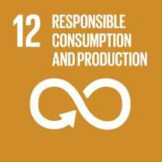

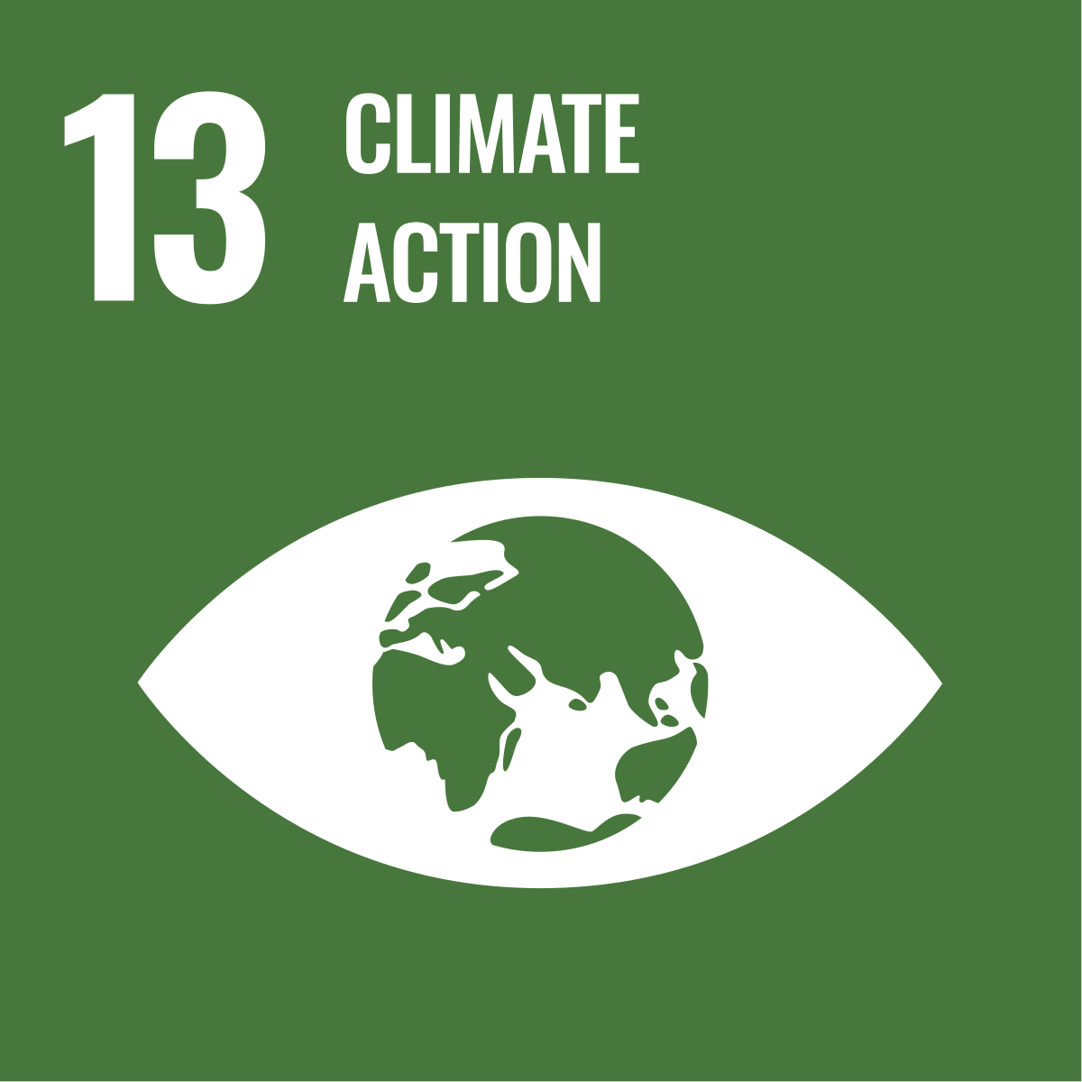
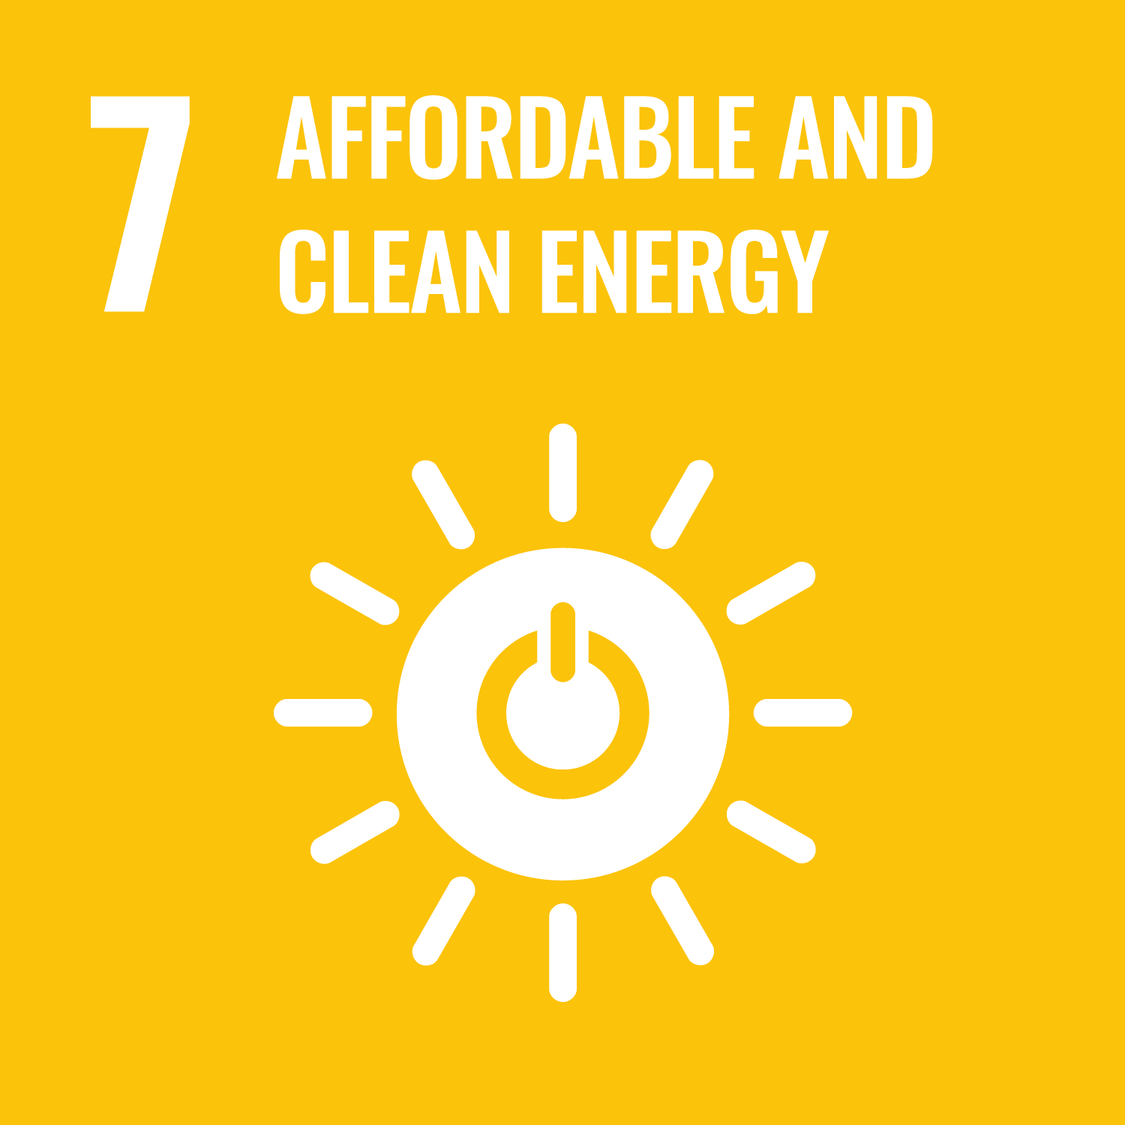
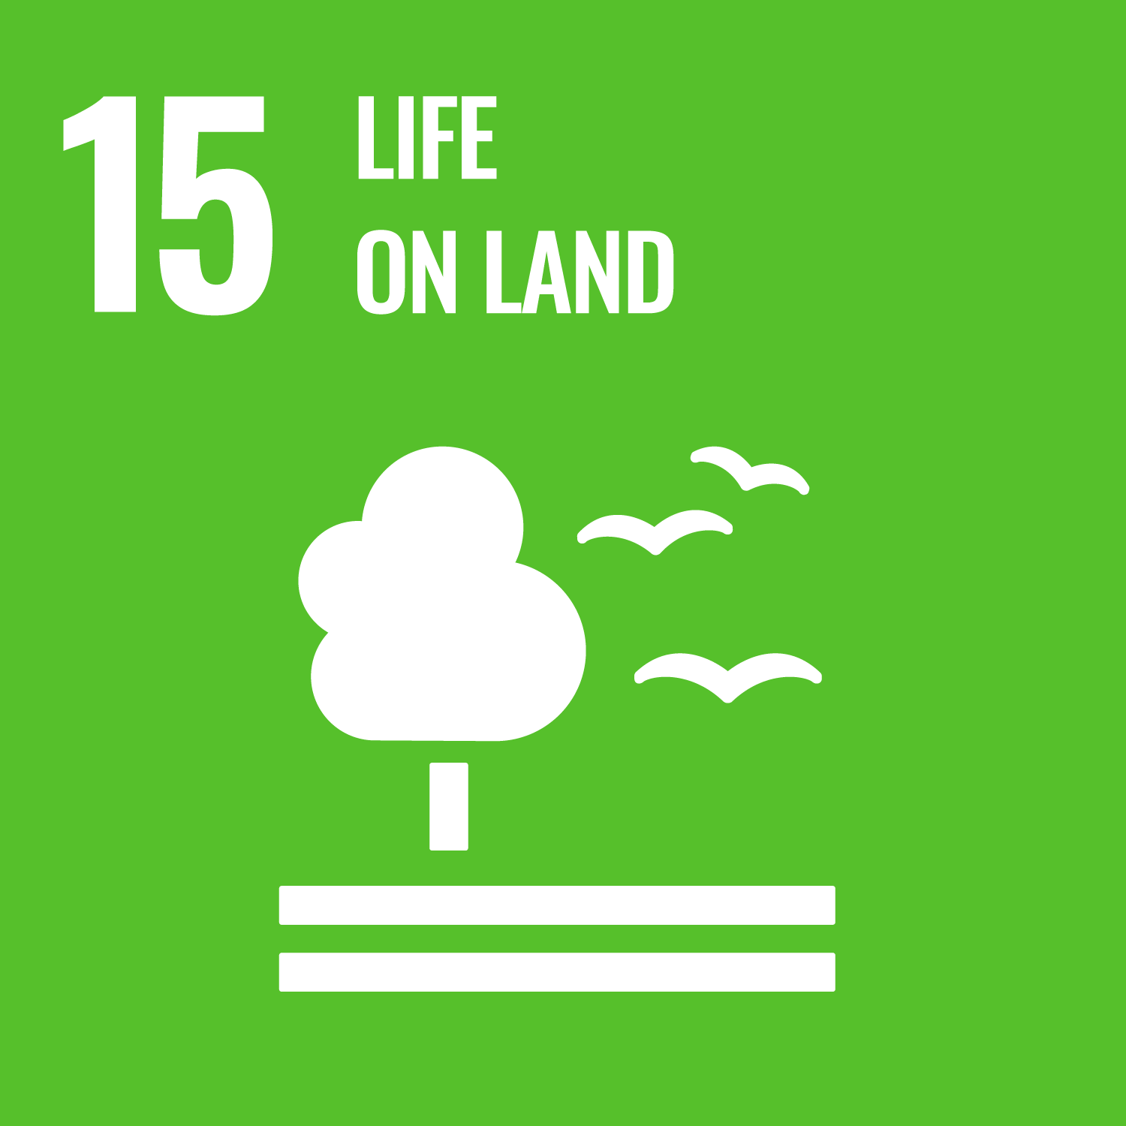

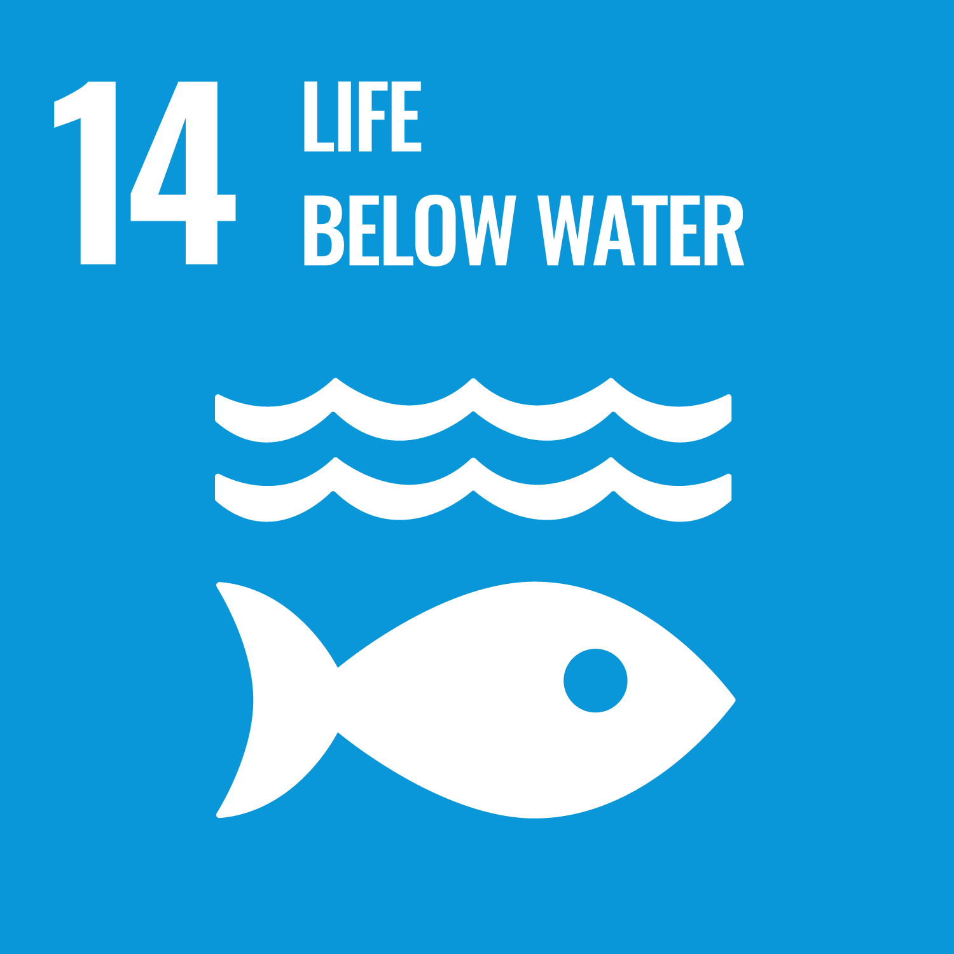

Links to the United Nations Sustainable Development Goals
Sustainable Behaviour

Slide 6
Introductory Tasks
Which factors influence our consumption behaviour in the areas of food, consumer electronics and clothing?
In which area is awareness and engagement for environmentally friendly consumption highest, and in which areas is it lower?
Which arguments and barriers play a role?
What impact does online consumption have?
How could consumption behaviour be made more environmentally friendly?
Source of knowledge
Swiss Sustainable Consumption Observatory (SSCO) 2021-2023. Key Insights From the First Three Waves

Slide 7
Sustainable Behaviour – Background and Aim
Background
Aim
The SSCO cross‑sectional survey brings together researchers from various projects on sustainable consumption and expands knowledge about the consumption behaviour of the Swiss population. The focus is on regular, representative surveys on nutrition, clothing and electronics.
The aim of the SSCO is to capture
the attitudes, motivations and behaviours of the Swiss population regarding sustainable consumption over the long term. The survey serves as an information source for decision‑makers in industry, politics and civil society organisations in order to promote the transition towards sustainable consumption.

Slide 8
Results I
So far, two survey waves have been conducted, and the third began in autumn 2023. The first survey (n = 1,264) took place in January 2022, and the second (n = 1,167) in November 2022. They provide insights into behaviors and attitudes toward sustainable consumption based on a representative sample of the Swiss population in the German-, French-, and Italian-speaking regions. The following main results emerge from the first two surveys:
Awareness and engagement for sustainable behaviour appear to be most developed in the area of food, followed by clothing. In consumer electronics, environmentally friendly attitudes and behaviours are significantly less pronounced.
These behavioural patterns are influenced by the desire to protect the environment: when purchasing food, consumers think more frequently about their relationship with nature and the environment than when buying clothing or electronics.
Half of respondents eat an unrestricted diet, one third follow a flexitarian diet, and around 10% are vegetarian or vegan. The majority would like to consume less meat and dairy products. Up to 10% of food is wasted, although many people would like to use products more often after the best‑before date

Slide 9
Results II
Swiss consumers purchase over 40% of their clothing online, mainly as replacements or due to the desire for something new. Only a minority consider repairs or second‑hand options as alternatives. One of the highest priorities is to buy fewer clothing items, particularly less fast fashion.
More than half of electronic devices are purchased online. The most common reason for buying a new device (75%) is to replace a partially or fully defective one. The most important priorities regarding perceived environmental impacts are to use electronic devices for longer and to repair defective devices instead of replacing them.
Sustainable alternatives in the food and clothing sectors are not perceived by most consumers as being of lower quality than conventional products. In the electronics sector, sustainable devices are generally not seen as less fashionable or trendy than mainstream products.

Slide 10
Overview of Research Projects
This thematic focus comprised five research projects:
Extending the lifetime of mobile devices
Sustainable consumption behaviour using hot water consumption as an example
Rebound effects of the sharing economy
The influence of environmental identities
Gentle nudges for SMEs

Slide 11

Extending the lifespan of mobile devices
«The production of internet‑enabled mobile devices causes significant environmental impacts. To reduce these negative impacts, it is crucial that such devices are used for as long as possible. With our LIFESAVING project, we investigate which approaches to longer use of mobile devices are ecologically effective and attractive for consumers and market actors.»
Dr. Yann Blumer, Project lead
Extending the lifespan of mobile devices

Slide 12
Extending the lifespan of mobile devices - Assignments
How long is a mobile device used on average, and why is this a problem?
Which environmentally relevant effects play a role?
What is a rebound effect?
How can people be encouraged to use electronic devices in a more environmentally responsible way?
What could new, more sustainable business models for mobile devices look like?
Sources of knowledge
Extending the lifespan of mobile devices (Website NFP 73)
Only a few people repair their mobile phones or buy them second-hand (press release)

Slide 13
Extending the lifespan of mobile devices - Background and Aim
Background
Aim
Previous studies have focused primarily on isolated measures and perspectives for extending the lifespan of mobile devices. However, there has been a lack of a well-founded understanding of the relevant consumer decisions over the entire lifetime of a device. Within the framework of LIFESAVING, the potential of various approaches to promote longer use and reuse of mobile devices in Switzerland was analyzed. To this end, three complementary perspectives were combined:
an environmental perspective,
a consumer perspective, and
a socioeconomic perspective.
The project analysed the potential of various approaches to promote longer use and reuse of mobile devices in Switzerland, combining three complementary perspectives:
the direct and indirect environmental impacts,
the attractiveness for consumers, and
the implementation potential for market actors.
Notes:
Ziel dieses Projekts war es, für die Schweizer Akteure evidenzbasierte Empfehlungen und Ideen bereitzustellen, die zu einer längeren Nutzung von Mobilgeräten in der Schweiz beitragen. Konkret sollten für verschiedene Massnahmen detailliertere Erkenntnisse zu folgenden Aspekten gewonnen werden: (i) zu den direkten und indirekten Umweltauswirkungen, (ii) zu ihrer Attraktivität für die Konsumentinnen und Konsumenten und (iii) zu ihrem Potenzial für die Umsetzung durch die Marktakteure in der Schweiz.

Slide 14
Extending the lifespan of mobile devices – Results I
Most environmental impacts occur during production
Using a meta-analysis, we developed a more precise and up-to-date life-cycle inventory for mobile devices as well as a framework for assessing their direct and indirect environmental impacts. Although there are substantial differences between devices and types of impacts, the majority of the environmental footprint of mobile devices (60–80%) occurs during the production phase—especially in the manufacture of integrated circuits (chips). For this reason, the environment benefits from all measures that contribute to a significantly longer service life of a device, even when taking into account the effects of extended use (e.g., emissions from a new battery or a new display during repairs) and alternative consumption (e.g., purchasing other goods with the money saved).

Slide 15
Extending the lifespan of mobile devices –
Results II
Willingness to purchase used devices
From a consumer perspective, there is substantial untapped demand for refurbished second-hand devices (“refurbishing”) and strong growth potential for this secondary market. Our online experiments showed that simple incentive measures—such as placing refurbished phones in online shops or adding informational notices and environmental framing (communication encouraging environmentally friendly behavior)—could lead to such phones being purchased far more frequently.
Policy framework and promoting longer use
An analysis of the overall mobile device market in Switzerland reveals positive trends such as a slightly increasing average length of use and more offerings of used and/or refurbished phones. However, this secondary market is still a niche and consists of many individual actors. This makes it difficult to implement measures to promote longer use of mobile devices, since uniform industry standards or consumer labels in retail are lacking. For this reason, better coordination and alignment among stakeholders and their interests are needed. Political frameworks and support from public authorities would also be helpful.

Slide 16

Consumer Behaviour on the Example of Hot Water Consumption
«If consumers are given incentives to reduce their hot water use, do they also heat less? Do people who are encouraged to use their cars less also behave more sustainably in other areas? In this project, we examined whether using a specific resource more sustainably is accompanied by more sustainable behaviour in other areas— or whether the opposite is the case.”»
Prof. Dr. Renate Schubert, Project lead Nachhaltiges Consumer behaviour

Slide 17
Consumer Behaviour on the Example of Hot Water Consumption - Assignments
How is hot water consumption behaviour researched?
Which behavioural interventions are available?
What are spillover or secondary effects?
What does environmental identity mean?
How large is the potential of behavioural interventions and where are their limits?
Sources of knowledge
Sustainable consumer behaviour (Website NFP 73)
Improving the effectiveness of behavioural interventions (Policy Brief)
Sustainable consumer behaviour (scientific lecture)

Slide 18
Consumer Behaviour on the Example of Hot Water Consumption – Background and Aim
Background
Aim
A wide range of economic and psychological measures aim to promote the sustainable use of resources. So far, the effectiveness of such measures has mainly been studied in isolation, without considering their impacts on other areas that are not directly targeted. These “side effects” are referred to as transfer effects or spillovers. They can be positive (more sustainable behavior in other areas of natural resources), negative (less sustainable behavior in other areas), or neutral.
With this project, we aimed to answer three main questions:
Which measures generate positive spillover effects or prevent negative ones?
Which factors explain the existence, direction, and intensity of spillover effects?
Which areas of natural resource use have the potential for spillovers?
Notes:
Ziel dieses Projekts war es, für die Schweizer Akteure evidenzbasierte Empfehlungen und Ideen bereitzustellen, die zu einer längeren Nutzung von Mobilgeräten in der Schweiz beitragen. Konkret sollten für verschiedene Massnahmen detailliertere Erkenntnisse zu folgenden Aspekten gewonnen werden: (i) zu den direkten und indirekten Umweltauswirkungen, (ii) zu ihrer Attraktivität für die Konsumentinnen und Konsumenten und (iii) zu ihrem Potenzial für die Umsetzung durch die Marktakteure in der Schweiz.

Slide 19
Consumer Behaviour on the Example of Hot Water Consumption – Results I
Analysis of sustainable consumer behavior in different settings
We conducted field analyses, laboratory experiments, and surveys in various settings in Switzerland and Singapore. In doing so, we observed consumption behavior in households, hotel rooms, student residences, shops, and in the laboratory, as well as in mobility contexts. We tested a wide range of measures to promote sustainable consumption behavior: consumption feedback, environmental protection tips, goal setting, social comparisons, financial and ecological incentives, sustainability labels, appeals to social identity and social norms, moral incentives, as well as default choice strategies or competition.
Sustainable behavior with correlations and spillover effects (I)
Regardless of the type of intervention, our studies found no evidence of overall negative spillover effects. Positive spillover effects were observed for certain measures and in certain domains. For example, in a field experiment involving 782 residential blocks in Switzerland, we observed that in addition to hot water use, cold water consumption and heating were consistently reduced.

Slide 20
Consumer Behaviour on the Example of Hot Water Consumption – Results II
Sustainable behavior with correlations and spillover effects (II)
Another field experiment involving a competition with a cash prize showed that participants not only used less electricity but also less water. Non-monetary incentives also led to more sustainable behavior, but generally not to a degree that produced positive spillover effects.
Strong drivers of positive spillovers appear to be individuals’ environmental identities and their sense of connectedness to nature. It is also helpful to propose several pro-social choices over a longer period of time so that people do not simply choose only one of them instead.
Data from initial exploratory studies as well as later in-depth studies indicate that the areas of electricity, water, and heating are closely interconnected and that the likelihood of spillover effects is high. In contrast, mobility behavior seems to show no connection with other environmentally related behaviors.

Slide 21
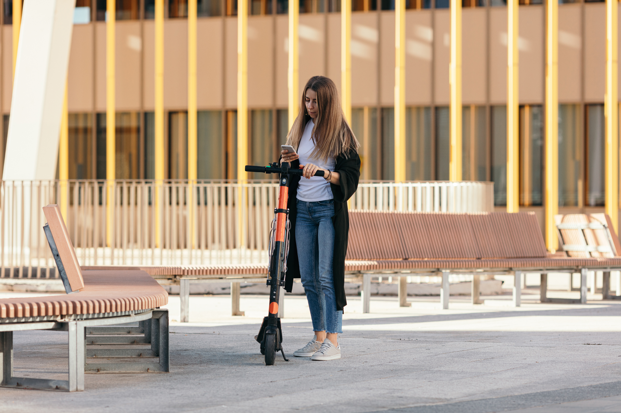
Rebound Effekte der Sharing Economy
«The sharing economy may not be a new concept, but it is one of the most promising developments for reducing the consumption of our finite resources. And yet, only a limited number of people actively engage in sharing. This project provides insights into the drivers and barriers of sharing behaviour and examines the extent to which rebound effects limit the positive environmental impacts of sharing.»
Prof. Dr. Claudia R. Binder, Project lead Rebound Effekte der Sharing Economy

Slide 22
Rebound Effects of the Sharing Economy - Assignments
What reasons do people give for peer-to-peer sharing?
What reasons do people give against peer-to-peer sharing?
What is a rebound effect and what does “moral licensing” mean?
What measures can be used to prevent these?
Sources of knowledge
Rebound Effects of the Sharing Economy (Website NFP 73)

Slide 23
Rebound Effects of the Sharing Economy –
Background and Aim
Background
Aim
Peer-to-peer sharing (P2P) refers to the lending and borrowing of items between individuals. This project examined the drivers, barriers, and impacts of sharing activities, with a focus on P2P sharing platforms. The overarching goal was to define measures that help sharing platforms strengthen their positive environmental impacts by increasing sharing behaviour and reducing potentially negative rebound effects caused by people who gain additional purchasing power as a result of their sharing activities.
The research project primarily aimed to investigate:
  why consumers participate in P2P sharing,
  why non-users do not participate in P2P sharing,
  what the causes of the rebound effect are,
  how P2P sharing can be promoted, and
  how the rebound effect can be reduced.
Notes:
Ziel dieses Projekts war es, für die Schweizer Akteure evidenzbasierte Empfehlungen und Ideen bereitzustellen, die zu einer längeren Nutzung von Mobilgeräten in der Schweiz beitragen. Konkret sollten für verschiedene Massnahmen detailliertere Erkenntnisse zu folgenden Aspekten gewonnen werden: (i) zu den direkten und indirekten Umweltauswirkungen, (ii) zu ihrer Attraktivität für die Konsumentinnen und Konsumenten und (iii) zu ihrem Potenzial für die Umsetzung durch die Marktakteure in der Schweiz.

Slide 24
Rebound Effects of the Sharing Economy – Results I
Reasons for and against P2P sharing
A systematic literature review and a large-scale survey show that consumers mainly participate in P2P sharing for economic, social, and environmental reasons. With regard to consumer resistance to P2P sharing, our survey indicates that usage barriers, value barriers, and functional risks are the greatest obstacles. These include non-users who are accustomed to consuming products in traditional ways, those who view P2P sharing as too time- and labour-intensive and financially insufficiently attractive, and finally those who worry that something might go wrong—especially when lending out items.

Slide 25
Rebound Effects of the Sharing Economy – Resultats II
Moral licensing after sharing and rebound effects
With regard to the drivers of the rebound effect, we find that moral licensing plays an important role in post-sharing consumption. Our large-scale study shows that users who engage in P2P sharing for economic and social reasons engage in moral licensing. This means that P2P sharing gives these users the opportunity to spend the financial resources they saved through sharing on other, potentially more resource-intensive purposes. Environmentally motivated users, by contrast, do not engage in moral licensing. When it comes to actively promoting P2P sharing, our experiments show that measures targeting consumers’ intrinsic motivation—through “eco-messages” (information about potential CO₂ savings from sharing instead of purchasing products)—are the most effective. The second most effective measure is integrated insurance coverage for items against damage. Measures aimed at reducing resource-intensive rebound consumption, such as tips for sustainable consumption or monetary incentives, showed no significant effects. We therefore conclude that reducing the rebound effects of sharing is a greater challenge than expected.

Slide 26
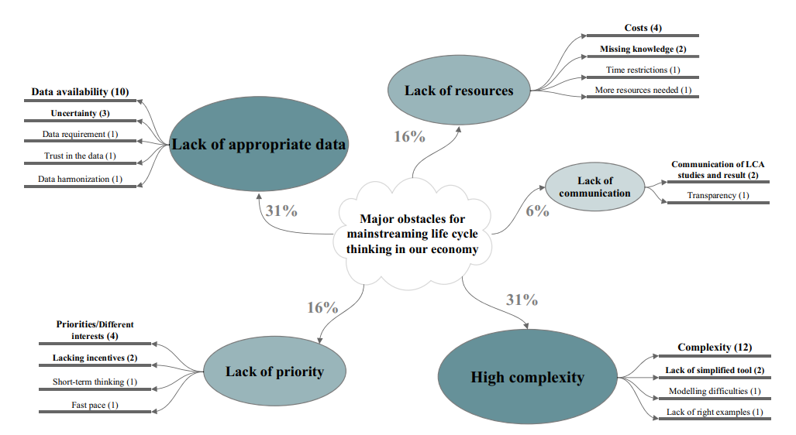
Main obstacles to mainstreaming the life-cycle concept in the economy
The participants’ perspective: the number of mentions is given in parentheses (a total of 51 responses were submitted by the participants).
Source: Stucki M. et al. (2021): How life cycle–based science and practice support the transition towards a sustainable economy

Slide 27
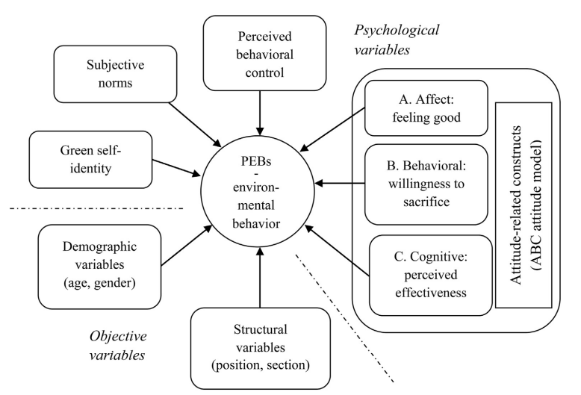
Rebound Effects of the Sharing Economy
Factors that influence environmental behaviour (PEBs = pro-environmental behaviours). Source: Hansmann R et al. (2020): Determinants of pro-environmental behavior: A comparison of university students and staff from diverse faculties at a Swiss University. Journal of Cleaner Production

Slide 28

The influence of environmental identities
«People have a complex relationship with nature. Two key factors influence whether they behave sustainably: the extent to which they feel connected to nature and whether they think about this connectedness when making consumption decisions. We show that thinking about one’s relationship with nature is more decisive than the relationship itself. This insight is relevant for environmental psychology research and for measures aimed at promoting sustainable consumption. »
Prof. Dr. Sandor Czellar, Project lead
The influence of environmental identities

Slide 29
The influence of environmental identities - Assignments
What is an “environmental identity”?
What role does it play in consumption decisions?
How can environmental identity be used to encourage environmentally friendly consumption?
Sources of knowledge
The influence of environmental identities (Website NFP 73)
The closer our connection to nature, the more likely we are to engage in actions… (Podcast NFP 73)
The influence of environmental identities (scientific lecture)

Slide 30
The influence of environmental identities – Background and Aim
Background
Aim
How can voluntary sustainable behaviours be encouraged? This question is central to environmental policy research and to measures that are effective in the long term. Behavioural regulations depend on political frameworks and can change. Our research examines a key mechanism of voluntary action: identity motivation, which leads people to express who they are through their actions. Environmental identity plays an important role in this, but has so far received little research attention.
The project examines how environmental identity—the feeling of connectedness with nature—influences sustainable behaviour. It focuses on two components:
the strength of the identity, and
its salience in consumption decisions.
The aim is to determine which of these two factors has the stronger influence on behaviour.
Notes:
Ziel dieses Projekts war es, für die Schweizer Akteure evidenzbasierte Empfehlungen und Ideen bereitzustellen, die zu einer längeren Nutzung von Mobilgeräten in der Schweiz beitragen. Konkret sollten für verschiedene Massnahmen detailliertere Erkenntnisse zu folgenden Aspekten gewonnen werden: (i) zu den direkten und indirekten Umweltauswirkungen, (ii) zu ihrer Attraktivität für die Konsumentinnen und Konsumenten und (iii) zu ihrem Potenzial für die Umsetzung durch die Marktakteure in der Schweiz.

Slide 31
The influence of environmental identities – Results I
Environmental identities and characteristics of individuals
Environmental identity represents the personal relationship a person has developed with nature. Over the past 20 years, this concept and how to measure it have been studied in considerable depth; however, there has been little research on how environmental identity relates to other psychological concepts. Our surveys show that individuals hold complex views of and relationships with nature. Environmental identity tends to be stronger among people with the following characteristics:
Their personal values are less materialistic and more morally and environmentally oriented.
Their personality is marked by higher self-esteem, greater agreeableness, and greater openness to new experiences.
Their views of nature are more positive and more strongly held.
They are more likely to report engaging in social and environmental behaviour and have less interest in status consumption.
From a sociodemographic perspective, these individuals are more likely to live in rural rather than urban areas.

Slide 32
The influence of environmental identities – Results II
The effects of identity strength and salience on sustainable behaviour
Using surveys and experiments, we examined the influence of environmental identity on sustainable behaviour. We analysed the impact of two identity components:
the strength of the identity, and
the presence or salience of environmental identity
in specific consumption decisions.
We developed novel measures and experiments to assess salience and refined existing measures for the strength of environmental identity. In our studies—both in self-reports and in observations of actual behaviour—what mattered most across a wide range of decisions was whether people thought about their environmental identity, not how strong it was. It is likely that these two identity constructs also have partly independent effects on sustainable behaviour. Measures that prompt people to think about their environmental identity when making consumption decisions are therefore likely to appeal to broad consumer groups. Regardless of how important someone considers environmental protection to be: if a person is reminded of their relationship with nature at the moment of choice, this often influences whether they opt for more sustainable behaviour.

Slide 33

Nudging small and medium-sized companies
«Tackling climate change requires behavioural changes from all economic actors in a society. In Switzerland, small and medium-sized enterprises (SMEs) account for 99% of all companies, making them a major group of resource consumers. With our project, we demonstrate that gentle incentives (nudges) can bring about behavioural change among SMEs.»
Dr. Jan Schmitz, Project lead
Nudging small and medium-sized companies

Slide 34
Nudging small and medium-sized companies - Assignments
What are “nudges,” and how do they influence the sustainability behaviour of SMEs?
What does “choice architecture” mean?
What are “sludges,” and how do they influence the sustainability behaviour of SMEs?
What are the main motivations for SMEs to behave sustainably?
Sources of knowledge
Nudging small and medium-sized companies (Website NFP 73)
Not Only for the Money: Nudging SMEs to Promote Environmental Sustainability (Brief)
How sludge impairs the effectiveness of policy programmes: A field experiment with SMEs (Policy Brief)
Nudging small and medium-sized companies (scientific lecture)

Slide 35
Nudging small and medium-sized companies
- Background and Aim
Background
Aim
Nudges in the form of incentives for behavioural change are often used to influence individuals’ behaviour. So far, only a few studies have examined whether they are also effective for companies (such as SMEs). It is also unclear whether exactly the same nudging tools work as they do for individuals, since decision-making processes in companies operate quite differently.
The project examines whether proven behaviour-change strategies that work for individuals are also effective for SMEs, or whether they need to be adapted. We also sought to gain a better understanding of which mechanisms play a role in environmentally relevant decisions within this large segment of the Swiss economy and how environmental policy incentives for companies can be designed more effectively in the future.
Notes:
Ziel dieses Projekts war es, für die Schweizer Akteure evidenzbasierte Empfehlungen und Ideen bereitzustellen, die zu einer längeren Nutzung von Mobilgeräten in der Schweiz beitragen. Konkret sollten für verschiedene Massnahmen detailliertere Erkenntnisse zu folgenden Aspekten gewonnen werden: (i) zu den direkten und indirekten Umweltauswirkungen, (ii) zu ihrer Attraktivität für die Konsumentinnen und Konsumenten und (iii) zu ihrem Potenzial für die Umsetzung durch die Marktakteure in der Schweiz.

Slide 36
Nudging small and medium-sized companies – Results I
Nudging SMEs can improve resource efficiency
We examined the direct effects of nudges aimed at promoting more environmentally friendly behaviour among SMEs by observing how companies respond to such incentives and whether there are factors that prevent these measures from reaching their full potential. We therefore provide a comprehensive analysis of the “nudging behaviour” of SMEs and their employees with regard to environmental aspects.
In particular, we show that nudging can work in SMEs and increase resource efficiency. An important insight is that SMEs are motivated not only by the financial benefits of reduced resource use, but especially by knowing that they are doing something for the environment. We demonstrate that behaviour can be significantly influenced by communicating the values of the best-performing companies as reference points, allowing others to measure themselves against them. Benchmarks for desired behaviour can thus motivate companies to reduce their resource consumption.

Slide 37
Nudging small and medium-sized companies – Results II
Positive spillover effects on employee behaviour and minor obstacles
We also show that environmentally friendly decisions by companies can have positive spillover effects on employees’ behaviour. This means that incentives for SMEs may potentially achieve more than just the effects measured at the company level. In addition, our results indicate that repeated campaigns calling for environmentally friendly behaviour are not, or only minimally, counterproductive.
However, small obstacles can reduce the success of nudges and the effectiveness of environmental measures. Finally, we demonstrate that two methods can motivate employees to act in line with company goals: motivational messages and role modelling. Motivational messages are more effective among higher-level employees and can even be counterproductive at lower levels. Leading by example—that is, behaving in the desired way—generally motivates employees across all levels.

Slide 38
Final Discussion
Discuss in pairs or small groups at the end:
What responsibility do consumers, companies, and the state have for sustainable behaviour?
Is nudging SMEs unethical (because it is manipulative) or ethically justifiable?
Which behavioural interventions are most effective, and why?
What contribution can I personally make?

Slide 39
Tools for personal consumption
What is the ecological footprint, how large is my personal ecological footprint, and how can I reduce it?
WWF-Footprint-calculator

Slide 40
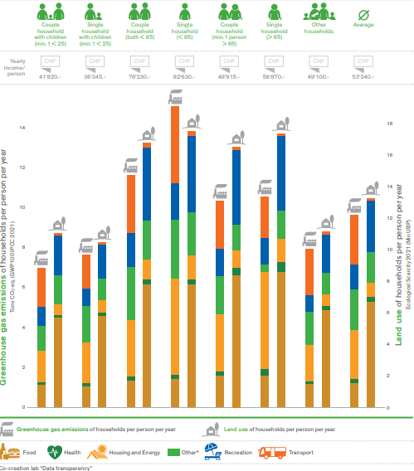
Greenhouse gas emissions and land use of different households in 2021
NFP 73: Policy recommendations – White Paper

Slide 41
Use of the learning module
Suitable for use in Bachelor’s degree programmes at Swiss higher education institutions
Also suitable as an introduction for Master’s and continuing education programmes at Swiss higher education institutions
Suitable for self-study; can also be used in face-to-face teaching
Scope: 3–4 hours of learning time, with an additional 3–4 hours for further in-depth study

Slide 42
NFP 73 Sustainable Economy: resource-efficient, future-oriented, innovative
The aim of NFP 73 is to generate scientific knowledge on a sustainable economy that uses natural resources sparingly, increases prosperity, and enhances the competitiveness of Switzerland as a business location.
Framework:
29 research projects in 9 priority areas
Duration: 2016–2023
Research period: 5 years
Funding volume: CHF 20,000,000
Acknowledgement:
The development of this learning module was made possible by SNSF / NFP 73.

