Slide 1



Agriculture and Nutrition
A learning module for the tertiary level

Slide 2

Focus Agriculture and Nutrition
«Concepts such as “ecosystem services” have shown that the agricultural sector also performs important functions outside the market. National Research Programme 73 now makes clear that these deep-rooted problems can only be solved through a systemic “just transition.” »
NFP73, Agriculture and Nutrition

Slide 3
Learning Objectives
The learner …
understands the nutritional and environmental impacts of our food consumption
knows the key interrelationships of sustainable value chains in the food sector
understands the links between ecology and economics in Swiss farms
is familiar with innovation opportunities for agriculture, especially digitalization, precision agriculture, and smart farming
reflects on the importance of legal frameworks and sustainable global trade relations

Slide 4
Introductory Questions
Please try, using your prior knowledge and experience, to answer the following questions. Ideally, discuss your answers with a colleague:
What importance does food have for me? What attitude do I have toward agriculture, and why?
What does a sustainable diet look like?
My prior knowledge: What are the most important challenges of sustainable agriculture?
Who and what influence agriculture the most? Which sectors and professions have a major impact, and why?
Which services does agriculture provide in Switzerland, and what are the biggest trade-offs?
Which sustainability goals are particularly relevant, and which ones are they?

Slide 5

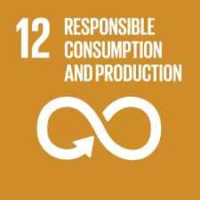





Links to the United Nations Sustainable Development Goals
Agriculture and Nutrition

Slide 6
Introductory Questions
Name the main consequences of an unsustainable food system.
What are the principles of a sustainable food system?
Which government frameworks are needed for a sustainable food system?
Sources of knowledge:
Agriculture and Nutrition (Website NFP 73)
A sustainable food system in the 21st century? (Video, 6 Min.)

Slide 7

Background Food System
Background
In today’s food system, there are substantial deficits in both environmental and social sustainability: in the Global North, we follow dietary patterns that leave an unacceptably large ecological footprint, while in the Global South the system’s social shortcomings become visible—from undernourishment and child labor to gender discrimination. Through collaboration among several projects, the National Research Programme “Sustainable Economy” (NFP 73) highlights existing deficits and offers strategies to address them.

Slide 8
Food System – Results
Systemic policy approaches for a just transition in agriculture
It became clear that previously dominant theoretical approaches such as “multifunctionality” and “ecosystem services,” while important in that they relativized the market’s problem-solving capacity, were not sufficiently systemic to respond adequately to the challenges at hand. Examples of such systemic approaches include the necessary simultaneity of national and trade-policy measures in agricultural policy, as well as the politically justified unequal treatment of animal- and plant-based foods for ecological reasons.
Rising food waste and new technological potentials in the context of digitalized agriculture likewise call for policy innovations that take into account the many interdependencies within global ecosystems. In precisely these areas, binding rules are currently lacking at both the national and international levels—rules that would enable a fairer and more environmentally compatible agricultural system.
The concept of a “just transition,” which until now has been applied mainly outside the agricultural sector, provides a suitable theoretical framework for this purpose.

Slide 9
Overview of Research Projects
In the focus area “Agriculture and Nutrition,” there were six research projects:
Nutritional and environmental impacts of Swiss food consumption
Diversified food systems through sustainable trade relations (see learning module “Governance”)
More sustainable value chains (see learning module “Supply Chains”)
Interplay between economics and ecology in Swiss farms
Digital innovations for sustainable agriculture
Legal frameworks for a resource-efficient circular economy (see learning module “Governance”)

Slide 10

Impacts of Swiss food consumption and trade
«Given limited resources and a growing world population, more sustainable dietary patterns and a reduction in food waste are needed. Global and national efforts to optimize food systems can make a significant contribution to achieving the Sustainable Development Goals of the 2030 Agenda.»
Prof. Dr.-Ing. Alexander Mathys, Project lead, Impacts of Swiss food consumption and trade

Slide 11
Impacts of Swiss food consumption and trade– Assignments
Compare the nutrient supply with ecosystem stability in different countries: What stands out?
What positive effects on sustainable development would result if the recommendations of the Swiss Society for Nutrition were followed?
How much food is thrown away per person each year on average worldwide? What positive effects would a reduction in food waste have?
Source of knowledge
Impacts of Swiss food consumption and trade (Website NFP 73)
Multi-indicator sustainability assessment (Project website ETHZ)
Multi-indicator sustainability assessment of global food systems (Scientific article)
Impacts of Swiss food consumption and trade (Scientific lecture)

Slide 12

Impacts of Swiss food consumption and trade – Background
Background
Global demand for food is expected to increase by about 70% by 2050. Agriculture and food production have the greatest impact on resource use and environmental sustainability. In addition, diet-related diseases are the most common causes of death and lead to health impairments. Ensuring adequate nutrition while keeping environmental impacts as low as possible is therefore becoming increasingly important. Food systems worldwide must confront this challenge in order to achieve greater sustainability in people’s diets.

Slide 13

Impacts of Swiss food consumption and trade – Aim
Aim
We aimed to develop a novel framework that combines multi-indicator–based environmental and ecosystem-impact assessments with nutritional-quality evaluation in order to assess the sustainability of national food systems.

Slide 14
Impacts of Swiss food consumption and trade – Results I
Nutritional and environmental impacts of our food consumption
First, the project presents a global analysis of the sustainability status of national food systems using 25 indicators across seven dimensions. No country can claim to have a perfectly sustainable food system. Like most other high-income countries, Switzerland performs well in terms of social indicators, but less well in the areas of the environment, food losses, and health-promoting diets. Low-income countries perform well in terms of per-capita environmental impacts related to food, but fare poorly in nutrition and social aspects.

Slide 15
Impacts of Swiss food consumption and trade – Results II
Potential of more sustainable diets in Switzerland
Second, we analyzed various scenarios of possible dietary changes in order to show the scale at which Switzerland could benefit—environmentally, health-wise, and economically—from a more sustainable diet. By following the recommendations of the Swiss Society for Nutrition (https://www.sge-ssn.ch/) , we could reduce the ecological footprint of our diets by 36%, save 33% in costs, and lower negative health impacts by 2.7%. A vegetarian or vegan diet can lead to deficiencies in certain micronutrients that we currently obtain mainly from animal products (vitamin B12, choline, and calcium).

Slide 16
Impacts of Swiss food consumption and trade – Results III
Global food waste: scale, nutrient losses, and environmental impacts
Third, quantifying global food waste shows that on average worldwide, 65 kg of food per person are lost each year. From the wasted food, one person could eat healthily for 18 days if we consider the 25 nutrients used in the analysis. The environmental footprint of daily food losses per person amounts to 124 g CO₂-equivalents, 58 liters of freshwater, 0.36 m² of cropland use, 2.90 g of nitrogen, and 0.48 g of phosphorus. The nutrients and environmental footprint of wasted food vary from country to country. Therefore, measures to change eating habits and reduce food losses must be tailored to individual countries. High-income countries waste six times more food per person than low-income countries, and the associated environmental burden is ten times higher than in low-income countries.

Slide 17
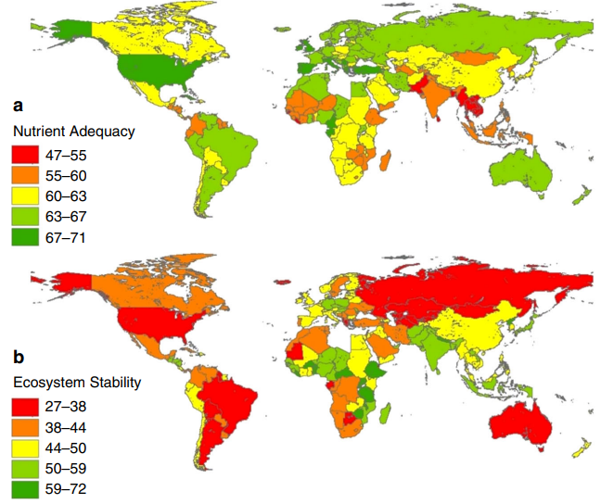
Relationship between diet and ecosystems
Source: Multi-indicator sustainability assessment

Slide 18
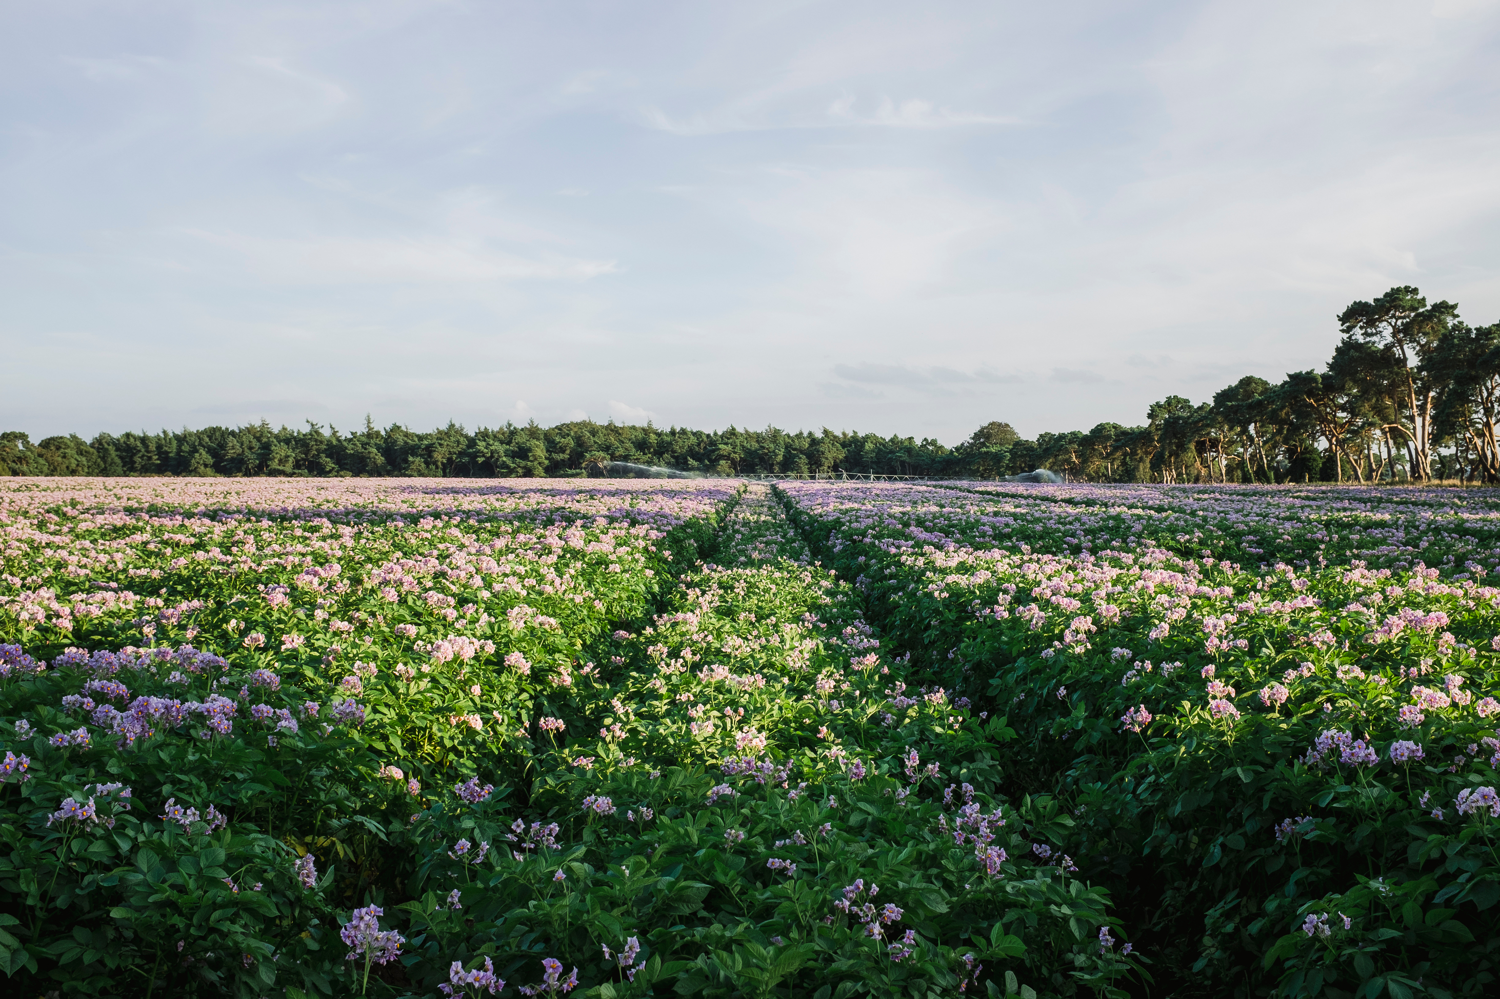
Interaction of economy and ecology in Swiss farms
«In Swiss agriculture, it is possible to produce in an environmentally compatible way while remaining economically viable. However, the very wide range of results in this study points to substantial room for improvement in both dimensions. Producing food, generating income, and protecting the environment are not mutually exclusive.»
Dr. Thomas Nemecek, Project lead, Interaction of economy and ecology in Swiss farms

Slide 19
Interaction of economy and ecology in Swiss farms - Assignments
Economic performance and environmental efficiency: Which factors have the greatest influence?
What is an “Ecological Performance Certificate” (ÖLN)?
Is there a trade-off between environmental efficiency and economic performance?
Source of knowledge
Interaction of economy and ecology in Swiss farms (Website NFP 73)
Environmental Performance Index (Wikipedia)

Slide 20
Interaction of economy and ecology in Swiss farms
Background
Aim
Most farms do not focus on a single product but instead operate several branches of activity. For example, they keep dairy cows and grow wheat and potatoes in their fields. Many decisions are made at the level of individual farm enterprises—such as the intensity of fertilization in crop production or the targeted milk yield. From both an ecological and an economic perspective, it is important to better understand what exactly is happening at the level of these farm enterprises.
In the project, we examine whether—at the level of farm enterprises—there is a positive, negative, or even no relationship between profitability and environmental impacts. We also analyze which characteristics of a farm influence its economic and ecological performance. Finally, we determine the potential for saving natural resources while simultaneously increasing farm efficiency.

Slide 21
Interaction of economy and ecology in Swiss farms – Results I
Differences in environmental efficiency and economic performance by product group and region
The analysis produced very different results, both for economic performance and environmental efficiency, and both between and within the examined product groups (milk, beef, cereals, sugar beets, and potatoes). The differences within individual product groups are mainly attributable to the production region (lowland, hill, or mountain zone) and the production method (organic farming or Proof of Ecological Performance). The production region had the greatest influence. The highest environmental efficiency was found in lowland production, where Switzerland has the most favorable conditions for agriculture, followed by hill and mountain zones.

Slide 22
Interaction of economy and ecology in Swiss farms – Results II
Differences by production systems
The differences between the two production systems—Organic farming and the Proof of Ecological Performance (PEP)—were less pronounced, with organic management showing slightly higher environmental efficiency than PEP management. For cereals, however, environmental efficiency under PEP was higher than under organic production. This can partly be explained by the relatively high share of Extenso farms, which do not use pesticides, insecticides, or fungicides. Overall, only minor differences between the production systems were observed.

Slide 23
Interaction of economy and ecology in Swiss farms – Results III
No trade-offs between environmental efficiency and economic performance
The income analysis for family members working on the farm produced very different results, both between and within product groups. Particularly in the animal-product groups milk and beef, there were cases of negative income per unit produced. Switching to arable farming would be expected to improve environmental efficiency.
The analysis of the correlation between environmental efficiency and economic performance within individual product groups found no evidence of trade-offs. On the contrary, there are significant indications that for the product groups milk and beef, farms with above-median environmental efficiency are also more likely to have above-median economic performance.

Slide 24
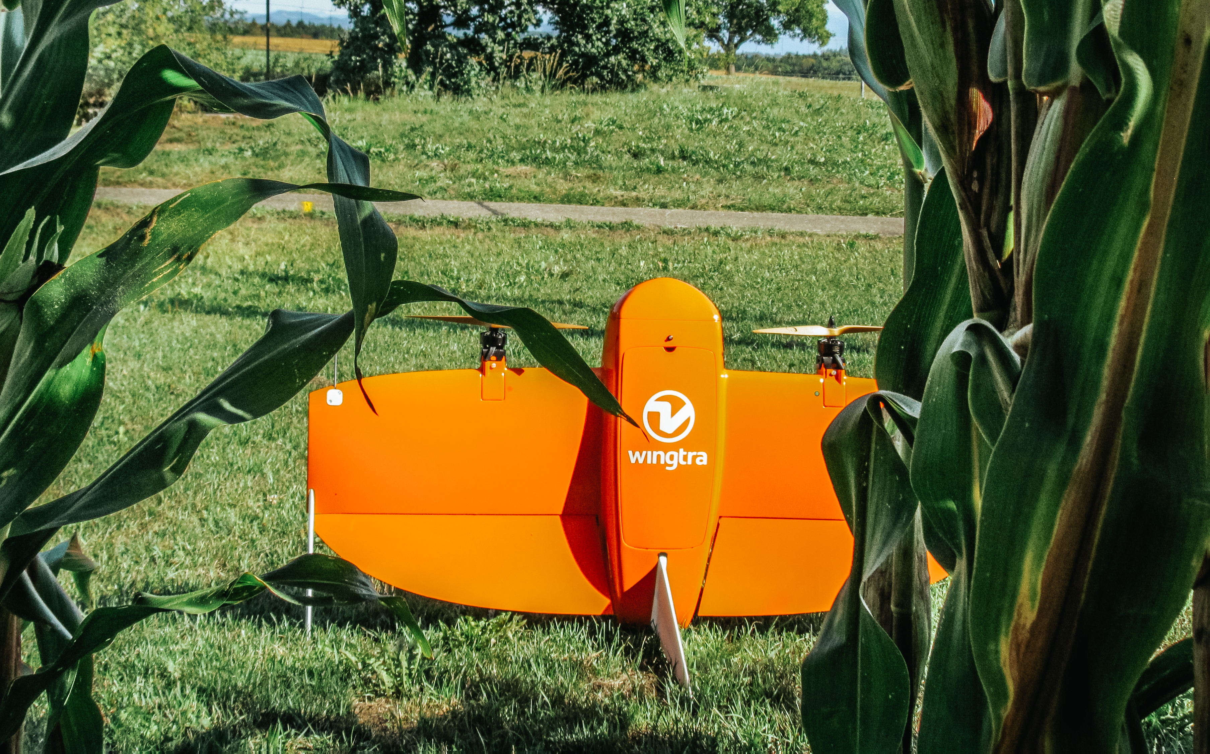
Digital innovations for sustainable agriculture
«New information and communication technologies have the potential to reduce the ecological footprint of Swiss agriculture without restricting food production. To realize the potential of precision agriculture, political support is needed, among other things.»
Prof. Dr. Robert Finger, Project lead, Digital innovations for sustainable agriculture

Slide 25
Digital innovations for sustainable agriculture - Assignments
What main problems does Swiss agriculture cause?
Which technical means can be used to reduce nitrogen inputs in agriculture?
What does “precision agriculture” mean, and what does “smart farming” mean?
What influences demand for agricultural precision technologies?
Which approaches can be used to promote digital innovations in agriculture?
Source of knowledge
Digital innovations for sustainable agriculture (Website NFP 73)
Digital innovations for sustainable agriculture (Policy Brief)
Digital innovations for sustainable agriculture (Video)
Digital innovations for sustainable agriculture (scientific lecture)

Slide 26
Digital innovations for sustainable agriculture - Background
Background
New digital technologies enable more precise application of agricultural inputs such as fertilizers and plant-protection products. This can make agriculture more environmentally friendly without reducing food production. A holistic consideration of technical, agronomic, and socio-economic factors can generate added value for Swiss agriculture and the food sector.

Slide 27
Digital innovations for sustainable agriculture - Aim
Aim
The aim of the project was to show how new information and communication technologies—such as the use of remote sensing (e.g., via satellites or drones)—can contribute to the sustainable development of Swiss agriculture. We tested new applications, for example the use of drones in fertilizer management, and quantified their environmental impacts. In addition, the project also sought to determine the costs and benefits of digital technologies in order to provide a basis for management and policy decisions.

Slide 28
Digital innovations for sustainable agriculture
– Results I
Nitrogen use in agriculture can be reduced
Our results from various field trials show that sensors can precisely measure the uneven distribution and emissions of nitrogen compounds in fields. Information from satellites or drones can therefore help to significantly reduce nitrogen application while maintaining yields. Measurements of greenhouse-gas emissions likewise suggest that optimized fertilizer applications and crop rotations with high year-round ground cover can achieve positive environmental effects.

Slide 29
Digital innovations for sustainable agriculture
– Results II
Growing demand for reliable precision technologies
The economic analysis of precision-agriculture methods shows that although financial gains for farmers do exist, they are often too small to justify high investments in digital technologies. Rising fertilizer prices, however, are making these technologies more attractive. Inter-farm cooperation and government support also increase demand for precision agriculture. According to surveys, Swiss farmers are open to precision agriculture if the technology is reliable and technical support is available.

Slide 30
Digital innovations for sustainable agriculture
– Results III
A holistic perspective is needed for digital innovation
From an agricultural-policy perspective, our results show that a holistic view is needed when considering possible support for digital innovations in agriculture. This includes five aspects:
stronger establishment of digital infrastructure is required;
knowledge about new technologies must be promoted through education and training and through exchange within farming networks;
clear rules are needed on how data from different actors can be used;
since large investments are not sensible for every farm, inter-farm perspectives are necessary;
policy measures should not focus on specific technologies, but explicitly on reducing the ecological footprint while maintaining production.

Slide 31
Final Discussion
Discuss in pairs or groups of three at the end:
What should a future-oriented and sustainable agriculture look like? Justify your answers.
Which measures do you think have the greatest potential to contribute to sustainable agriculture? Why?
What problematic side effects could the proposed measures have? How would you reduce them?
Who can contribute what: farmers, trade, consumers, policymakers?
What contribution can I personally make?

Slide 32
Appendix

Slide 33
Use of the learning module
Suitable for use in bachelor’s degree programs at Swiss higher education institutions
Also suitable as an introduction for master’s and continuing-education programs at Swiss higher education institutions
Suitable for self-study; can also be used in face-to-face teaching
Scope: 3–4 hours of learning time, with an additional 3–4 hours for further in-depth study

Slide 34
NFP 73 Sustainable Economy: resource-efficient, future-oriented, innovative
The aim of NFP 73 is to generate scientific knowledge on a sustainable economy that uses natural resources sparingly, increases prosperity, and enhances the competitiveness of Switzerland as a business location.
Framework:
29 research projects in 9 priority areas
Duration: 2016–2023
Research period: 5 years
Funding volume: CHF 20,000,000
Acknowledgement:
The development of this learning module was made possible by SNSF / NFP 73.

