Slide 1



Forest management
A learning module for the tertiary level

Slide 2
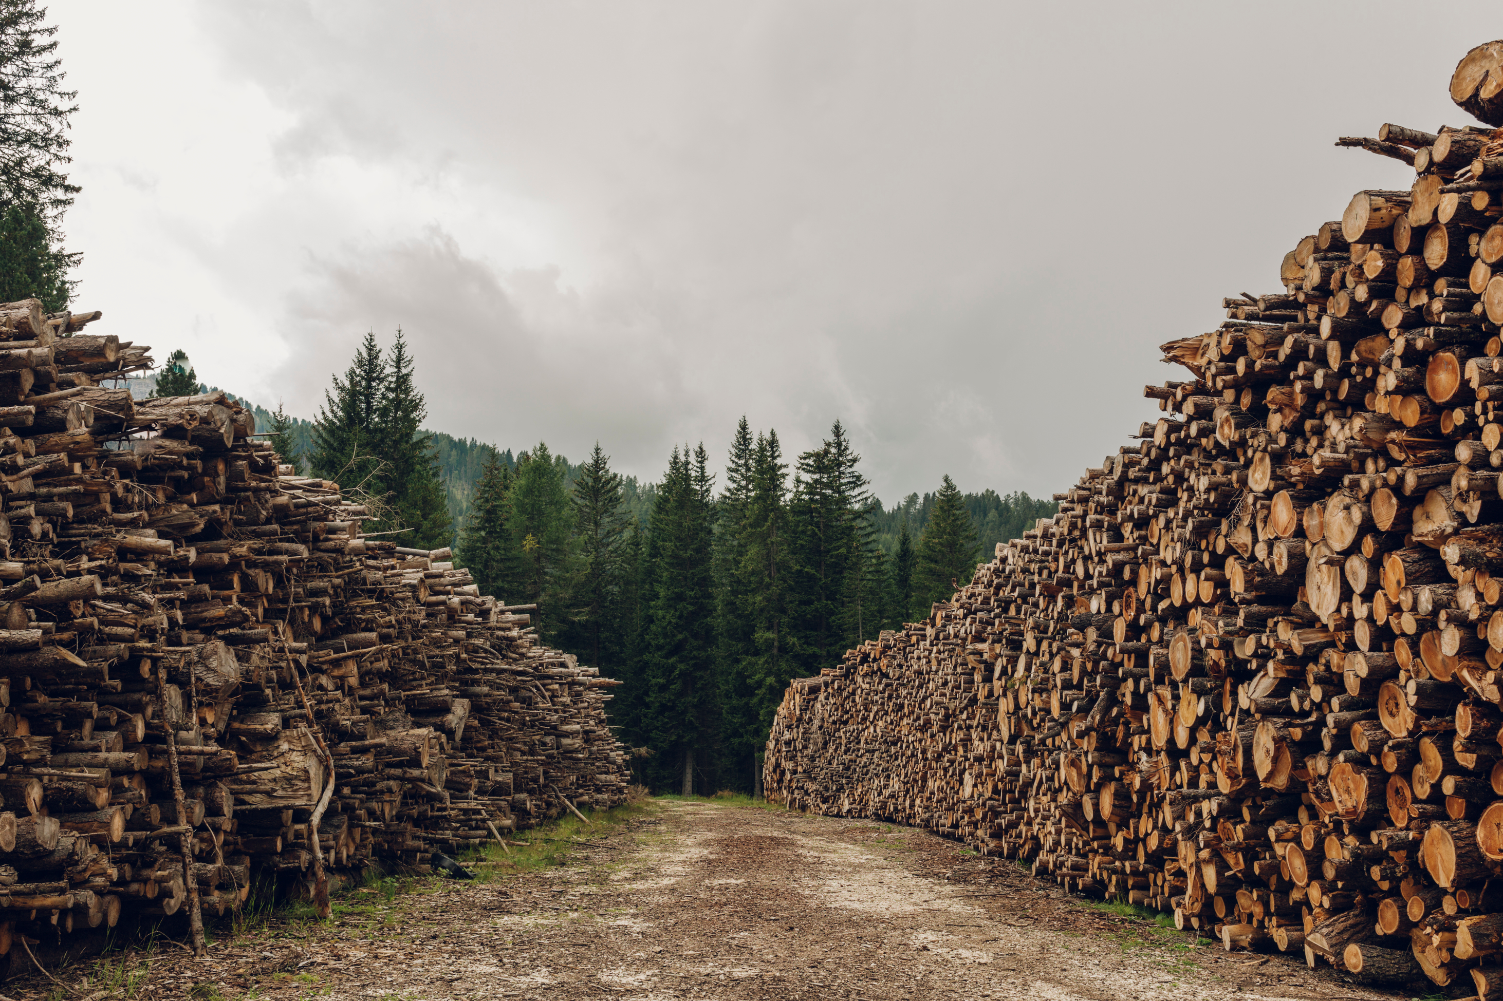
Focus Forest Management
“Forests provide a wide range of forest ecosystem services, but there is still a lack of knowledge about the synergies and trade-offs between these services. With the transition to a sustainable economy, existing trade-offs are being intensified and new ones created. What is important is ‘mainstreaming’ across all sectors and levels of decision-making.”
NFP 73, Forestry

Slide 3
Learning Objectives
The learner …
understands the ecosystem services of forests
reflects on the trade-offs in forestry
knows the insurance (risk-mitigation) services of forest ecosystems

Slide 4
Introductory Questions
Please try, using your prior knowledge and experience, to answer the following questions. Ideally, discuss your answers with a colleague:
What significance do forests have for me? What attitude do I have toward forestry, and why?
My prior knowledge: What are the most important challenges of sustainable forestry?
Who and what influence forests and forestry the most? Which sectors and professions have a major impact, and why?
What services do forests provide in Switzerland, and what are the biggest trade-offs?
Which SDGs are particularly relevant for this focus area?
To which sustainability goals are there important links, and what are they?

Slide 5







Links to the United Nations Sustainable Development Goals
Forest Management

Slide 6
Introductory Exercises
What does “mainstreaming of forest ecosystem services” mean, and what are these services?
How can people be made aware of the services provided by forests?
What challenges does the forest have to cope with?
Sources of knowledge:
Focus Forest Management (Website NPF 73)
Forests and their services for people (Video, 3:30)
Der Wald steht vor grossen Herausforderungen (Podcast in German)

Slide 7
Forest Management – Background
Background
Forests provide a wide range of services such as timber, CO₂ storage, protection from natural hazards, and they contribute to the conservation of biodiversity. Strategies to address major global challenges (mitigating climate change, promoting renewable energy, etc.) are increasing the demand for forest services.
This is why adjustments in forest management, political instruments, and prioritization mechanisms are needed. Many policymakers and stakeholders are not fully aware of these complex interconnections, which is why the “mainstreaming” of forest services should have a high political priority.

Slide 8
Forest Managment – Aim
Aim
The synthesis emphasizes how crucial it is to incorporate a broad range of ecosystem services into political, economic, and individual decision-making. It also highlights project results that can contribute to the design of effective policy instruments—for example, creating markets for forest services (CO₂ storage, biodiversity offsets), as well as developing decision-support tools for forest enterprises.

Slide 9
Significance for research and practice
Forests and forest ecosystem services play a central role in adapting to climate change, conserving biological diversity, and transitioning to a sustainable economy. This should be taken into account in future research. In addition to identifying synergies and conflicts across a wide range of (economic) sectors and vertically across levels of administration, it is crucial to develop instruments that support the “mainstreaming” of forest services and thereby both private and public decision-making.
Thanks to close collaboration and exchanges with stakeholders—especially the Federal Office for the Environment, forest owner associations, cantonal authorities, and NGOs—our synthesis has helped ensure that forest services are considered more concretely in forest policy and forest management, alongside the still more commonly used concept of forest functions. With the prototype of an IT-based decision-support system, the foundation has been laid for the development of a broadly applicable decision-making tool for forest management.

Slide 10

Overview research projects
In the focus area “Forest Management,” there were three research projects:
Ecosystem services of forests
Trade-offs in forestry
Insurance values of forest ecosystems

Slide 11

Ecosystem services of forests
“Which forest management approaches improve the future services of our forests? Under different management and climate scenarios, we simulated forest growth using two computer models. Based on various indicators, different ecosystem services could then be assessed.”
Dr. Esther Thürig, Project lead, Ecosystem services of forests

Slide 12
Ecosystem services of forests – Assignments
Name the three steps required for the “mainstreaming of forest ecosystem services.”
Name five services that forests provide for people.
Explain: How do the different services depend on the climate scenario, the site conditions, and forest management?
Sources of knowledge:
Focus Forest Management (Website NPF 73)
Forests and their services for people (Video, 3:30)
Ecosystem services in forests (Scientific lecture)
Mainstreaming Forest Ecosystem Services (thematic synthesis)

Slide 13
Ecosystem services of forests – Background
Background
For centuries, foresters and forest owners planned primarily with a view to achieving optimal timber yields. Today, Swiss forests are expected to provide a wide range of services, such as protection from avalanches and debris flows, as well as recreation. Some services can be delivered simultaneously, while others compete with one another. Megatrends such as climate change and the energy transition pose new challenges for the long-term provision of forest ecosystem services. The strategy of forest management influences which forest services are primarily promoted.

Slide 14
Ecosystem services of forests – Aim
Aim
The project aimed to develop a decision-support tool that allows forest enterprises to simulate which services their forests might provide better or worse in the future. The prototype links the Swiss forest growth model SwissStandSim with forest enterprise data and offers criteria for evaluating how well specific forest services are being delivered. The type of forest management and future climate scenarios can be varied.

Slide 15
Ecosystem services of forests – Results I
Important information for forest development
A statistical method was developed that makes it possible to extrapolate entire forest stands from small-scale sample plot data, regardless of their spatial scale. This now allows stand-level models—such as SwissStandSim—to be supplied with the necessary information. Through studies on tree mortality, we were also able to improve the description of empirical dieback processes, thereby significantly advancing the modeling of forest development across Switzerland.

Slide 16
Ecosystem services of forests – Results II
Decision-support prototypes for Swiss forest management
Using the developed decision-support prototype, three simulations were carried out for forest enterprises up to the year 2060. Two enterprises are located in the Swiss Plateau, and one in the Pre-Alps. All simulations were run under the current climate as well as under three future climate scenarios: “wet,” “medium,” and “dry.” For the two Plateau enterprises, timber yield and biodiversity and recreational quality were set as the main ecosystem-service objectives; for the enterprise in the Pre-Alps, the protective function was prioritized. It emerged that two of the enterprises are already applying a form of management that achieves the highest overall benefit today. This shows that forest management in the studied enterprises is already very sustainable. The analysis also showed that, for all enterprises, a complete abandonment of timber harvesting would be the option with the lowest overall benefit. The decision-support tool currently exists only as a prototype. To make it user-friendly and accessible to everyone, a graphical user interface is needed, and the adaptation of the model to new stands must be simplified and simulation times optimized.

Slide 17
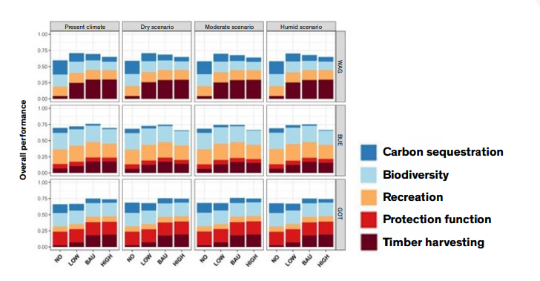
Ecosystem services of forests – Overall performance
Overall performance of all forest ecosystem services and biodiversity indicators in three forest enterprises under current and future climate-change scenarios.
Management strategies: none (NO), reduced (LOW), unchanged (BAU), or intensified management (HIGH)
Sites: Wagenrain (WAG), Bülach (BUE), and Gottschalkenberg (GOT)
https://nfp73.ch/download/60/230224_SNF_NFP73_PB_MAFES_EN.pdf?inline=true

Slide 18
Trade-offs in Forests
“During the transition toward greater sustainability, forests come under pressure because they are expected, for example, to compensate for environmental obligations not met by other sectors. The resulting trade-offs force forestry to balance competing demands. We describe policy solutions for two examples: carbon sequestration and forest clearing for compensation purposes.”
Dr. Tobias Schulz, Project lead, Trade-offs in Forests

Slide 19
Trade-offs in Forests – Assignments
Explain why forests are increasingly coming under pressure today.
Name important trade-offs and describe how they can be mitigated.
Explain: What is a decision-support system, and what do forest and wood carbon sinks mean?
Sources of knowledge:
Trade-offs in forests (Website NPF 73)
Mainstreaming Forest Ecosystem Services (thematic synthesis)

Slide 20
Trade-offs in Forests – Background
Background
Economic sectors that are increasingly oriented toward sustainability are competing more and more for scarce land, thereby increasing pressure on forests. While the growing “bioeconomy” on the one hand represents an opportunity for the forestry sector, population growth and certain renewable-energy strategies on the other hand can lead to trade-offs and difficult choices that may increasingly come at the expense of forests in the future. These demands on current forest policy require an adaptation of the instruments available to address such trade-offs.

Slide 21
Trade-offs in Forests – Aim
Aim
With this project, we pursued the following objectives:
to identify newly emerging trade-offs between sectors in a sustainable economy from the perspective of the forestry sector, and to determine (market-based) policy instruments or combinations of instruments to address these conflicts;
to assess the political feasibility of these individual or combined instruments by examining their acceptance among stakeholders and actors in the respective case-study regions;
to forecast the impacts of the proposed individual or combined instruments using spatially explicit simulations.

Slide 22
Trade-offs in Forests – Results I
Forests in competition with sustainable economic projects
As the analysis of forest-clearing applications shows, sustainable economic sectors are competing for land use. In the Swiss Plateau and the Alpine region, forests are being cleared to make room for sustainable economic projects (e.g., energy production through geothermal, wind and hydropower, and biomass; infrastructure for “slow mobility” such as pedestrians and cyclists; and recycling), although their share is still relatively small. To what extent socio-economic factors are relevant in the choice of locations for clearings cannot be determined conclusively. Topographical factors and landscape structure are likely to be more decisive in this context. Our proposed concept for balancing interests distinguishes both between emerging and prevailing trade-offs and between trade-offs at the level of political programs and at the level of forest management.

Slide 23
Trade-offs in Forests – Results II
Regulations in forestry and forest management
We found that the forestry and forest sector generally rejects regulation—unless it concerns claims on forests made by other sectors. It is assumed that artificial markets (i.e., markets created through environmental regulations and institutions that limit certain emissions or resource use and issue tradable emission or usage rights) can resolve many of the trade-offs between sustainably operating sectors, as long as traditional forest use is protected by a strong regulatory framework. Strategies based on property rights can also represent a possible solution, especially with regard to small-scale forest owners.

Slide 24
Trade-offs in Forests – Results III
Use of forest land for carbon sequestration
Our case study on CO₂ sequestration and damage-mitigation strategies involving forest land (in the canton of Lucerne) showed that carbon sinks in forested areas are largely accepted by central and well-coordinated actors—such as the cantonal forest administration, regional forest-owner associations, foresters, and the wood-processing industry. Many younger forest owners who manage large areas but question the profitability of timber production also opt to increase standing timber volumes, produce firewood, and use forest land for carbon sequestration if this allows them to generate sufficient income.

Slide 25
Trade-offs in Forests – Results IV
Compensation measures in forests
Our second case study, which focused on forest clearings for compensation measures (in the canton of Bern), confirms the strong trade-off between economic sectors competing for land. A bilateral agreement concluded between cooperating stakeholder groups shows that there are politically feasible options (compensation within production processes or reforestation on urban land), whereas market-based solutions are rejected. A majority of forest owners oppose compensation measures in forests. A similar number of forest owners—though fewer than in the first case study (CO₂ sequestration and damage mitigation)—support compensation measures provided they are production-integrated measures at less profitable sites.

Slide 26
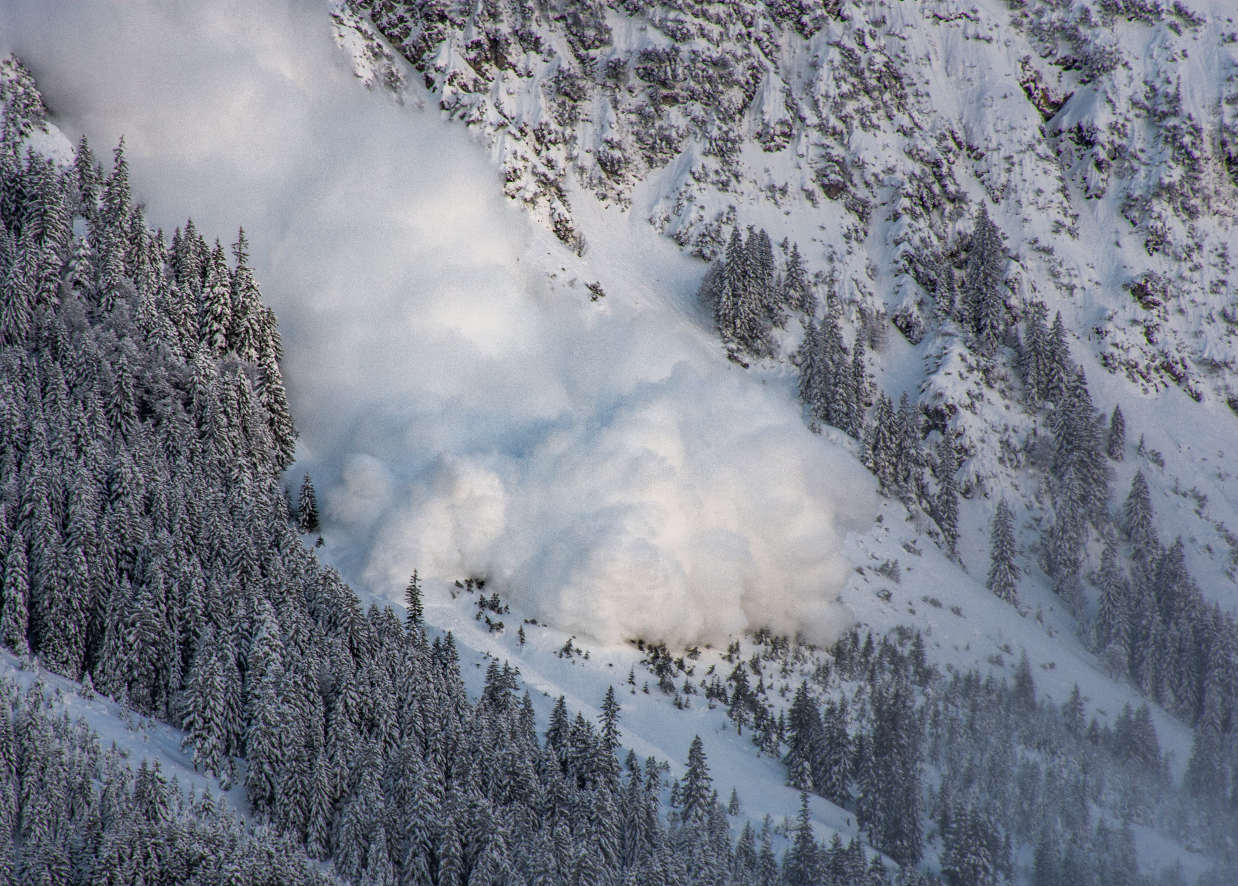
Insurance value of forest ecosystems
“With this project, we analyzed what insurance services forest ecosystems can provide. To this end, public preferences were evaluated, and various institutional frameworks as well as facilitating and hindering factors were examined. Using the information obtained, a theoretical business model was developed that can serve as a basis for the practical implementation of insurance against natural hazards.”
Prof. Dr. Roland Olschewski, Project lead,
Insurance value of forest ecosystems

Slide 27
Insurance value of forest ecosystems –
Assignments
What natural hazards does the forest protect against? Name at least three.
Explain: What does “willingness to pay” mean?
Explain: What must be considered when insuring against natural hazards?
Sources of knowledge:
Insurance value of forest ecosystems (Website des NFP 73)
Forests and their services for people (Video, 3:30)
Insurance value of forest ecosystems (Scientific lecture)

Slide 28
Insurance value of forest ecosystems – Background
Background
Forest ecosystems often provide services free of charge, for example by protecting against natural hazards. If this protective function is improved through optimal forest management and contributes to risk prevention beyond legal requirements, forest owners are providing an additional insurance service for the exposed population. However, because they are usually not compensated for this service, underprovision may occur—meaning that the population receives less protection than would actually be desirable and possible.

Slide 29
Insurance value of forest ecosystems – Aim
Aim
The project pursued the following objectives:
to provide scientific evidence that ecosystems can deliver insurance services;
to create a shared understanding and acceptance of the insurance value of natural resources among the involved actors;
to demonstrate the potential and determine the value of insurance services provided through ecosystem management;
to identify the influence of context and the institutional environment on the provision of insurance services; and
to develop a business model that makes the insurance value of ecosystems usable for the insurance sector.

Slide 30
Insurance value of forest ecosystems – Results I
Quantification of protection against natural hazards
We developed and validated a simulation framework for the scenario-based quantification of protection against natural hazards (and other ecosystem services) provided by mountain forests. This framework makes it possible to examine how climate, management, and disturbance factors such as wind, bark beetles, or rockfall affect the forest’s protective capacity. In the validation case study, the remaining rockfall risk was 20–30% depending on the forest development scenario. Stone size and forest density were the main factors determining protection effectiveness.In addition, our rockfall simulations showed that piles of deadwood left in the forest after storms have considerable protective capacity and even improve it compared to the forest stand before the storm. This surprising result confirms that nature-based protective solutions for gravitational natural hazards could become increasingly important from both an ecological and an economic perspective

Slide 31
Insurance value of forest ecosystems – Results II
Incorporating protective forests into insurance models
Our experiment on the preferences of the affected population produced the following findings:
there is a willingness to pay for reducing natural-hazard risks beyond current legal requirements;
there is no single insurance model that fits all situations, because respondents’ preferences and willingness to pay—as well as regional contexts—vary too much;
linking forest management with hazard modeling can lead to scientifically sound and practically relevant solutions for managing natural-hazard risks.
Our theoretical insurance model showed that including the protective function of forests as part of insurance contracts can create a win–win situation for both insurers and property owners. The possibility of combining financial and natural-hazard insurance can in turn encourage forest owners to ensure such protection through forests, which benefits society as a whole.

Slide 32
Final Discussion
Discuss in pairs or groups of three at the end:
What surprised me about the research findings?
Which forest ecosystem services are particularly important for society?
What can I personally contribute to reducing trade-offs involving forests?
Would I be willing to pay for the protective function of forests?

Slide 33
Appendix

Slide 34
Further sources for in-depth study on the topic

Slide 35
Use of the learning module
Suitable for use in bachelor’s programs at Swiss universities
Also suitable as an introduction for master’s and continuing-education programs at Swiss universities
Suitable for self-study; can also be used in classroom teaching
Scope: 3–4 hours of learning time, with an additional 3–4 hours for in-depth study

Slide 36
NFP 73 Sustainable Economy: resource-efficient, future-oriented, innovative
The aim of NRP 73 is to generate scientific knowledge on a sustainable economy that uses natural resources sparingly, increases prosperity, and enhances the competitiveness of Switzerland as a business location.
Framework:
29 research projects in 9 priority areas
Duration: 2016–2023
Research period: 5 years
Funding volume: CHF 20,000,000
Acknowledgement:
The development of this learning module was made possible by SNSF / NRP 73.

