Slide 1
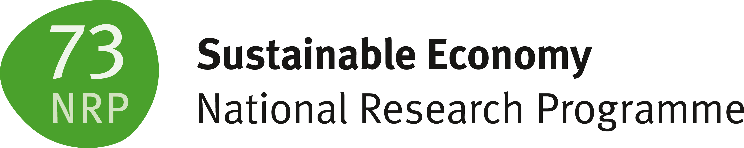


Supply chains
A learning module for the tertiary level

Slide 2
Focus Supply Chains
«Sustainability in supply chains means capturing environmental, social, and economic impacts and promoting good corporate governance across the entire value chain of products and services. On a per-capita basis, Switzerland’s global supply-chain environmental impacts are the highest in the world. To improve the impacts caused by Switzerland’s economic activity and public procurement, innovative concepts must be developed. Approaches and new insights in this area are provided by three research projects. The Co-Creation Lab “Data Transparency for Sustainability” also provides access to comprehensive data on Switzerland’s global supply chains. This advances the state of the art in environmental and social life-cycle assessment and offers a comprehensive overview of Switzerland’s consumption footprint.» NFP73, Research Project Supply Chains

Slide 3
Learning Objectives
The learner …
understands the importance of supply chains for sustainable development
knows the key factors for sustainability in supply chains
can explain how environmental assessments and sustainability analyses help make supply chains more sustainable
can explain how legal frameworks should evolve to promote sustainable supply chains
recognizes the relevance of sustainable public procurement and knows which factors, processes, and decision-makers are important in this context

Slide 4
Introductory Questions
Please try, using your prior knowledge and experience, to answer the following questions. Ideally, discuss your answers with a colleague:
What do I already know about sustainable supply chains?
What is the importance of supply chains?
Which goals and principles are important in sustainable supply chains?
Which concrete examples of sustainable supply chains do I know (approaches, projects, companies, etc.)?
Which sustainability goals are particularly relevant, and which ones are they?

Slide 5
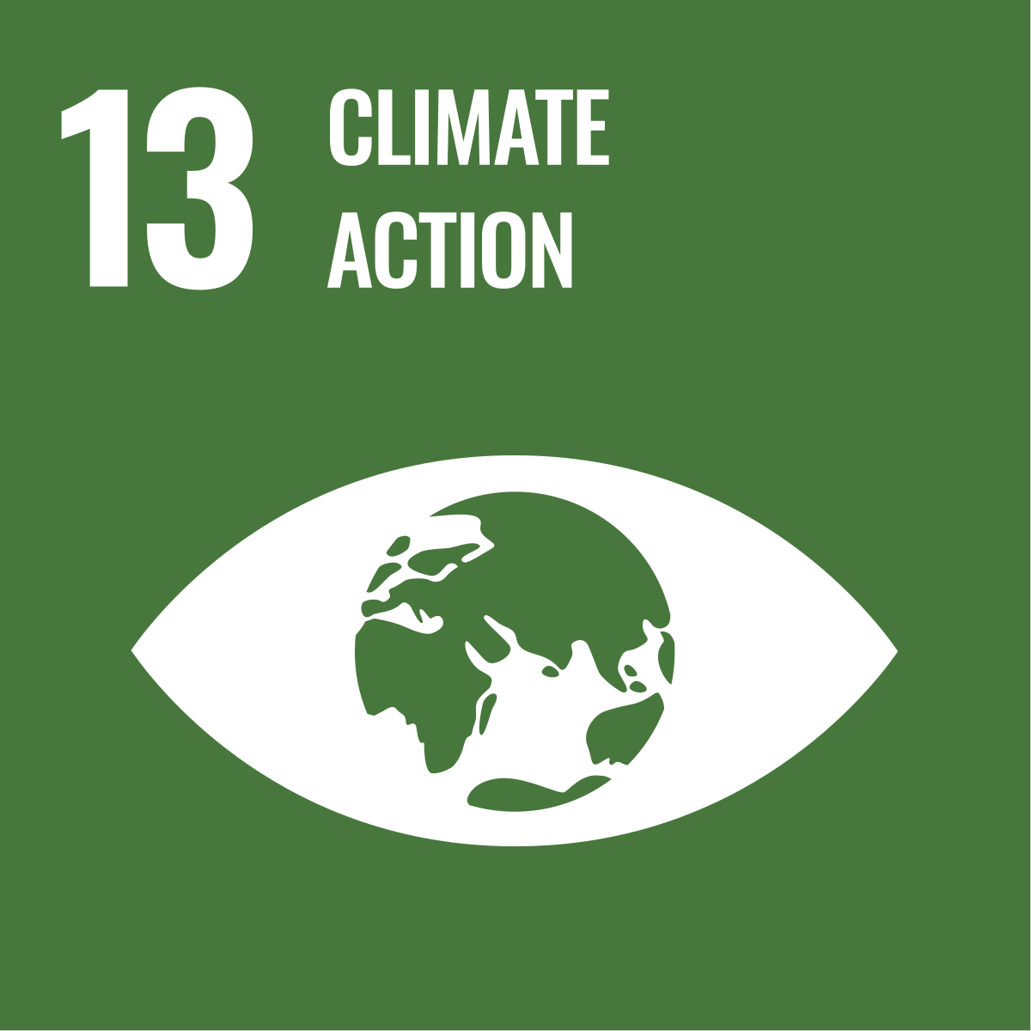
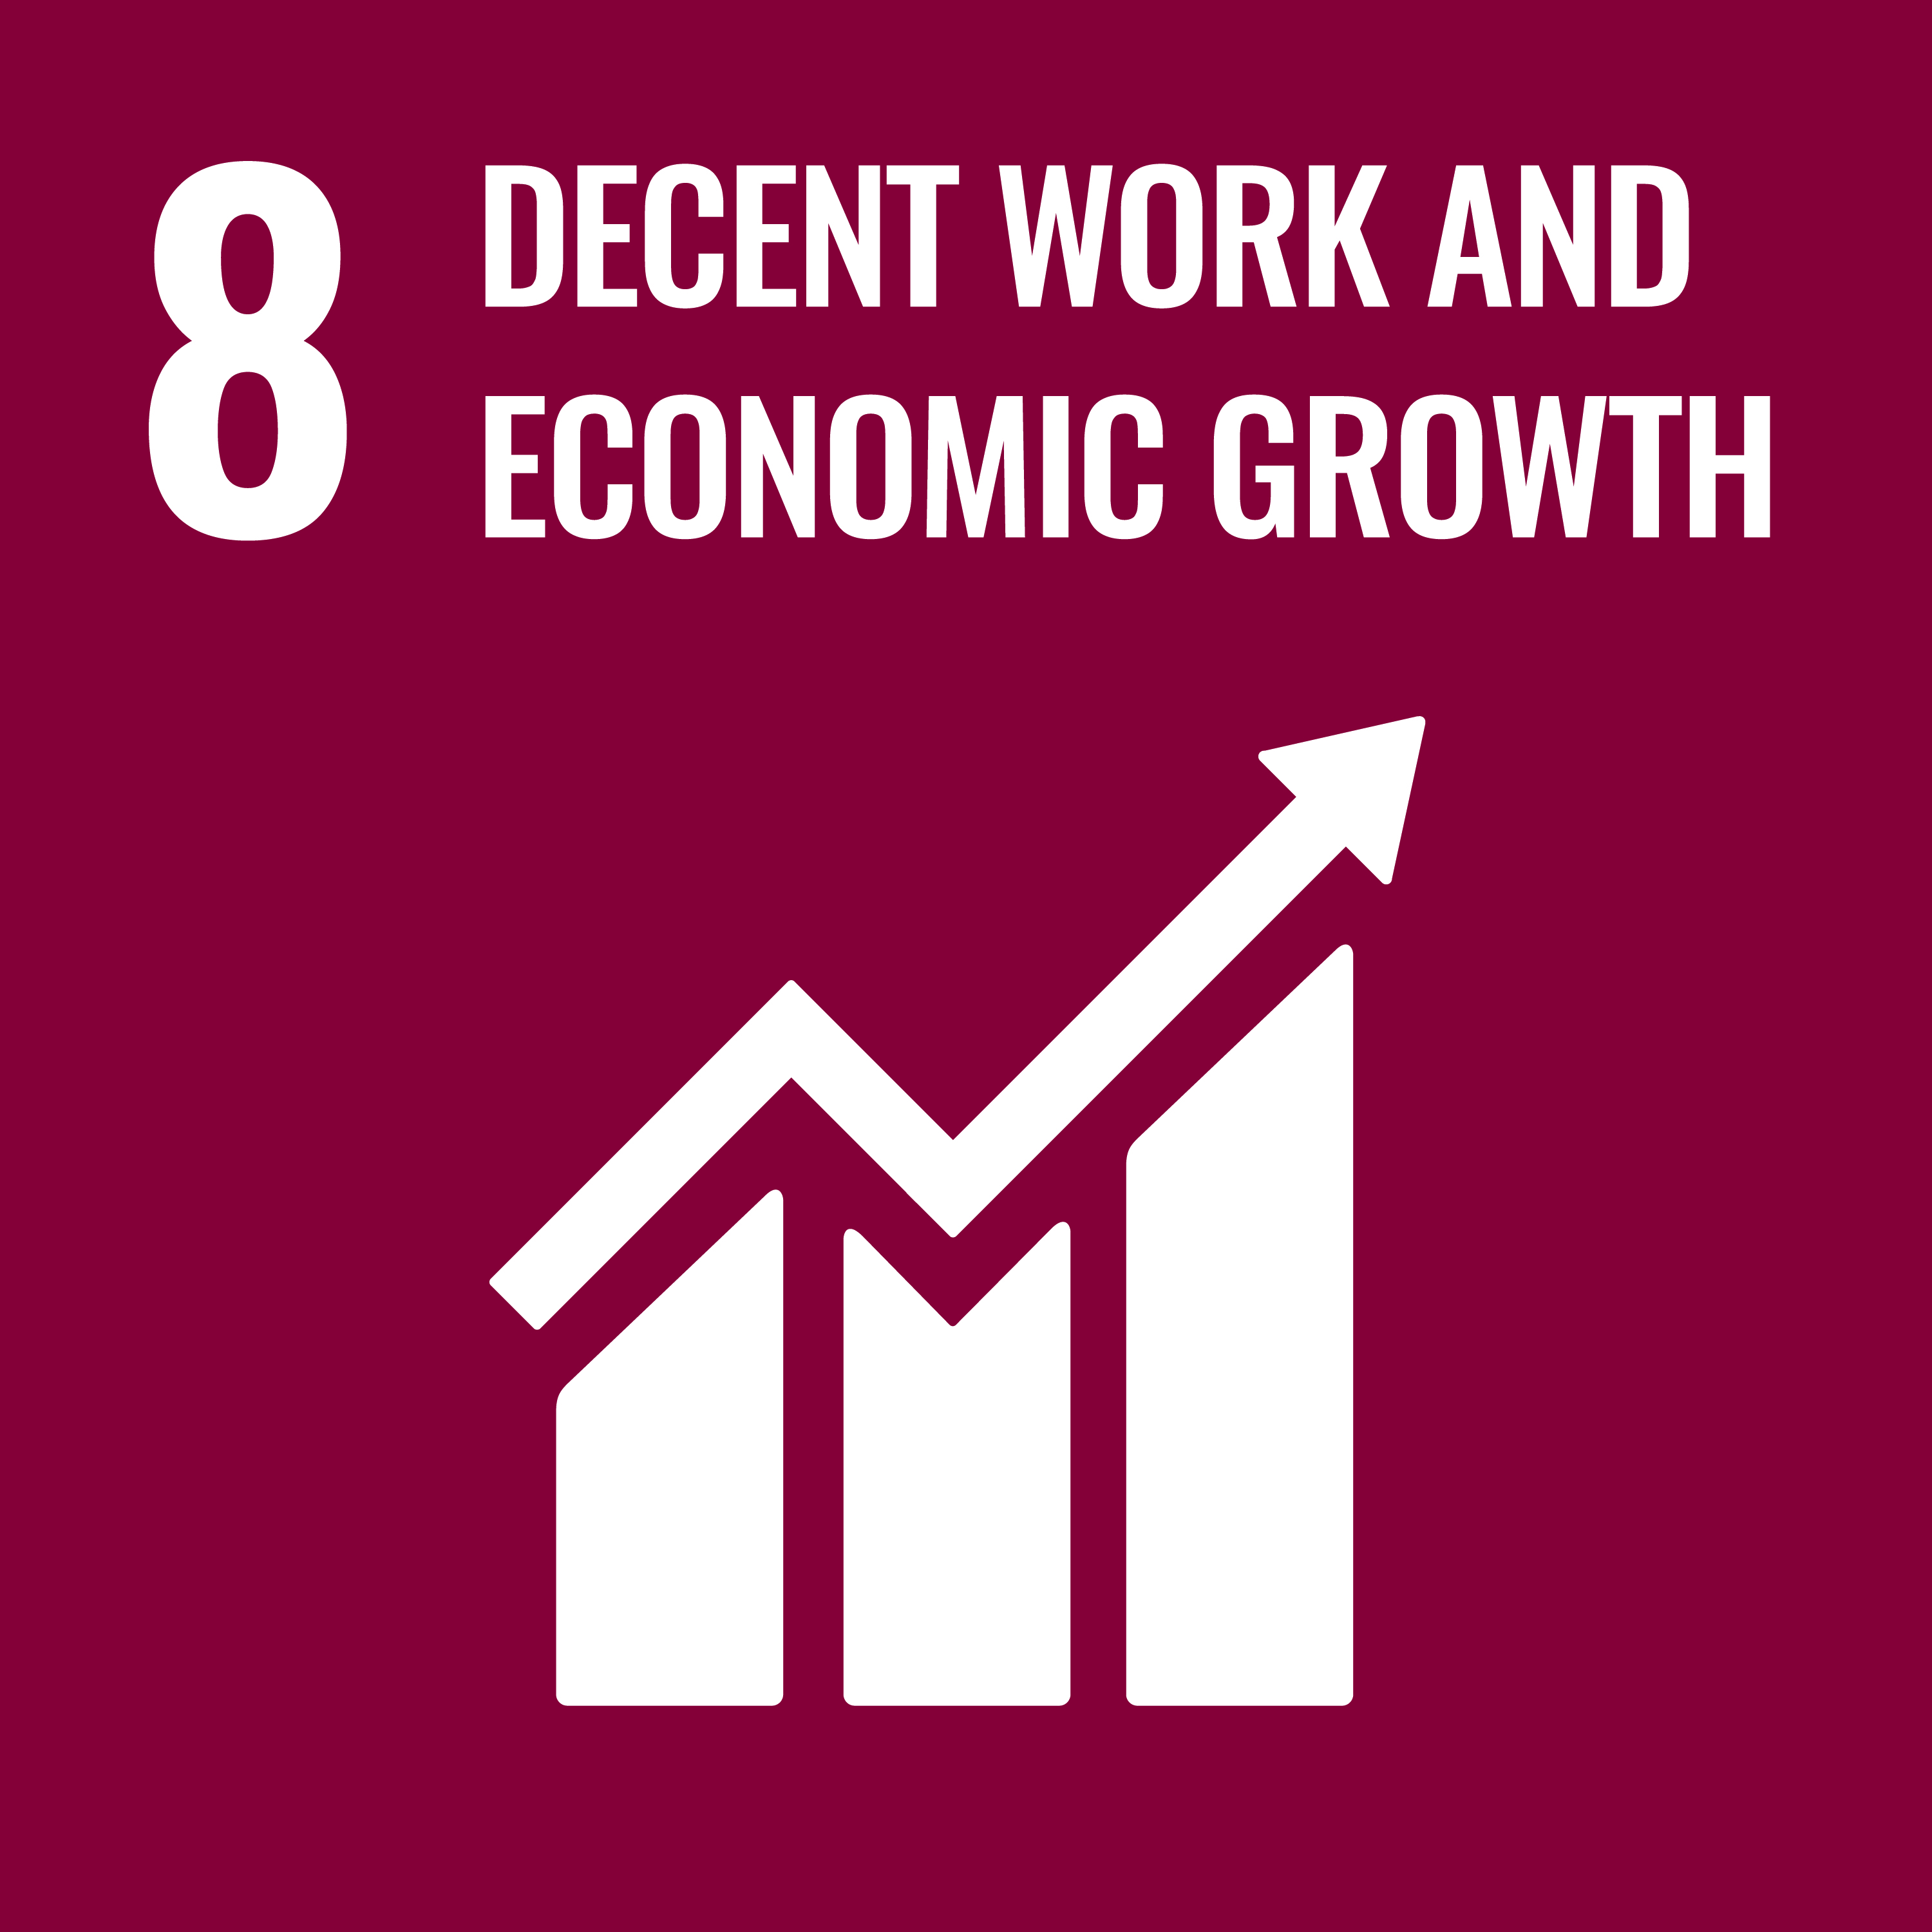
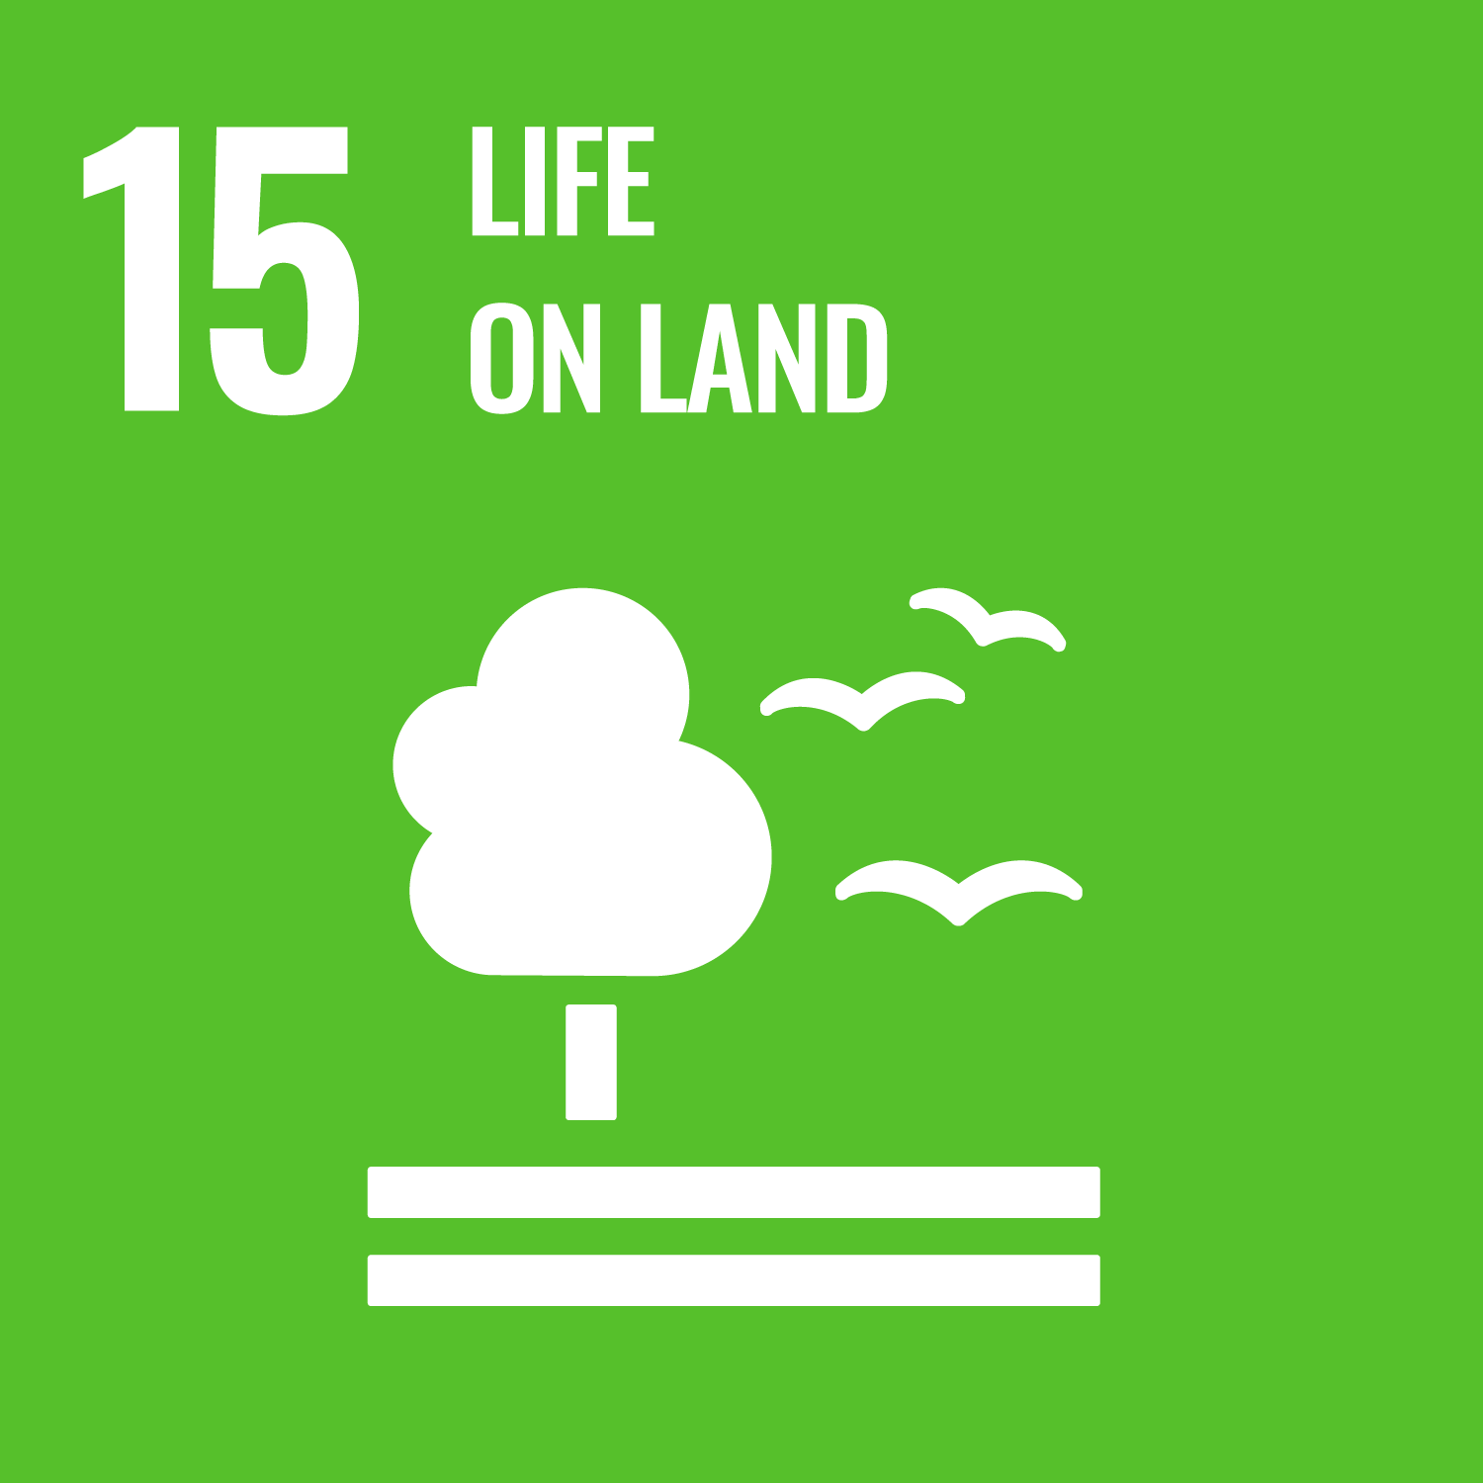
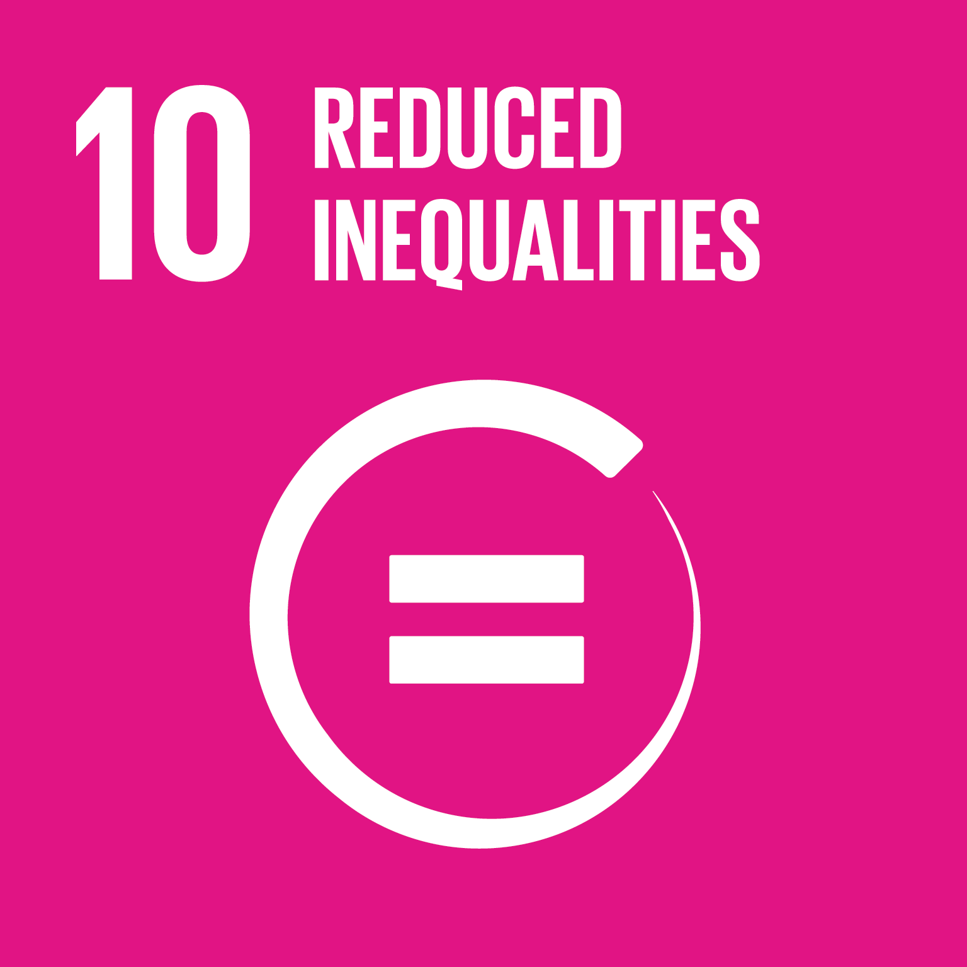
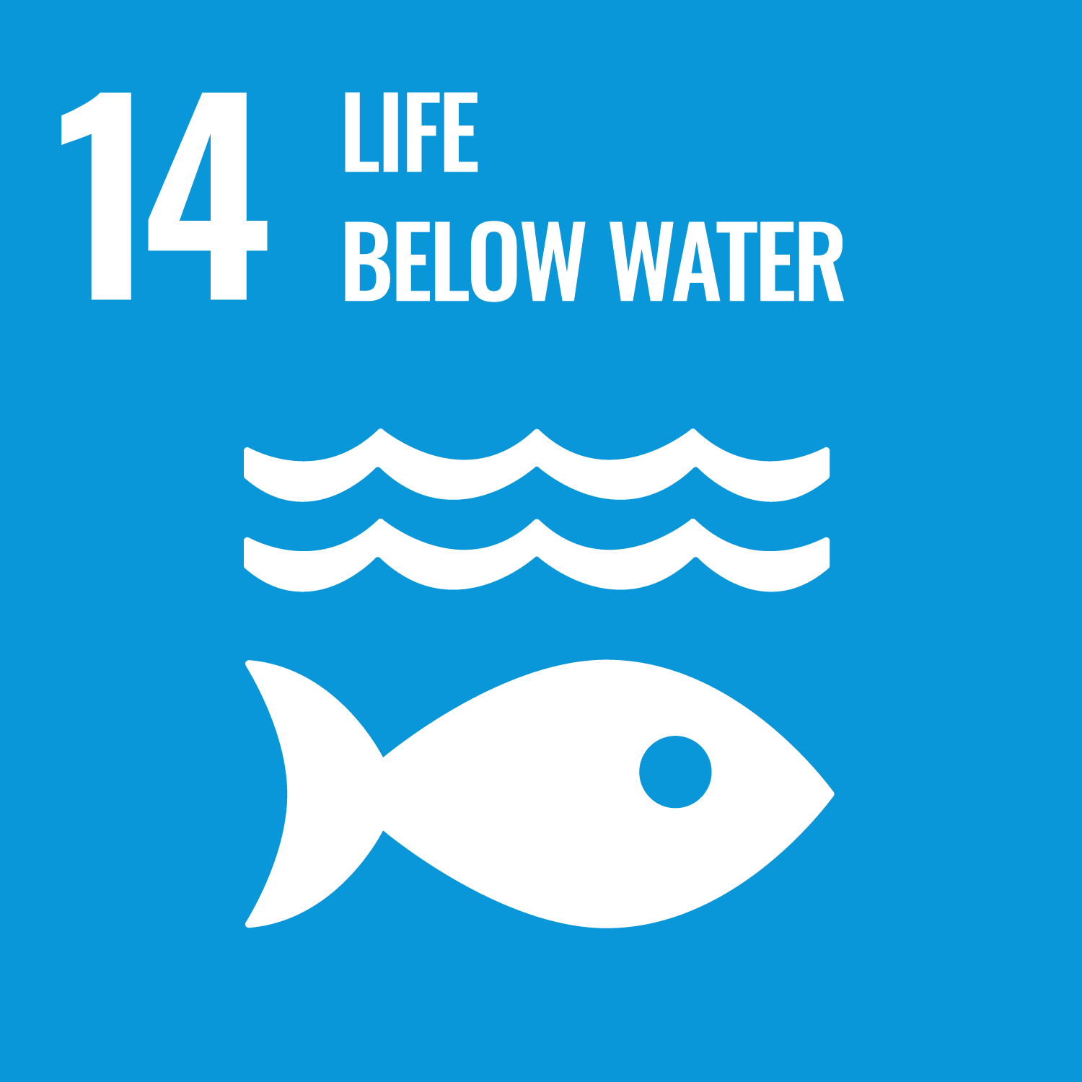
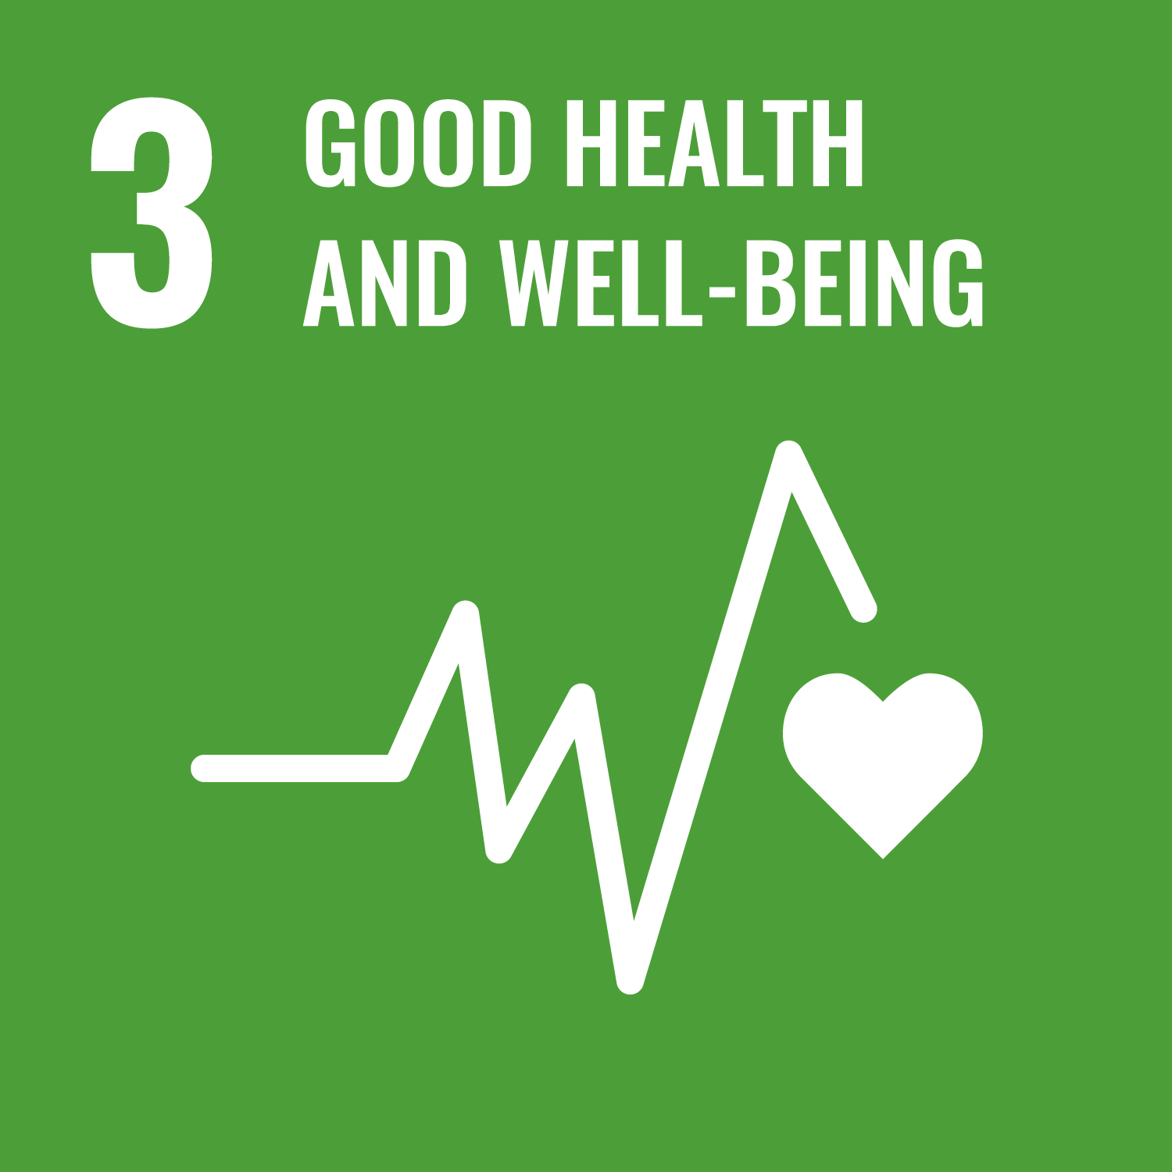
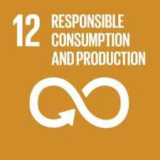
Links to the United Nations Sustainable Development Goals
Supply Chains

Slide 6
Introductory Questions
What are “supply chains,” and what do they have to do with sustainability?
In which country are the per-capita environmental impacts of global supply chains the highest?
What are the main problems of unsustainable supply chains?
Which approaches can be used to make supply chains more sustainable?
Sources of knowledge
Lieferketten (Wikipedia)
Supply Chain (Website NFP 73)

Slide 7

Overview of Research Projects
In the focus area “Supply Chains,” there were three research projects:
Transparent environmental assessment and sustainability analysis of Swiss final consumption (Open assessment of Swiss economy and society)
More sustainable value chains using cocoa as an example (Enhancing supply chain sustainability)
Sustainable public procurement

Slide 8
Open assessment of Swiss economy and society
«As a piece of fundamental scientific research, the OASES project pursued the goal of contributing to a better understanding of the impacts of private household consumption and supply chains in Switzerland. We developed new and open methods for assessing critical resources, for integrating databases, and for understanding and reducing result uncertainty.»
Dr. Christopher Mutel, Project lead Open assessment of Swiss economy and society

Slide 9
Open assessment of Swiss economy and society – Assignments
Why is data transparency important for the sustainability analysis of supply chains?
What benefits does open-source software bring to research?
What kinds of supply-chain data are relevant for environmental assessment?
What events can disrupt global supply chains?
Sources of knowledge
Open assessment of Swiss economy and society (Website NFP 73)

Slide 10
Open assessment of Swiss economy and society
Background
Aim
There are ad hoc reports that examine environmental impacts and critical resources in the Swiss economy, but they are difficult to reproduce or compare. A more comprehensive analysis is of crucial interest to a broad range of stakeholders in Switzerland. Such documentation must depict both Swiss and global supply chains in detail, quantify uncertainty, and be reproducible and easy to update in the future.
Development of a new approach that combines a top-down with a bottom-up energy and material flow database in order to create a detailed and comprehensive picture of these supply chains and their environmental impacts;
integration of social impacts;
integration of critical resources and potential supply-chain disruptions;
development of a global framework for sensitivity analyses that processes these data and indicators efficiently and accurately.

Slide 11
Open assessment of Swiss economy and society
– Results I
Impacts of resource-supply disruptions
A new approach was developed that allows assessment of country-specific impacts of supply disruptions in a technology supply chain. This approach was applied in a case study of electric vehicles sold in Switzerland. Hotspots as well as the overall impacts of supply disruptions in cobalt and aluminum supply chains were evaluated. Some resources or processes were already largely known, such as cobalt mining in the Democratic Republic of the Congo. In addition, new critical processes were identified, such as the production of aluminum wiring harnesses in Morocco. The disruption of global supply chains for seemingly ordinary resources during the COVID-19 pandemic demonstrates the usefulness of our approach.

Slide 12
Open assessment of Swiss economy and society – Results II
Open-source approach for further research
An open-source approach to merging life-cycle inventory databases has been developed and applied to ecoinvent and EXIOBASE. Combining a complete but highly-aggregated database with a detailed set of process models covering some parts of the economy has produced our best picture yet of the environmental impacts of Swiss household consumption of resources, and allowed us to prioritise future data improvement efforts. As our approach is available as open source software, and uses open supplemental data, it can continue to be updated in the future by researchers and other stakeholders. The geographic resolution of our input data proved incompatible with the social indicators database, and no robust analysis of social impacts could be carried out.

Slide 13
Open assessment of Swiss economy and society – Results III
Global sensitivity analysis
We developed a global sensitivity-analysis method that can efficiently process large databases with hundreds of thousands of uncertain input parameters. It can also handle correlated or grouped parameters as well as uncertainties that cannot be represented by probability distributions. An important innovation was the use of iterative validation at the individual screening steps, through which non-influential parameters are identified and excluded. With this validation step, we can quantify how well our reduced model reproduces the results of the full model.

Slide 14

More sustainable value chains using cocoa as an example
«We developed and applied methods to assess the sustainability and resilience of cocoa supply chains and evaluated improvement measures in a transdisciplinary setting. Our findings help strengthen the sustainability and resilience of the global value chains that supply the Swiss market.»
Dr. Christian Schader, Project lead, More sustainable value chains using cocoa as an example

Slide 15
More sustainable value chains using cocoa as an example – Assignment
Where in the cocoa supply chain do the greatest environmental impacts arise, and what causes them?
Which approaches can be used to reduce environmental impacts?
Which factors are central to relationships in sustainable supply chains?
Which types of resilience capacities of farms can be distinguished, and how can they be strengthened?
Sources of knowledge
Enhancing supply chain sustainability (Website NFP 73)

Slide 16
More sustainable value chains using cocoa as an example – Background
Background
Swiss chocolate manufacturers are increasingly being held accountable for the environmental, social, and economic impacts of their supply chains. Despite numerous sustainability initiatives, many challenges remain, and the various actors must improve their resilience in order to better cope with growing disruptions in global supply chains. Addressing sustainability and resilience in supply chains requires an understanding of current conditions, the main challenges, and the effectiveness of sustainable sourcing practices.

Slide 17
More sustainable value chains using cocoa as an example – Aim
Aim
The project pursued three objectives:
  to analyze the sustainability of specific supply chains that supply the Swiss market with cocoa; on the basis of these results, targeted measures could then be developed, implemented, and evaluated;
  to assess relationships between different partners in the supply chain and evaluate how farmers perceive the sustainable sourcing practices in their supply chains;
  to advance resilience research by developing and testing an assessment framework for farm-level resilience.

Slide 18
More sustainable value chains using cocoa as an example – Results I
Challenges and impacts in the area of sustainability
We found that farms cause the greatest environmental impacts in cocoa supply chains, mainly through land-use change and the use of agricultural inputs. A holistic sustainability assessment at the farm level identified major challenges in the areas of governance and social conditions. Environmentally friendly cocoa production did have positive side effects for human health and resource conservation with regard to the long-term productivity of farms, but this came at the expense of investment and farm profitability. The evaluation of measures to reduce pesticide use on cocoa farms showed that training farmers alone is not sufficient to achieve broad adoption of sustainable cocoa-growing practices.

Slide 19
More sustainable value chains using cocoa as an example – Results II
Advantages and disadvantages of sustainable sourcing practices
Farmers saw both benefits and drawbacks in the sustainable sourcing practices within their supply chains. Their relationships with their direct buyers were complex and varied, with trust in and loyalty toward these buyers depending on a range of factors, including the length of the business relationship and the availability of competing offers. Conflicts arose mainly because of prices, insufficient communication, and lack of support. The farmers surveyed collectively expressed a desire for training to be less theoretical and more practice-oriented, and therefore more useful to them.

Slide 20
More sustainable value chains using cocoa as an example – Results III
Transformative capacity and resilience of the supply chain
According to resilience theory, three different capacities are decisive for resilience:
  the capacity for short-term absorption (e.g., economic robustness),
  medium-term adaptation (e.g., economic adaptability), and
  long-term transformation (e.g., social infrastructure).
Our results show that farmers with strong short-term absorptive capacity—for example through diversified livelihoods or the use of good agricultural practices—were better able to cope with the impacts of the COVID-19 pandemic. This suggests that studies on farm resilience should distinguish between these three capacities and address specific strategies for known risks, rather than summarizing outcomes in a single resilience score.
We also identified important ways in which farmers can strengthen their resilience, such as reducing travel activity or cultivating subsistence crops. However, this also entails major trade-offs with respect to the overall resilience of the supply chain.

Slide 21

Sustainable Public Procurement
«Development and testing of sustainability indicators for public procurement tenders in Switzerland. The indicators are intended to be in line with the WTO Agreement on Government Procurement, socially accepted, and legally enforceable.»
Prof. Dr. Peter Seele, Project lead, Sustainable Public Procurement (SPP)

Slide 22
Sustainable Public Procurement - Assignment
Why is public procurement important for sustainable development?
Which sustainability indicators need to be considered in public procurement?
Which factors in tendering processes are important for sustainability?
How is sustainability already being taken into account in public procurement?
Sources of knowledge
Sustainable Public Procurement (Website NFP 73)
Sustainable public procurement (scientific lecture)

Slide 23
Sustainable Public Procurement – Background
Background
In public procurement, an established framework for measuring and comparing sustainability is still lacking. However, national law is increasingly promoting sustainability in tendering processes. Completed and planned revisions of public procurement law provide for sustainability comparisons in public tenders. Switzerland has adopted the WTO Agreement on Government Procurement (GPA) and structured the Federal Act on Public Procurement (FAPP) accordingly. In guidelines such as the recently introduced ISO 20400, there is still a lack of clear, shared instruments for measuring and comparing sustainability. With our research project, we aim to help close this gap.

Slide 24
Sustainable Public Procurement – Aim
Aim
Within the interdisciplinary project “Sustainability in Public Procurement,” the Stürmer team (Computer Science, Bern) analyzed how sustainability has been implemented in past public tenders. Based on the findings on the status quo, the Seele team (Business Ethics, Lugano) subsequently identified suitable sustainability indicators for public procurement. In doing so, they also took into account the differing approaches in Europe (fixed criteria, less flexible) and in Switzerland (more flexible, greater individual responsibility for the contracting authority). Finally, the DeRossa team (Legal Studies, Lugano) examined the theoretically derived indicators for their legal compliance within the existing Swiss legal framework and for possible improvements.

Slide 25
Sustainable Public Procurement – Results I
Bern, Computer Science:
The Stürmer team conducted empirical analyses using procurement data from Swiss public authorities. By developing a sector-specific method for identifying sustainability criteria in procurement documents, the team was able to measure the level of sustainability achieved to date based on datasets of Swiss tenders. The focus was on selection criteria, technical specifications, and award criteria in tenders in the areas of information technology, construction, road transport, food and catering, and textiles. The results show that sustainability criteria are not yet the norm in public procurement, but have become more frequent in recent years.

Slide 26
Sustainable Public Procurement – Results II
Lugano, Business Ethics:
The Seele team identified existing sustainability indicators from various sectors and assessed their relevance for sustainable public procurement. Case examples from the Big Data analysis conducted by the Stürmer team were also included. This led, among other things, to peer-reviewed publications on a typological analysis of sustainability indicators in general (Knebel and Seele 2020) and specifically for Switzerland (Knebel and Seele 2021).

Slide 27
Sustainable Public Procurement – Results III
Lugano, Legal Studies
The sustainability indicators identified by the Seele team provide an important tool for improving sustainability in procurement practices, since the new criteria they propose have already been tested in private-sector reporting and are therefore well known. In the legal component of the research, it was shown what room for maneuver public procurement authorities have when incorporating these indicators into the sustainability criteria permitted by law—and where significant problems might arise.

Slide 28

Final Discussion
Discuss in pairs or groups of three at the end:
How relevant are sustainable supply chains for me?
Should public authorities place greater emphasis on price, quality, or sustainability in procurement?
What can I personally contribute to sustainable supply chains?

Slide 29
Appendix

Slide 30
Use of the learning module
Suitable for use in Bachelor’s degree programmes at Swiss higher education institutions
Also suitable as an introduction for Master’s and continuing education programmes at Swiss higher education institutions
Suitable for self-study; can also be used in face-to-face teaching
Scope: 3–4 hours of learning time, with an additional 3–4 hours for further in-depth study

Slide 31
NFP 73 Sustainable Economy: resource-efficient, future-oriented, innovative
The aim of NFP 73 is to generate scientific knowledge on a sustainable economy that uses natural resources sparingly, increases prosperity, and enhances the competitiveness of Switzerland as a business location.
Framework:
29 research projects in 9 priority areas
Duration: 2016–2023
Research period: 5 years
Funding volume: CHF 20,000,000
Acknowledgement:
The development of this learning module was made possible by SNSF / NFP 73.

