Slide 1



Circular economy
A learning module for the tertiary level

Slide 2

Focus Circular Economy
“The circular economy is widely discussed—but is it really sustainable? Various projects within NFP 73 investigated this question, and their findings were brought together in this thematic synthesis.”
NFP 73, Circular Economy

Slide 3
Learning Objectives
The learner …
understands the goals and principles of a circular economy
recognizes how a business model can be developed using circular economy approaches
knows concrete examples of circular economy
reflects on the opportunities and challenges of a circular economy
understands the implementation of circular-economy principles in hospital operations and modular water infrastructure

Slide 4
Introductory Questions
Please try, using your prior knowledge and experience, to answer the following questions. Ideally, discuss your answers with a colleague:
What do I already know about the circular economy?
What is the significance of the circular economy?
Which goals and principles are important in a circular economy?
Which concrete examples of circular economy do I know (approaches, projects, companies, etc.)?
What is my personal attitude toward the circular economy?
Which sustainability goals are particularly relevant, and which ones are they?

Slide 5
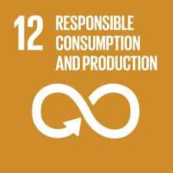



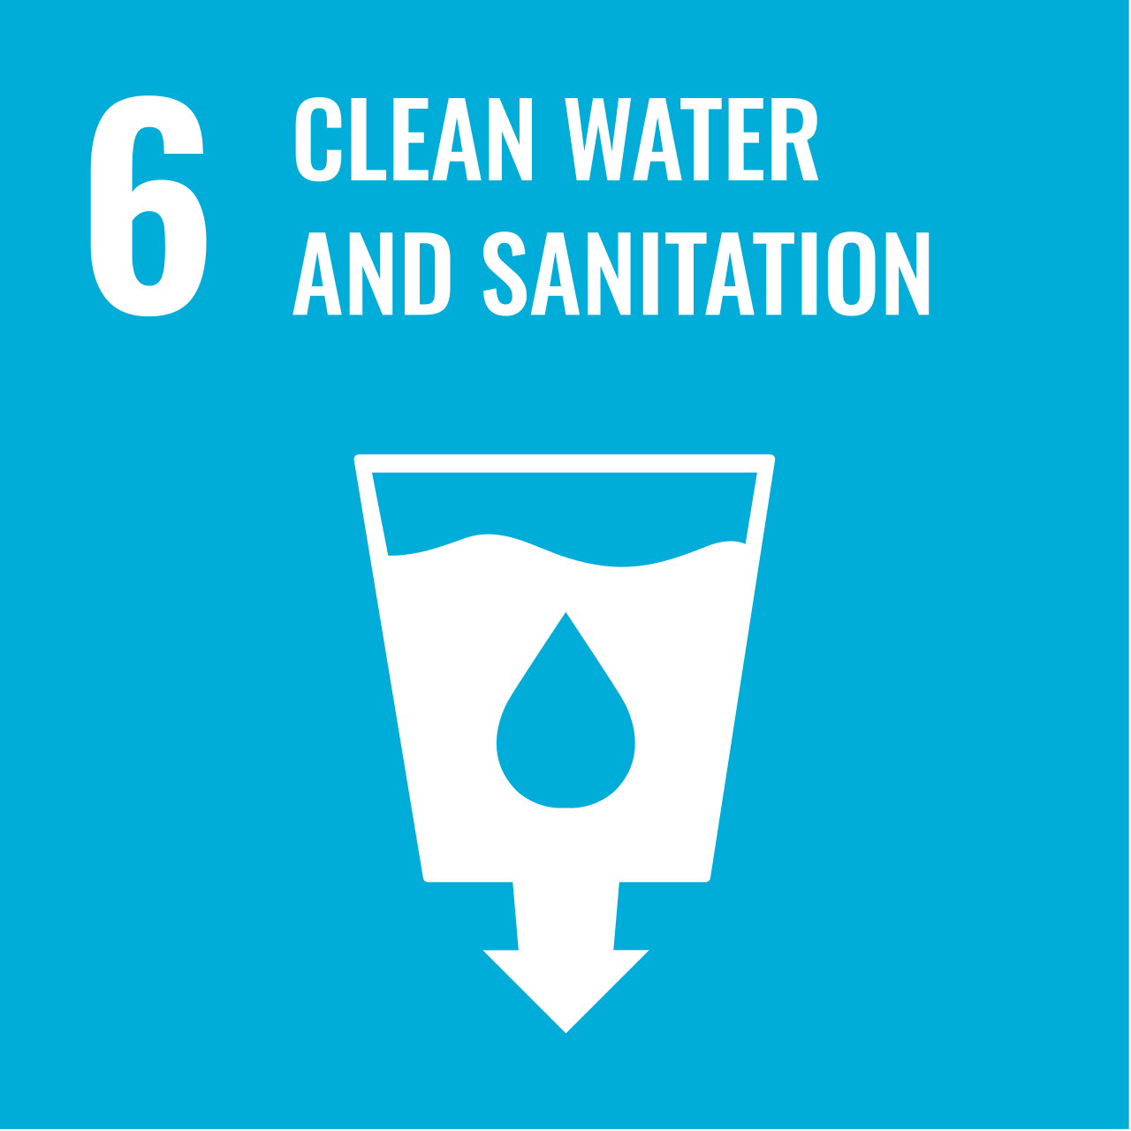
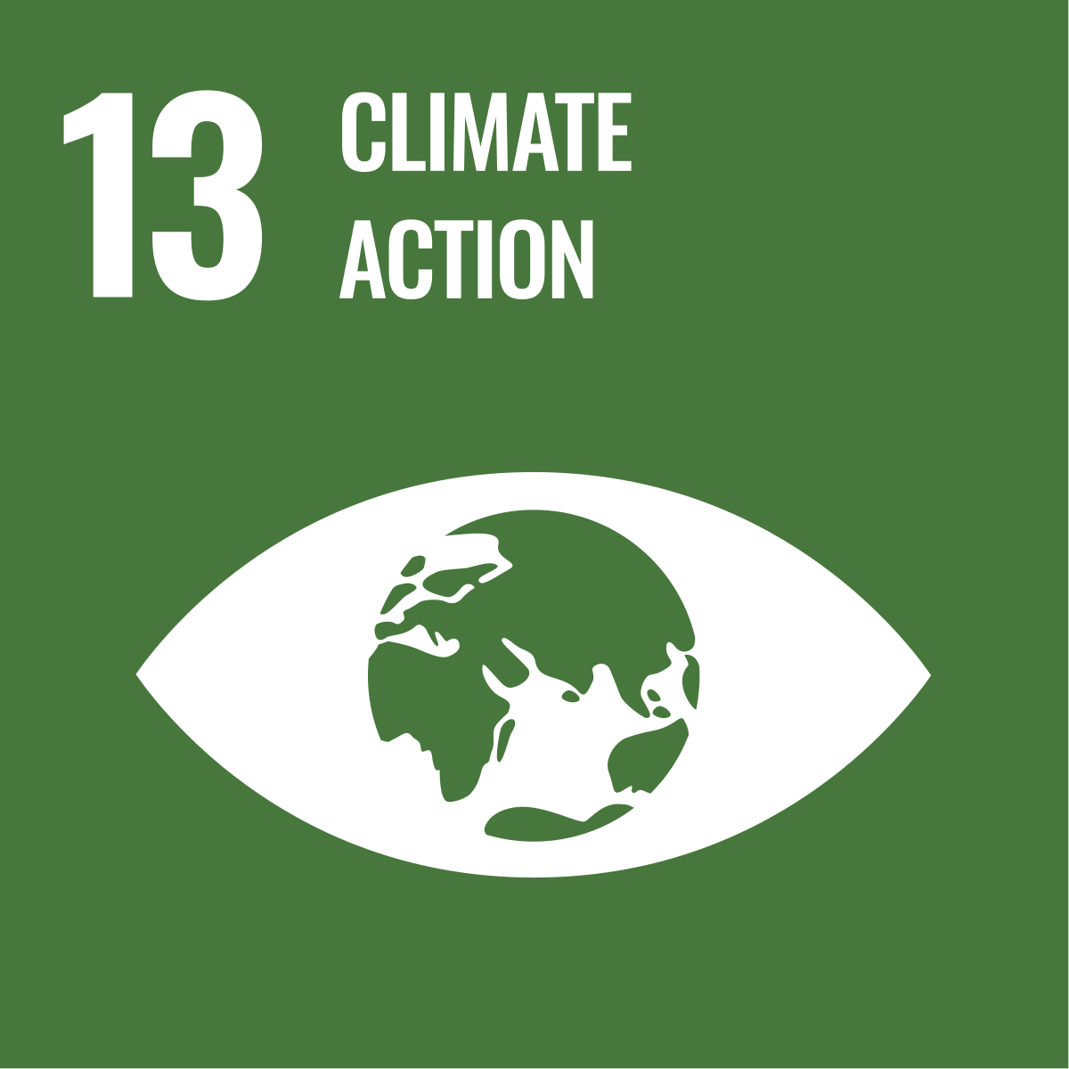
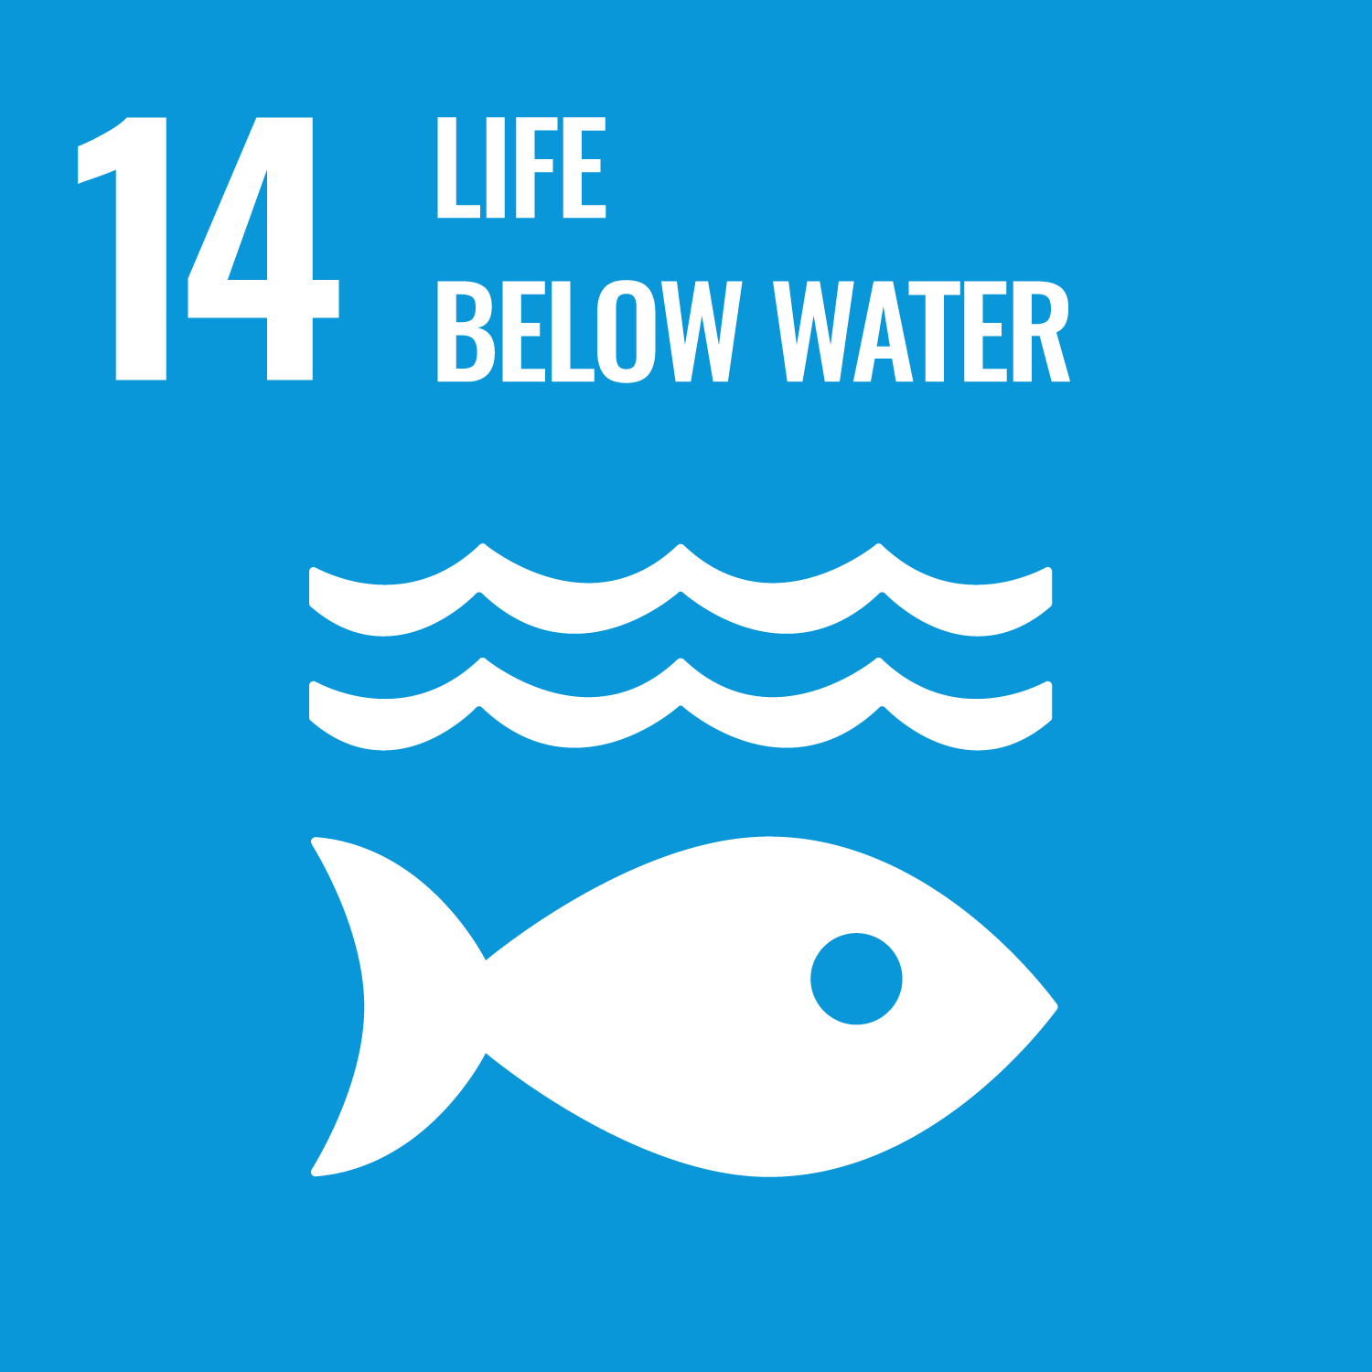
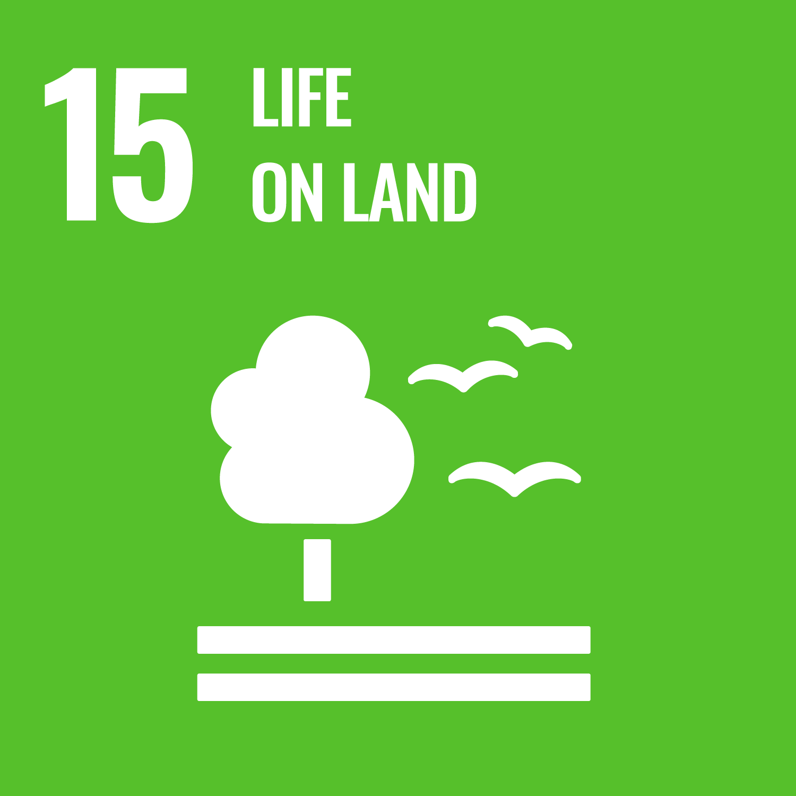
Links to the United Nations Sustainable Development Goals
Circular Economy

Slide 6
Introductory Exercises
What is a circular economy, and which basic principles are important?
What business opportunities arise in a circular economy?
How can a business model be developed in a circular economy, and which patterns can be applied?
Sources of knowledge:
Circular Economy (Wikipedia)
Circular Economy (Website NFP 73)
Circular Economy (CE): Business Opportunities and Strategies for a Sustainable Economy in Switzerland (CEO Brief)
Business Model Innovation for the Circular Economy (White Paper der Universität St. Gallen)

Slide 7

Circular economy – Background
Background
Closing loops, as nature shows us how to do, is meant to make us independent of primary resources and avoid waste problems. However, it is not clear which strategies deliver the greatest environmental benefits, how they can be implemented economically, and which regulatory and systemic barriers stand in the way.

Slide 8
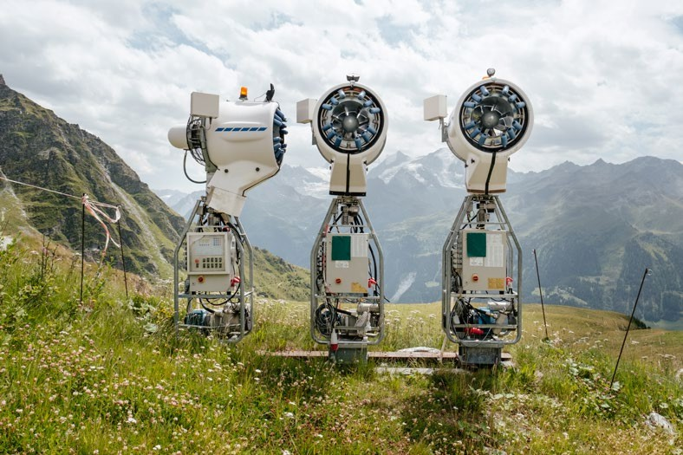
Circular economy – Aim
Aim
Decision-makers in business and society are seeking support for the successful and effective design of circular systems. The research projects of NFP 73 therefore aimed to examine the conditions for a sustainable circular economy and to develop decision-making methods. The thematic synthesis summarizes the resulting insights.

Slide 9
Circular economy – Results I
Research projects within NFP 73 examined conditions and developed methods to ensure that circular systems can also be designed sustainably. The range of support for companies and policymakers extends from product design and indicators to business model innovation for implementing a sustainable circular economy. The circular economy is more than just recycling; rethinking, reusing, or repairing can also save resources and reduce environmental impacts. However, there is no universal solution or waste hierarchy.
For different products and services, different circular strategies should be prioritized from an environmental perspective. Ultimately, what matters is how effectively a circular system can reduce environmental impacts and resource consumption. A paradigm shift toward long-term, global, and systemic thinking is necessary for successful and effective implementation.

Slide 10
Circular economy – Results II
To create a circular system, cooperation is needed along circular value chains. This applies in particular to the design of products and services, but also to new business models and ways of redistributing profits among the partners involved.
Because if even one of the participants in the loop is not profitable, the circle will not be completed. Legislation can and must support this process by creating incentives for collaboration and environmentally friendly product design, as well as by defining and applying goals and indicators that prioritize sustainability.

Slide 11
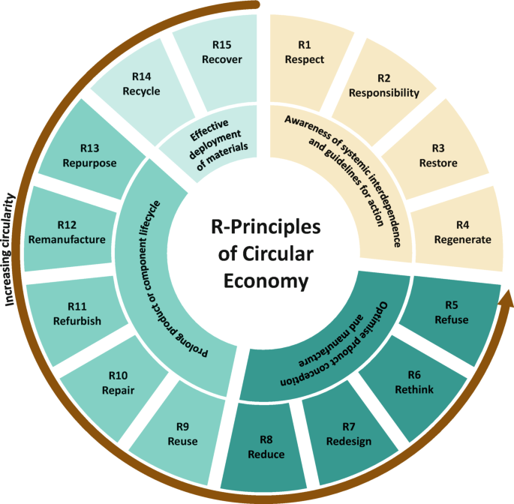
The 10 R of the circular economy
Source: Loza Adaui, C.R., Schmiedeknecht, M.H., Steinbiß, K., Fröhlich, E. (2024). https://doi.org/10.1007/978-3-031-70749-0_1

Slide 12
Overview research projects
In the focus area “Circular Economy,” there were four research projects:
On the path toward a sustainable circular economy
Laboratory for a circular economy
Resource efficiency in Swiss hospitals
Challenges of modular water infrastructures

Slide 13
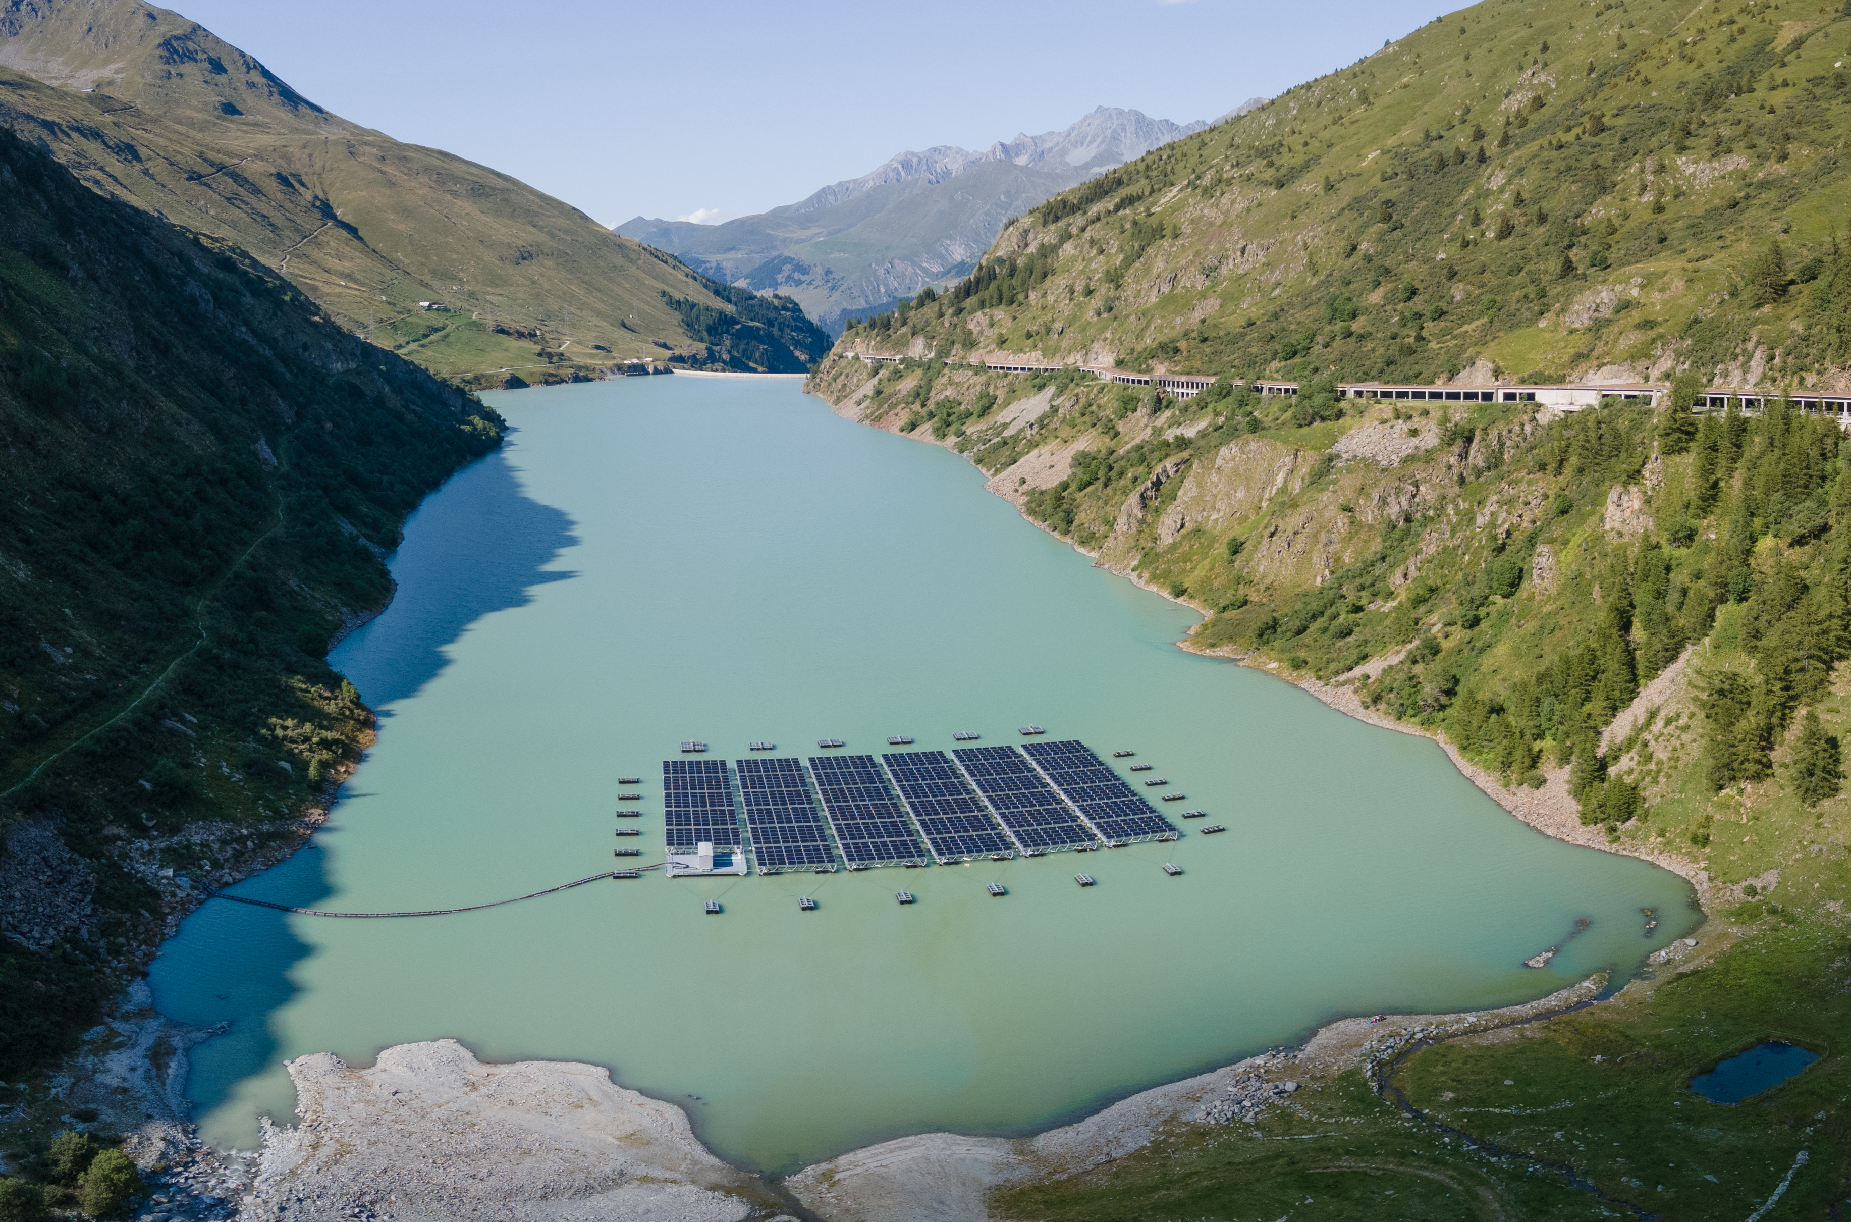
Towards a sustainable circular economy
“In the project ‘Towards a Sustainable Circular Economy’ (TACLE), a material-flow approach was combined with corporate and policy perspectives. The main objective was to identify hidden potential for improved resource management in Switzerland and to pave the way toward a sustainable circular economy.”
Prof. Dr. Volker Hoffmann
Project lead, towards a sustainable circular economy

Slide 14
Towards a sustainable circular economy – Assignments
Name examples of circular economy from different sectors.
What does it depend on whether a circular-economy approach is environmentally sustainable?
Why are assessment methods for circular approaches important, and which criteria are considered?
What measures can policymakers take to support a sustainable circular economy?
Sources of knowledge:
Towards a sustainable circular economy (Website NFP 73)
Kreislaufwirtschaft als Werkzeugkasten für eine nachhaltige Entwicklung in der Schweiz (Policy Brief in German)
Towards a sustainable circular economy (Scientific lecture)

Slide 15

Towards a sustainable circular economy – Background
Background
Due to population growth and new consumption patterns, pressure on natural resources has increased worldwide. The concept of the circular economy is therefore increasingly being proposed in politics, business, and research as a way to address this problem. However, there are significant knowledge gaps regarding the implementation and impacts of a circular economy, and this project aimed to investigate those gaps.

Slide 16
Towards a sustainable circular economy – Aim
Aim
The aim of the project was:
to identify and quantify opportunities to optimize resource efficiency in Swiss industry through a sustainable circular economy;
to analyze how companies can build or redesign value chains toward a circular economy; and
to support policymakers and industry in the transition to a circular economy.
The overarching research question of the project was:
Where is there hidden potential to improve resource management in Switzerland, and how can this be used to implement a circular economy?

Slide 17
Towards a sustainable circular economy – Results I
Case studies show improvements in the Swiss economy
We identified and quantified how resource efficiency in the Swiss economy can be improved through a sustainable circular economy, both in terms of resource use and from a socio-economic perspective. To this end, new indicators were also developed to measure the environmental and economic sustainability of circular-economy approaches. Case studies on thermal insulation, furniture, textile clothing, and plastics were assessed environmentally and—except for textiles—also analyzed from a socio-economic perspective.

Slide 18
Towards a sustainable circular economy – Results II
Reduction of environmental impacts in different industries
The results show that in the thermal-insulation industry, implementing circular strategies through approaches such as reduction and recycling offers the greatest potential for implementation, both in terms of costs and resource use. In the case of furniture, internal and external factors—such as modular product design and transport distances for reuse or refurbishment—proved to be central to a successful transition in furniture companies. Restoring furniture, including take-back systems, and repairing clothes showed the greatest potential for reducing environmental impacts. In addition, we found that rebound effects (i.e., money saved being spent on other goods or services) can diminish the positive effects of reduced consumption or longer use of clothing or furniture. A study of the plastic-packaging industry revealed that policymakers need to understand the full spectrum of regulatory solutions for removing barriers to the circular economy and the implications for the various stakeholders. Only in this way can policy steer the transition toward a sustainable circular economy.

Slide 19
Towards a sustainable circular economy – Results III
Innovations and organizational aspects on the path to a circular economy
The analysis of building and restructuring value chains toward a sustainable circular economy showed that disruptive circular innovations—such as design-for-disassembly concepts in the construction sector or enzymatic recycling for plastics and textiles—play an important role for companies, alongside organizational aspects (interdependencies among stakeholders and the joint redesign of established value chains).
Economic, environmental, and social aspects
Overall, it is crucial for policymakers, when transitioning to a circular economy, to give adequate consideration to economic, environmental, and social aspects—alongside the conceptual criterion of material circularity, which indicates what share of materials circulates in closed loops.

Slide 20
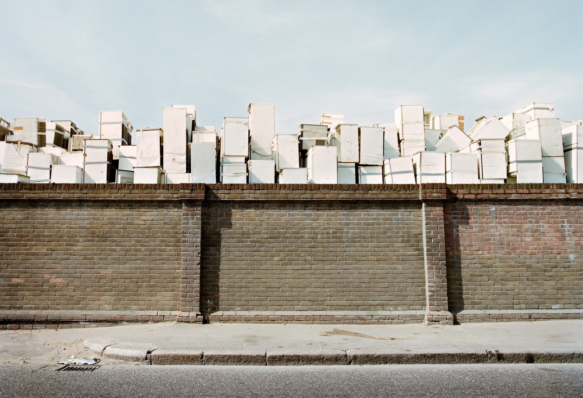
Laboratory for circular economy
“With this interdisciplinary research project, we sought to demonstrate under which business, legal, political, environmental, and technical conditions sustainable economic activity in the form of a circular economy can be both environmentally sound and economically profitable.”
Prof. Dr. Karolin Frankenberger, Project lead, Laboratory for circular economy

Slide 21
Laboratory for circular economy - Assignments
How large is the share of the circular economy in Switzerland at present?
Why is it not always sensible to use devices for as long as possible? Examples?
Which sector can enable the greatest ecological benefits in the transition to a circular economy?
How do business models need to be further developed for a circular economy?
Wissensquellen
Laboratory for circular economy (Website NFP 73)
Long-term thinking facilitates a circular economy (Video)
Laboratory for circular economy (Wissenschaftlicher Vortrag)

Slide 22

Laboratory for circular economy – Background
Background
Today’s economic system is largely based on a linear model. The consequences are waste generation and the overuse of natural resources. The circular economy—an economic system in which products, components, and materials are kept in use at their highest value for as long as possible—is an important lever for solving our environmental problems. However, the widespread introduction of a circular economy faces social obstacles: according to studies, only 8.6% of our economic activities meet the relevant requirements, meaning that the Circularity Gap Report 2021 points to a huge circularity gap.

Slide 23
Laboratory for circular economy – Aim
Aim
The aim of this inter- and transdisciplinary project was to develop guiding principles to support companies in the Swiss economy in successfully introducing a sustainable circular economy. To this end, we worked with six large and small partner companies (Losinger Marazzi, Nespresso, V-Zug, Dr. Gabs, SV Group, and Tisca Tiara) and developed tools and concepts to facilitate the adoption of circular-economy practices in these firms. In doing so, we focused primarily on three aspects:
material and energy requirements,
the legal and administrative framework conditions, and
the respective business model.

Slide 24
Laboratory for circular economy – Results I
Failure to reduce environmental impacts would amount to a disregard for fundamental rights
A sustainable circular economy could, in the medium term, help ensure the exercise of fundamental rights in Switzerland as guaranteed by the Federal Constitution (human dignity – Art. 7, right to life – Art. 10, economic freedom – Art. 27, guarantee of property – Art. 26, etc.). Failing to reduce the environmental impacts of our systems—given the climate crisis and the transgression of other planetary boundaries—would likely have consequences comparable to a violation of fundamental rights (“intervention-like preliminary effects”).

Slide 25
Laboratory for circular economy – Results II
Better implementation of sustainability principles
Within the framework of a sustainable circular economy, several principles enshrined in the Swiss Federal Constitution could also be better implemented—particularly those relating to prevention and precaution (Art. 74 para. 2 BV) as well as sustainability (Art. 2 and Art. 73 BV). This would facilitate the implementation of further provisions concerning, among other things, a sustainable energy supply (Art. 89 BV) or sustainable agriculture (Art. 104 and 104a BV). The polluter-pays principle (Art. 74 para. 2 BV) should be applied in such a way that prices reflect the finiteness of global resources. To achieve this, the external costs arising from exceeding planetary boundaries would need to be internalized through specific market mechanisms (e.g., by taxing environmental footprints or introducing certain quotas), thereby ensuring a sustainable circular economy within Switzerland’s liberal economic system (Art. 94 BV).

Slide 26
Laboratory for circular economy – Results III
Companies must align their business models with the circular economy
To do so, companies need to renew their business models and align them with the principles of the circular economy. It is crucial that these models address value creation, value delivery, and value capture in line with circular-economy principles. Individual firms often cannot perform all tasks along the value chain themselves; they therefore depend on other actors—especially other companies.
The various business models along the value chain must be coordinated and oriented toward a shared value proposition and circular product design. This is how circular products and solutions can be introduced across company boundaries. In these so-called circular ecosystems, skilled “orchestrators” are needed to ensure that firms operate within planetary boundaries while overcoming both internal and external barriers.

Slide 27

Resource efficiency in Swiss hospitals
“Which processes in a hospital are particularly harmful to the environment, and how can they be made more sustainable while taking into account the needs of patients and staff? In this project, primary data were collected and relevant hospital processes were analyzed together with partner hospitals from environmental and logistics perspectives.”
Matthias Stucki, Project lead, Resource efficiency in Swiss hospitals

Slide 28
Resource efficiency in Swiss hospitals
– Assignment
Which hospital areas place the greatest burden on the environment?
How large is the potential to reduce this burden—without compromising healthcare services?
Which hospital areas offer the greatest potential for reducing environmental impacts?
What is an environmental life-cycle assessment / Life Cycle Assessment (LCA)?
Name some measures with a large impact.
Sources of knowledge:
Resource efficiency in Swiss hospitals (Website NFP 73)
The Sustainable Hospital Revolution: Approaches to reduce the environmental impact (Policy Brief)
Resource efficiency in Swiss hospitals (scientific lecture)
Green Hospital (Website research project)

Slide 29
Resource efficiency in Swiss hospitals –
Background
Background
Although the health and social-care sector is the fourth most important consumption area from an environmental perspective—after food, mobility, and housing—there have been hardly any comprehensive sustainability assessments in this field. Before this project, it was unclear where the greatest levers for improvement lay and how they could be used in practice. Until now, there had been no analyses of the environmental efficiency of hospitals, and it was not known which areas offered the greatest potential for optimization.

Slide 30
Resource efficiency in Swiss hospitals – Aim
Aim
The project aimed to generate consistent and comprehensive insights into resource use and environmental impacts caused by Swiss hospitals. To this end, it examined which factors are decisive for the environmental footprint of the healthcare sector and for the resource efficiency of hospitals across their entire life cycle. These results served as the basis for developing best practices for sustainable and efficient hospital operations in Switzerland.
The following hospital areas were examined: electricity, heating, catering/food services, building infrastructure, laundry, water consumption, waste and wastewater, textiles, medical products, cleaning products, paper and printer use, pharmaceuticals, electronic devices, and large medical equipment.

Slide 31
Resource efficiency in Swiss hospitals – Results I
Key areas for increasing sustainability in hospitals
Our life-cycle assessment of the environmental impacts of these 14 hospital areas in 33 Swiss hospitals showed that catering/food services, building infrastructure, heating, electricity, and pharmaceuticals together account for about 70% of greenhouse-gas emissions from Swiss hospitals. According to the Swiss ecological-scarcity method, these same areas are also responsible for around 70% of the total environmental burden caused by the hospital sector. This method evaluates the environmental impacts of pollutant emissions and resource extraction within the framework of a life-cycle assessment.

Slide 32
Resource efficiency in Swiss hospitals – Results II
Aspects included in the sustainability analysis
This analysis considers current emissions in relation to Switzerland’s national and international emissions targets. Examples of aspects taken into account include energy and mineral use, air, water, and soil pollution, land use, and climate change.
The production of large medical equipment, cleaning products, and medical products, as well as laundry services, paper/printing, and water consumption, each account for less than 4% of climate and environmental impacts. An eco-efficiency analysis using Data Envelopment Analysis (DEA) and Stochastic Frontier Analysis (SFA) showed that half of the hospitals could reduce their environmental impacts by at least 50% without compromising healthcare services.

Slide 33
Resource efficiency in Swiss hospitals – Results III
Optimization potential for sustainable hospitals
When both efficiency and the environmental relevance of the different areas are taken into account, the greatest optimization potential is likewise found in building infrastructure, catering/food services, heating, electricity, and pharmaceuticals, followed by waste and wastewater. The single largest optimization potential in hospitals lies in heating. Improving the average heating efficiency across all hospitals by one percentage point would reduce overall global-warming potential (GWP) by 0.6%, or almost 1,700 tonnes of CO₂-equivalents per year.
For Swiss acute-care hospitals, total life-cycle greenhouse-gas emissions are estimated at 445,000 tonnes of CO₂-equivalents (CO₂eq) per year. This corresponds to 20.43 t CO₂eq per standardized revenue in CHF, or 3.26 t CO₂eq per healthcare service provided by one full-time equivalent (FTE) member of healthcare staff in a year.

Slide 34
Resource efficiency in Swiss hospitals – Results IV
Sustainability potential in logistics
An on-site process analysis revealed that logistics could be optimized in all the hospitals studied—for example, by streamlining the ordering process for individual units through specifying order quantities, training staff to avoid wasting cleaning cloths, and increasing the number of vegetarian meals by offering more meat-free options and serving a vegetarian menu as the default.

Slide 35
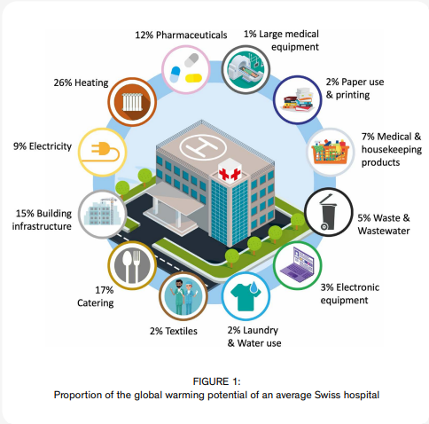
Resource efficiency in Swiss hospitals
Quelle: The Sustainable Hospital Revolution: Approaches to reduce the environmental impact

Slide 36
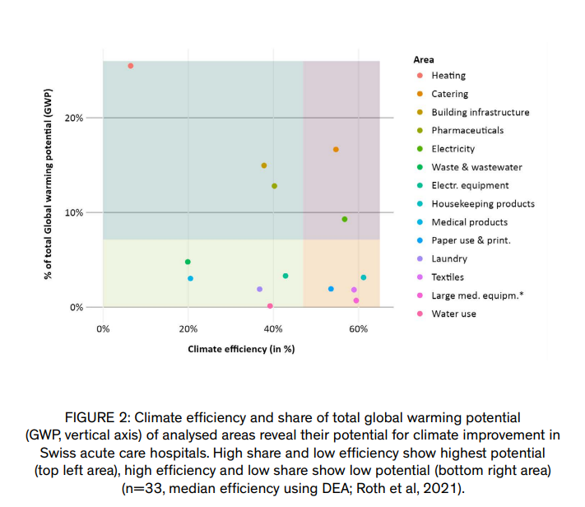
Resource efficiency in Swiss hospitals
The climate efficiency and the share of global-warming potential (GWP, vertical axis) of the examined areas show their potential for climate optimization in Swiss hospitals. Source: The Sustainable Hospital Revolution: Approaches to reduce the environmental impact

Slide 37

Challenges of modular water infrastructure systems
«In this project, we examined whether and how modular, more strongly decentralized infrastructures can be integrated into a sustainable future of urban water management. Our particular focus was on the strategic implications for Swiss regulators, operators, and technology companies in this sector.»
Prof. Dr. Bernhard Truffer, Project lead,
Challenges of modular water infrastructure systems

Slide 38
Challenges of modular water infrastructure systems – Assignments
What sustainability challenges is urban water management facing?
Explain what is meant by decentralized and modular solutions in water infrastructures.
What advantages do decentralized and modular solutions offer?
What is needed for decentralized and modular solutions to be implemented?
Sources of knowledge:
Challenges of modular water infrastructure systems (Website NFP 73)
Challenges and Opportunities of Modular water Infrastructures for Greening the Swiss Economy (Website eawag)

Slide 39

Challenges of modular water infrastructure systems – Background
Background
Urban water management is facing major sustainability challenges (climate change, emerging contaminants, aging infrastructure). Thanks to new technologies, far more decentralized and modular solutions could be used to address these problems. However, significant regulatory and operational barriers still stand in the way of their widespread adoption. To shape the innovation strategies of the various actors involved, early assessments of potential transformation dynamics are therefore essential.

Slide 40
Challenges of modular water infrastructure systems – Aim
Aim
The aim of the project was to assess recent technological developments and the overall dynamics in this industry sector in order to identify the role Swiss companies could play in this emerging economic field. We also sought to examine alternative governance structures for the development, operation, and regulation of these new infrastructures, and to develop tools that would allow us to determine the optimal transition from today’s centralized systems to more hybrid ones in the future. The challenges and opportunities along this path were to be assessed jointly with representatives from the water sector.

Slide 41
Challenges of modular water infrastructure systems – Results I
Modular water-treatment systems in practice
Modular water-treatment systems have experienced a strong surge of innovation in recent years: worldwide, new wastewater-treatment technologies, new concepts for monitoring and remote control, as well as new business models and governance approaches have been developed. In addition, modular water infrastructures are increasingly being tested both globally and in Switzerland. The first fully functional systems are already available on the market and are being piloted in civil society as well as in companies and cities.

Slide 42
Challenges of modular water infrastructure systems – Results II
High water quality with modular solutions
With decentralized wastewater treatment, water quality comparable to that of centralized plants can be achieved, while sensor technologies and remote-controlled systems enable reliable and profitable business models as well as effective governance concepts. Suitable governance structures are currently being developed, but the present capacities and resources of utilities, property owners, and regulatory authorities are still insufficient.

Slide 43
Challenges of modular water infrastructure systems – Results III
Cost assessments of modular water infrastructures
Cost estimates for the transition to hybrid infrastructures in selected Swiss municipalities show that introducing currently available modular systems would already be economically viable today. This applies not only to remote settlements, but also to suburban areas and inner-city districts—for example when former industrial sites are redeveloped. As costs continue to fall in the future, the overall market potential for modular water-treatment systems will increase.

Slide 44
Challenges of modular water infrastructure systems – Results IV
Great potential in stormwater management
Operators, planners, and regulators in Switzerland’s urban water sector consider these developments relevant for their current and future investment decisions. They point out that more active engagement with modular alternatives has so far been hindered by major uncertainties and unclear incentives. However, they see considerable future potential—especially in connection with new approaches to stormwater management.
To reap the benefits of this transition, close coordination among the different parties is required. At the same time, sunk costs and possible problem shifting must be avoided in the future.

Slide 45
Final Discussion
Discuss in pairs or groups of three at the end:
Is an ecologically and economically sustainable circular economy possible?
What contributions can policymakers, companies, and consumers make?
What can I personally do to support a sustainable circular economy?

Slide 46
Appendix

Slide 47
Further sources for in-depth study on the topic
Sanu durabilitas: Laboratory for Applied Circular Economy (LACE): knowledge transfer notes (Website with reports)

Slide 48
Use of the learning module
Geeignet für den Einsatz in Bachelorstudiengänge an Schweizer Hochschulen
Als Einführung auch geeignet für Master- und Weiterbildungsstudiengänge an Schweizer Hochschulen
Geeignet für das Selbststudium, kann auch im Präsenzunterricht eingesetzt werden
Umfang: 3-4 Stunden Lernzeit, für Vertiefung weitere 3-4 Stunden Lernzeit

Slide 49
NFP 73 Sustainable Economy: resource-efficient, future-oriented, innovative
The aim of NRP 73 is to generate scientific knowledge on a sustainable economy that uses natural resources sparingly, increases prosperity, and enhances the competitiveness of Switzerland as a business location.
Framework:
29 research projects in 9 priority areas
Duration: 2016–2023
Research period: 5 years
Funding volume: CHF 20,000,000
Acknowledgement:
The development of this learning module was made possible by SNSF / NRP 73.

