Slide 1



Sustainable Finance
A learning module for the tertiary level

Slide 2
Focus Sustainable Finance
« The transition to a sustainable economy requires investment and therefore capital. Typical examples include investments in improved resource efficiency, cleantech or sustainable mobility. At the same time, financial institutions should increasingly allocate financial resources according to ecological and social criteria. In order not to exceed planetary boundaries through economic and societal activities while simultaneously increasing prosperity, innovative financing systems are required. Sustainable finance is intended to motivate companies to invest in projects that are environmentally friendly and improve the well-being of society as a whole. Two projects focused on the financing of cleantech as well as on various issues ranging from the feasibility of a Swiss social stock exchange to the question of why companies issue green bonds»
NFP 73, Finance

Slide 3
Learning Objectives
The learner …
is familiar with the objectives of a sustainable financial system
understands the influence of green bonds—that is, bonds used to finance sustainable projects—on corporate investment decisions in favour of “green” projects
learns how the environmental and social footprint of institutional investors’ portfolios can be quantified
understands the relevance of improved access to finance for investment instruments and institutions in the microfinance sector, as well as the potential introduction of a Swiss social stock exchange
recognizes how effective environmental policy can promote investments in clean technologies
learns how new financing instruments can help stimulate investment in clean technologies

Slide 4
Introductory Questions
Please try to answer the following questions based on your prior knowledge and experience. Ideally, discuss your answers with a fellow student or colleague:
What does this topic have to do with me and my environment?
What role might financing play in the transition to a sustainable economy?
How can investment decisions influence the development of a sustainable economy?
What factors could influence investment decisions?
Which Sustainable Development Goals are particularly relevant, and which ones are they?

Slide 5


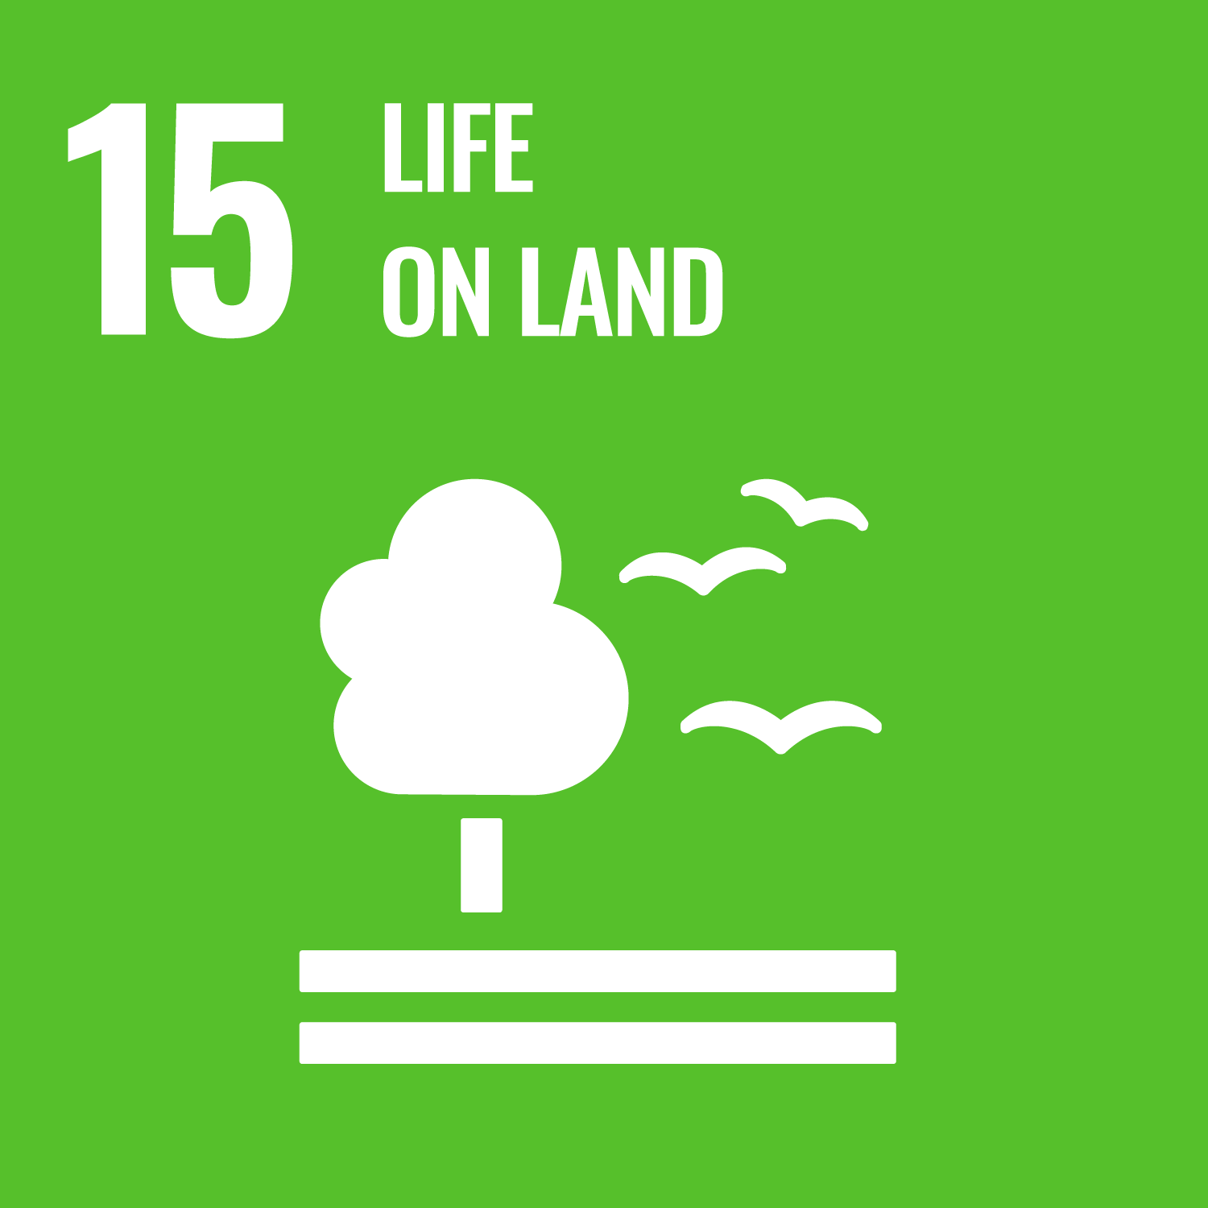

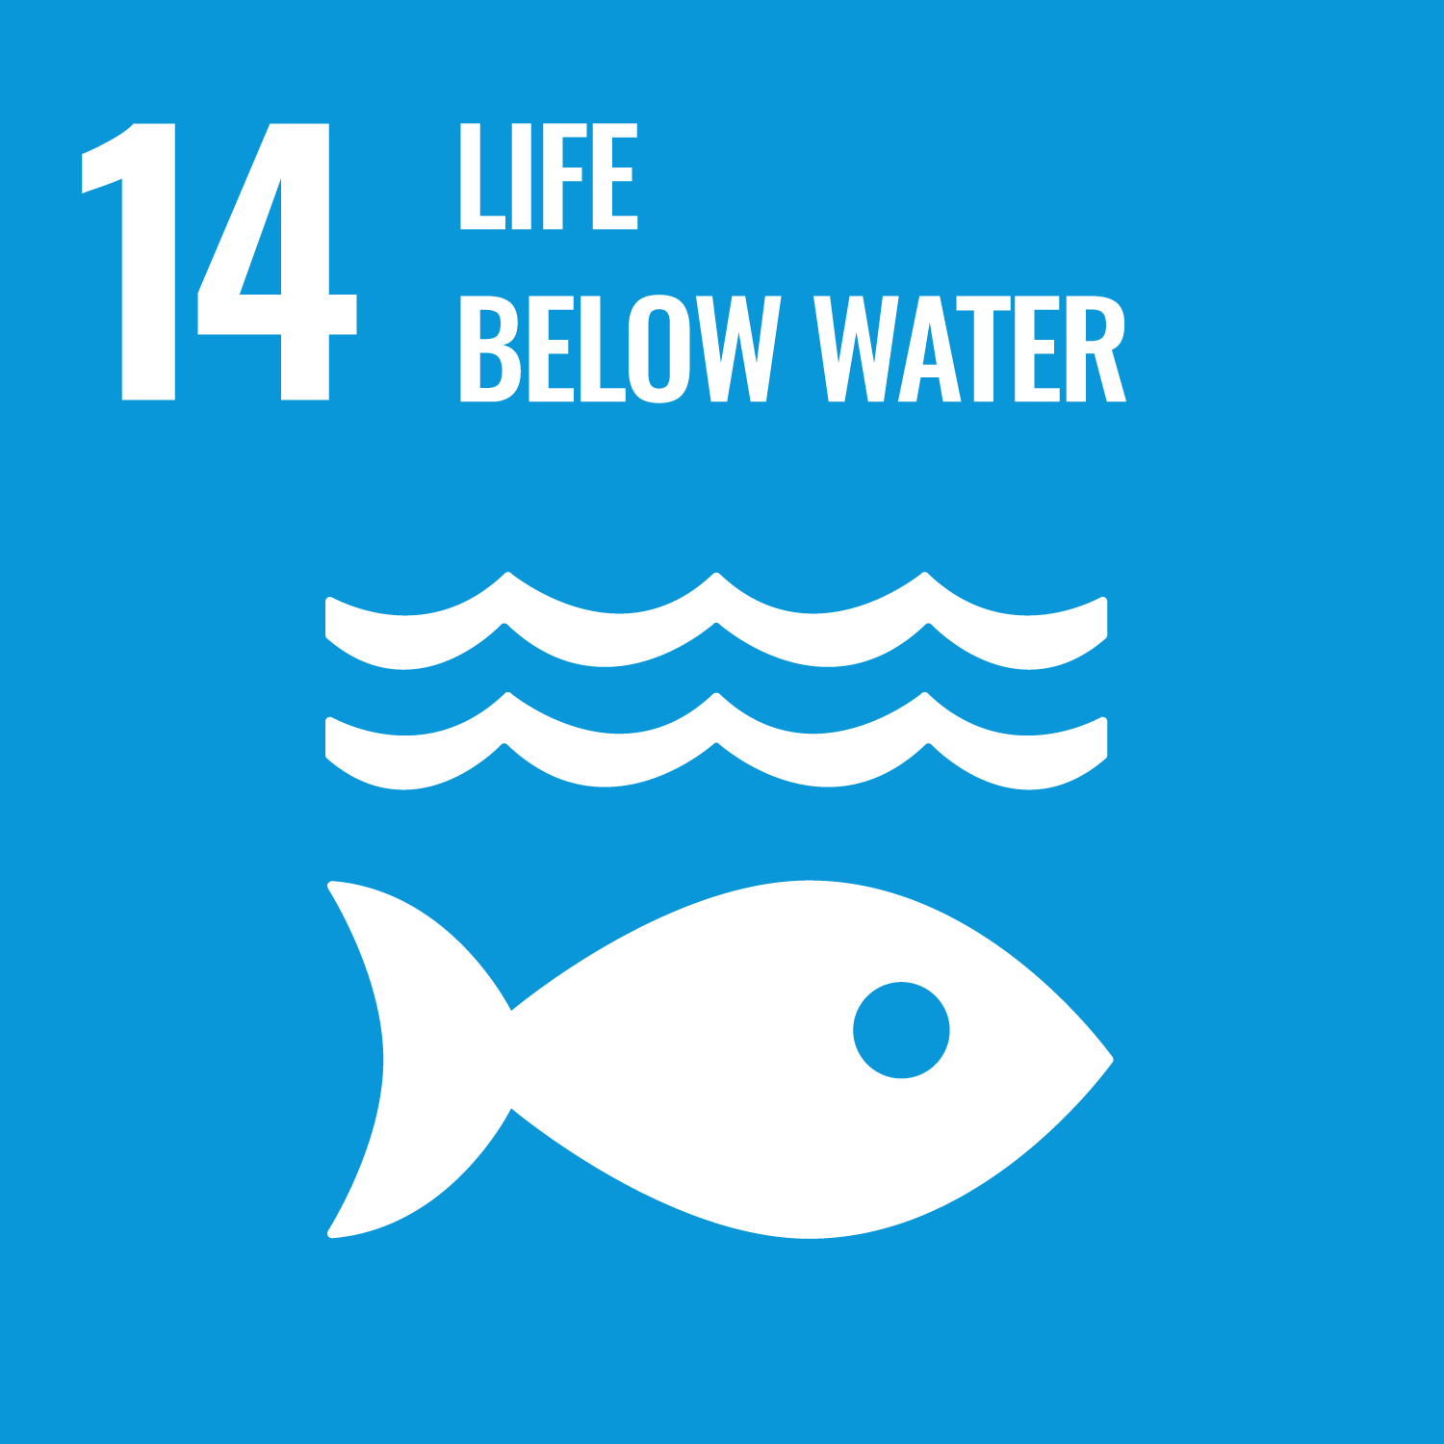
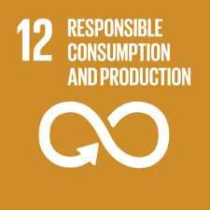
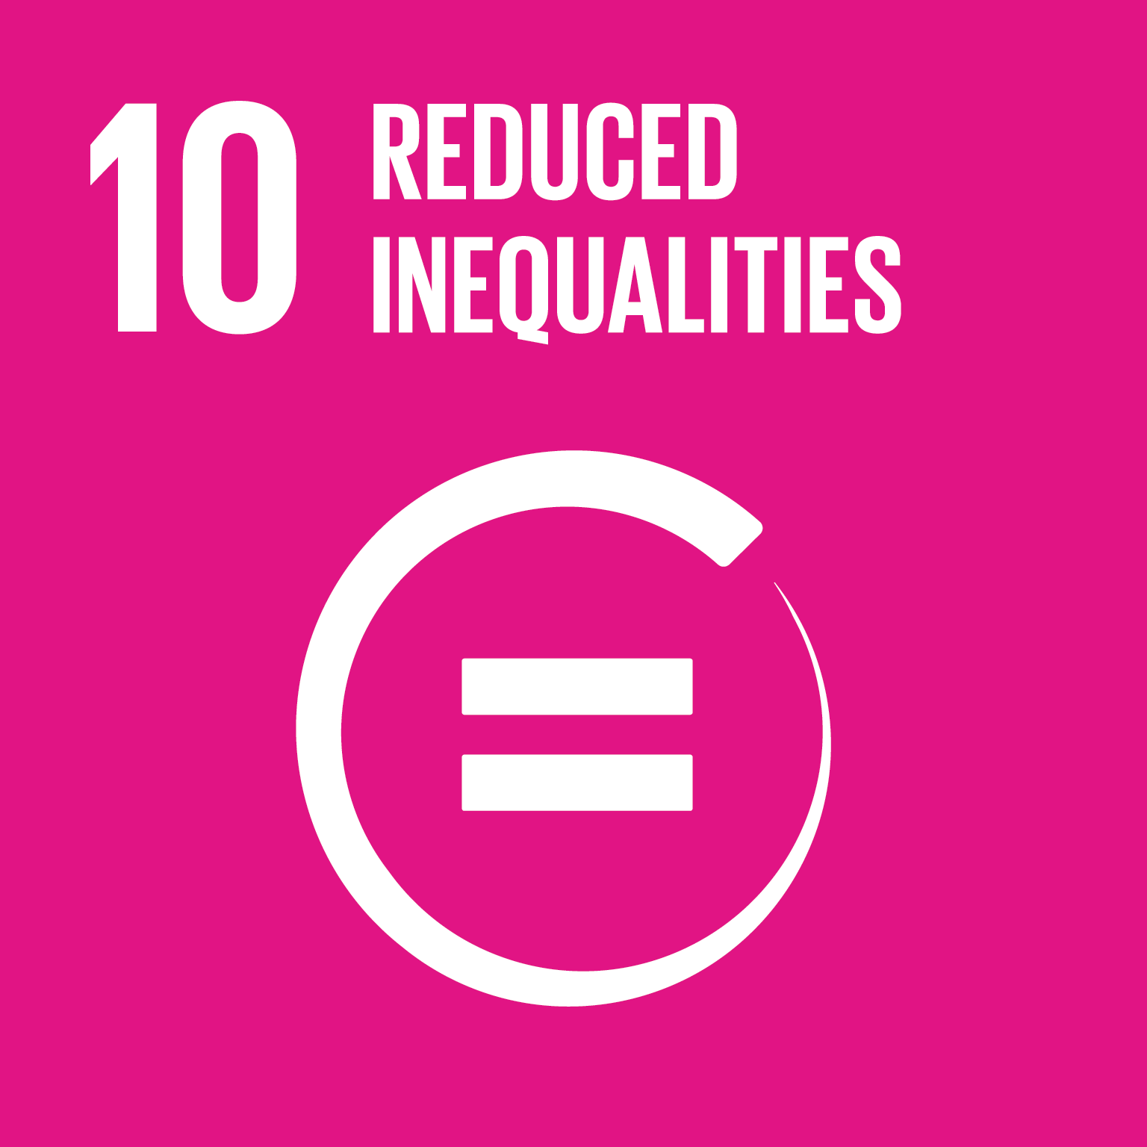
Links to the United Nations Sustainable Development Goals
Sustainable Finance

Slide 6

Overview of Research Projects
In this focus area, there were two research projects:
Financing of cleantech
Sustainable finance
https://nfp73.ch/en/projects/sustainable-finance

Slide 7
Sustainable Finance
«In this project, we examine the influence of green bonds—that is, bonds used to invest in sustainable projects—on companies’ investment decisions in favor of ‘green’ projects. In addition, we quantify the environmental and social footprint of institutional investors’ portfolios and investigate whether they actually invest responsibly when they claim to do so. The focus is on opportunities for improved access to finance for investment instruments and institutions in the microfinance sector, as well as on the possible introduction of a Swiss social stock exchange.»
Prof. Dr. Jean-Charles Rochet, Project Manager,
Sustainable Finance

Slide 8
Sustainable Finance – Assignments
What role can certifications play and how do they work?
How do ESG ratings operate and what are their shortcomings?
Which approaches can make microfinance work (e.g. for off-grid home solar systems)?
How can the concept of a Swiss social stock exchange be assessed?
Sources of knowledge:
New Approaches to Sustainable Finance (Lecture, englisch, 7:08)

Slide 9

Sustainable Finance – Background
Background
Knowledge of sustainable finance has steadily increased over recent decades. However, mainstream economic literature continues to be dominated by the view that companies are focused solely on profit maximization and pay little attention to ESG aspects (environmental, social, and governance). Accordingly, the influence of institutional investors such as banks and pension funds on ESG issues has so far been insufficiently researched. To support the financing of microfinance initiatives, the establishment of a Swiss social stock exchange would be desirable.

Slide 10

Sustainable Finance – Aim
Aim
The aim of this project was to build on the current state of research and to make both scientific and practical contributions. This was to be achieved by contributing to both the quantity and quality of available knowledge and by developing scientifically grounded recommendations, as well as a Swiss social stock exchange that supports ESG projects by providing financing for investment vehicles and institutions in the microfinance sector.

Slide 11
Sustainable Finance – Results I
Certification of financing
The first subproject shows that companies can use the certification of financing as “green” to signal that they are contributing to the energy transition. In our model of green bond issuance, this signaling effect strengthens incentives to reduce CO₂ emissions. The model is based on the hypothesis that corporate executives are more likely to issue green bonds when they have a stronger interest in share prices. We test this hypothesis by drawing on industry-specific differences in the share price sensitivity of managerial compensation and country-specific differences in effective CO₂ prices.

Slide 12
Sustainable Finance– Results II
Sustainability footprint of institutional investors
The second subproject, which focuses on the sustainability footprint of institutional investors, delivers the following key findings:
Institutional investors play an important role in promoting sustainability in the economy.
Not all institutional investors who claim to promote sustainability actually do so in practice.
An analysis of the methodologies shows that ESG ratings from different data providers are highly heterogeneous.
Such inconsistent ESG ratings are perceived by investors as an additional source of uncertainty.

Slide 13
Sustainable Finance– Results III
Sustainable microfinance
The third subproject, which focuses on sustainable microfinance, yields the following key findings:
Off-grid home solar systems (Off-Grid Solar Energy, OGS) are central to providing access to affordable, reliable, sustainable, and modern energy for low-income microenterprises in the Global South that lack access to banking services—corresponding to Sustainable Development Goal 7 (SDG 7).
Access to finance is crucial for the deployment of off-grid solar energy solutions.
Significant progress has been made in achieving SDG 7 over the past ten years, with around half of this progress attributable to OGS start-ups that supply approximately 500 million households.
Pay-as-you-go financing models have proven particularly effective, accounting for about 85% of all solar investments. Under this model, solar systems are not paid for upfront but acquired through instalment payments, while being usable from the first payment onward. This approach removes the initial investment barrier.
The global crisis has adversely affected the payment capacity of OGS customers, OGS value chains, and capital flows into this sector.

Slide 14
Sustainable Finance– Results IV
The subproject on establishing a social stock exchange in Switzerland produced the following key findings:
At the global level, there is a large market for both social enterprises and sustainable investments.
Existing initiatives to create sustainability exchanges have shown that implementation is challenging.
A successful Swiss social stock exchange would need to enter into strategic partnerships and focus on impact verification, pipeline development, and impact measurement.
It is not advisable to build an independent infrastructure from scratch.

Slide 15
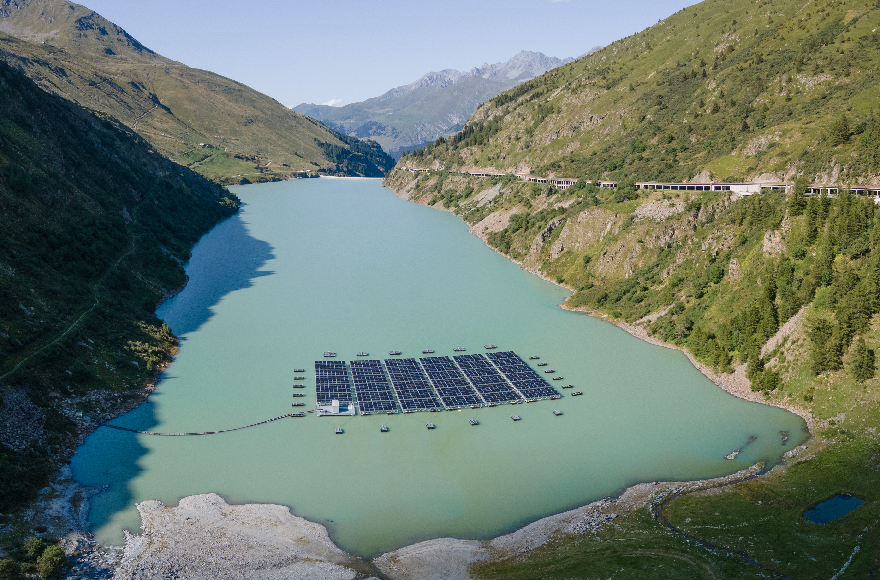
Financing of Cleantech
«This project examined how effective environmental policy and new financing instruments can help promote investment in clean technologies, such as renewable energy or electric vehicles.»
-Dr. Joëlle Noailly, Project lead, Financing of cleantech

Slide 16
Financing of Cleantech – Assignments
What is the greatest challenge in financing cleantech?
Explain how environmental policy uncertainty affects investment behavior in cleantech.
What types of investors can be distinguished, and what motives guide them?
Explain how new financing instruments for cleantech work and what they can achieve.
Source of knowledge:
«Uncertainty hinders clean tech investments – so we cannot hesitate on taking action on policy anymore» (Podcast, english, 22:35)
Finance clean tech (scientific lecture, english, 6:50)

Slide 17

Financing of Cleantech – Background
Background
In its 2022 special report, the Intergovernmental Panel on Climate Change (IPCC) stated that global annual investments of USD 2.3 trillion in low-carbon power generation technologies are required to keep global warming below 1.5°C compared to pre-industrial levels. Bloomberg New Energy Finance, however, estimates that in 2021 only USD 755 billion was invested in sectors contributing to the energy transition. A better understanding of cleantech financing is therefore crucial in light of this enormous investment gap.

Slide 18
Financing of Cleantech – Aim
Aim
The main objective of the project was to examine how society can steer investment into the cleantech sector. Many investors still regard the sector as high risk because cleantech depends on future demand for climate-friendly technologies. However, this demand is strongly influenced by political decisions, which are difficult to predict and can lead to large fluctuations in demand over time. Clean technologies are also more capital-intensive than other frontier technologies and are therefore less attractive to traditional, established investors.
Accordingly, the project investigated:
Projekt 1) how environmental policy uncertainty affects investment in a low-carbon economy; and
Projekt 2) whether new financing instruments can attract investors to support cleantech start-ups.

Slide 19
Financing of Cleantech – Results
The project results show that effective and consistent environmental and climate policy is crucial for steering investment into this sector and for enabling cleantech markets to emerge. Political uncertainty has negative effects and leads to delays in investment, despite the urgency of climate action. The analyses of new financing instruments indicate that tools such as start-up competitions and/or crowdfunding can be useful complements in promoting environmentally friendly investment. However, they are not a silver bullet for closing the financing gap.

Slide 20
Final Discussion
Conclude by discussing the following questions in pairs or small groups of three:
What are the most important facts and relationships that I have learned?
How would I concretely improve the financing of projects that promote a sustainable economy?
hat can I personally already contribute now?

Slide 21
Appendix

Slide 22
Further sources for in-depth study on the topic
Swiss Sustainable Finance Academy

Slide 23
Use of the learning module
Suitable for use in Bachelor’s degree programmes at Swiss higher education institutions
Also suitable as an introduction for Master’s and continuing education programmes at Swiss higher education institutions
Suitable for self-study; can also be used in face-to-face teaching
Scope: 3–4 hours of learning time, with an additional 3–4 hours for further in-depth study

Slide 24
NFP 73 Sustainable Economy: resource-efficient, future-oriented, innovative
The aim of NFP 73 is to generate scientific knowledge on a sustainable economy that uses natural resources sparingly, increases prosperity, and enhances the competitiveness of Switzerland as a business location.
Framework:
29 research projects in 9 priority areas
Duration: 2016–2023
Research period: 5 years
Funding volume: CHF 20,000,000
Acknowledgement:
The development of this learning module was made possible by SNSF / NFP 73.

