Slide 1

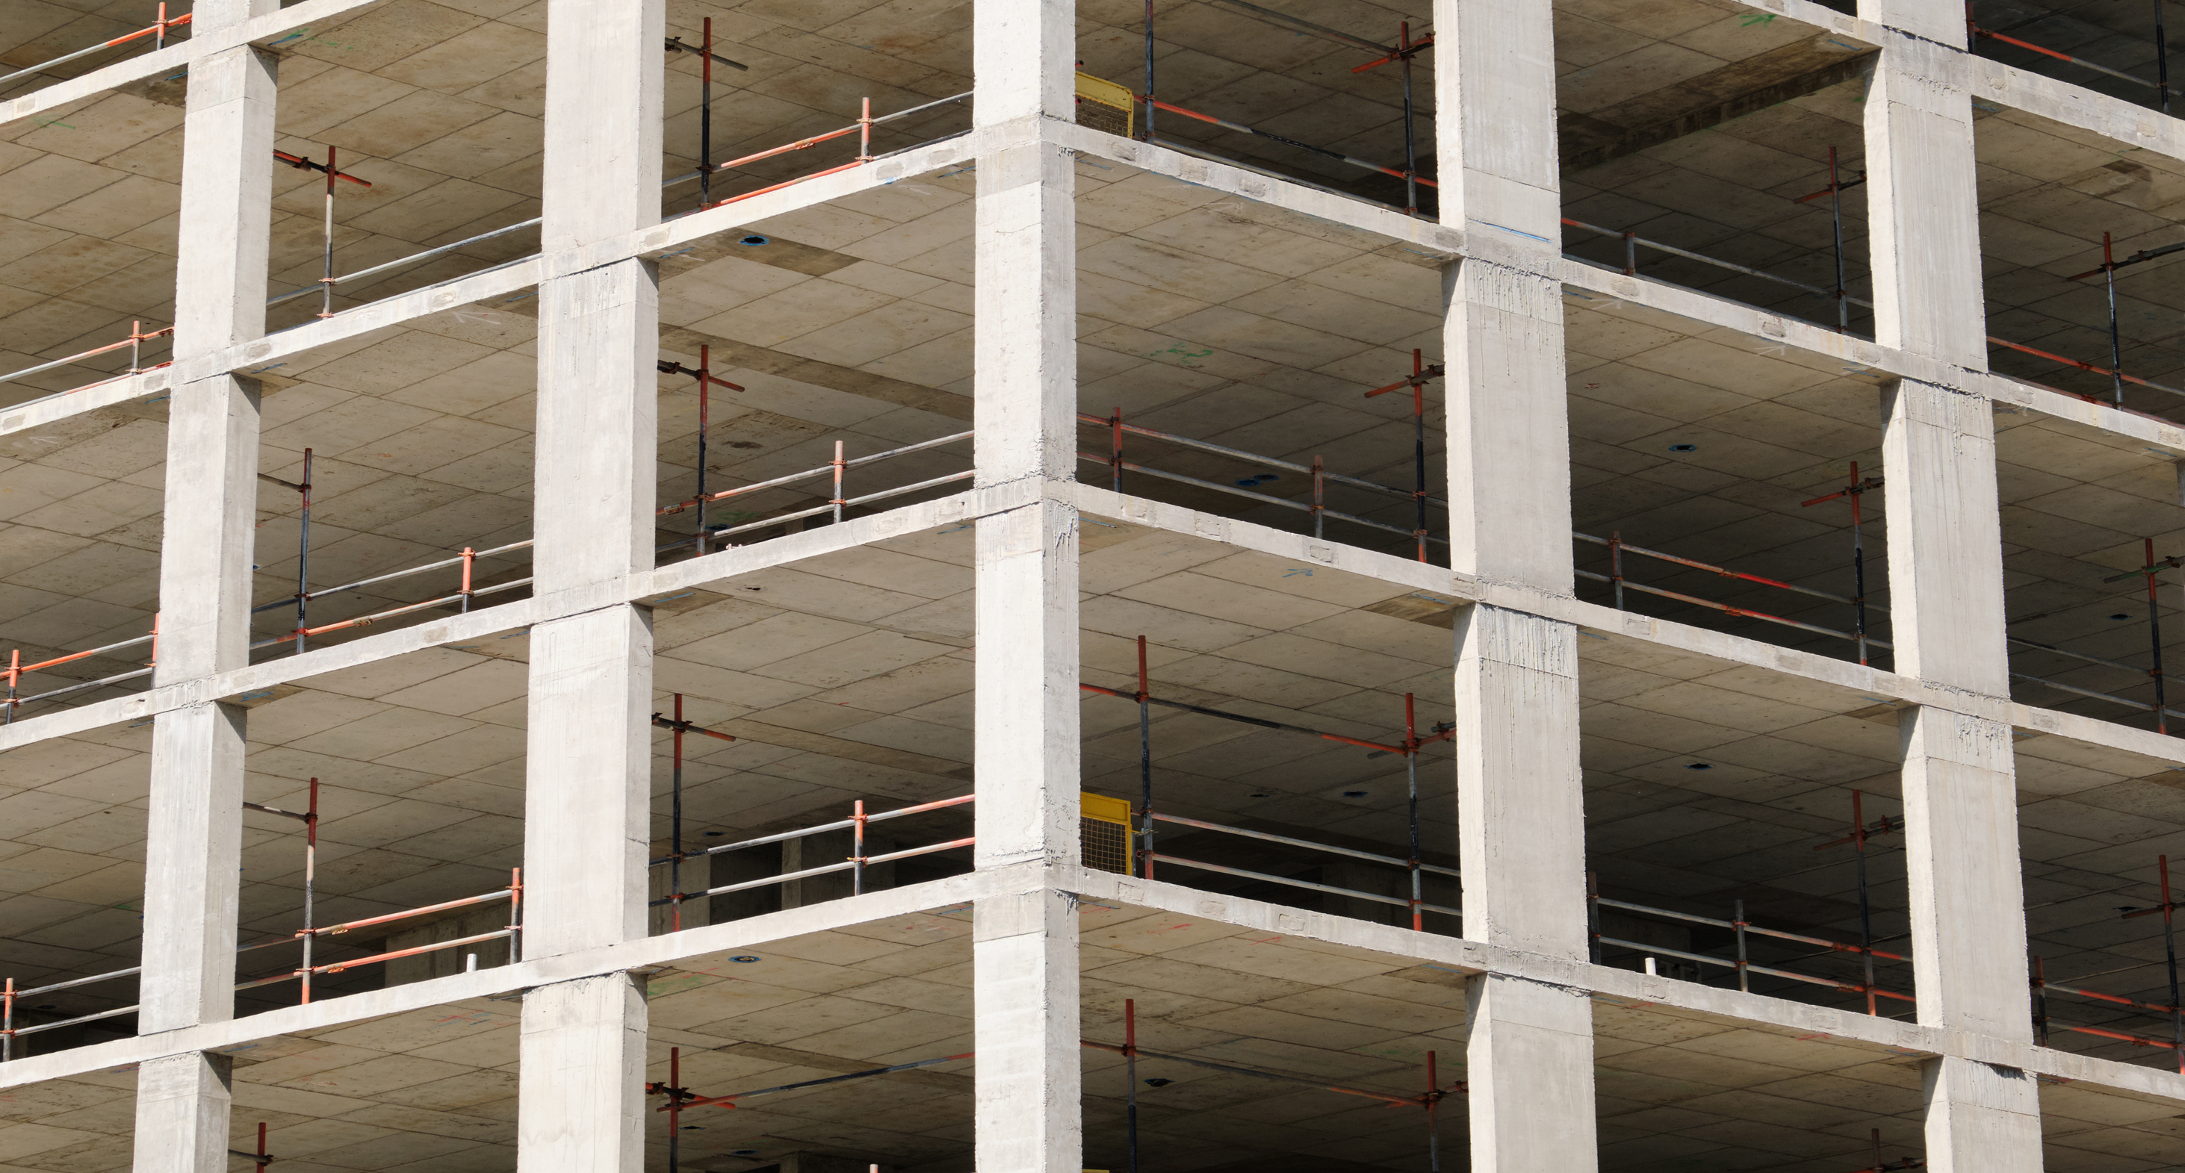

Building and Construction
A learning module for the tertiary level

Slide 2

Focus Building and Construction
«The ecological footprint of residential buildings decreases when
(i) demand for living space and
(ii) material and energy use over the life cycle of residential buildings change.
In the Co-Creation Lab (CCL) ‘Sustainable Living and Building,’ these two aspects were combined and more than 70 experts were involved through workshops and interviews.»
NFP 73, Building and Construction

Slide 3
Learning Objectives
The learner …
understands the major importance of building and housing for sustainable development,
knows how housing demand has developed over the past 40 years,
knows which solution approaches have been proposed,
recognises the problem of the large volume of construction waste, and
understands solutions for a circular economy in building construction and how business models in the construction sector must adapt for this purpose.

Slide 4
Introductory Questions
Please try to answer the following questions using your prior knowledge and experience. Ideally, discuss your answers with a colleague:
What does “living” mean to me, and what is important to me about it?
How many square metres do I currently use for housing?
Which forms of housing can I imagine for myself—now and in the future—and why?
What do you already know about recycling in the construction industry?
What do you think—how could the reuse of building materials be promoted?
Which sustainability goals are particularly relevant here, and what are they?

Slide 5
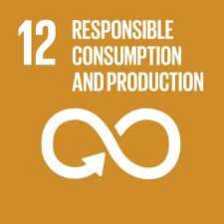
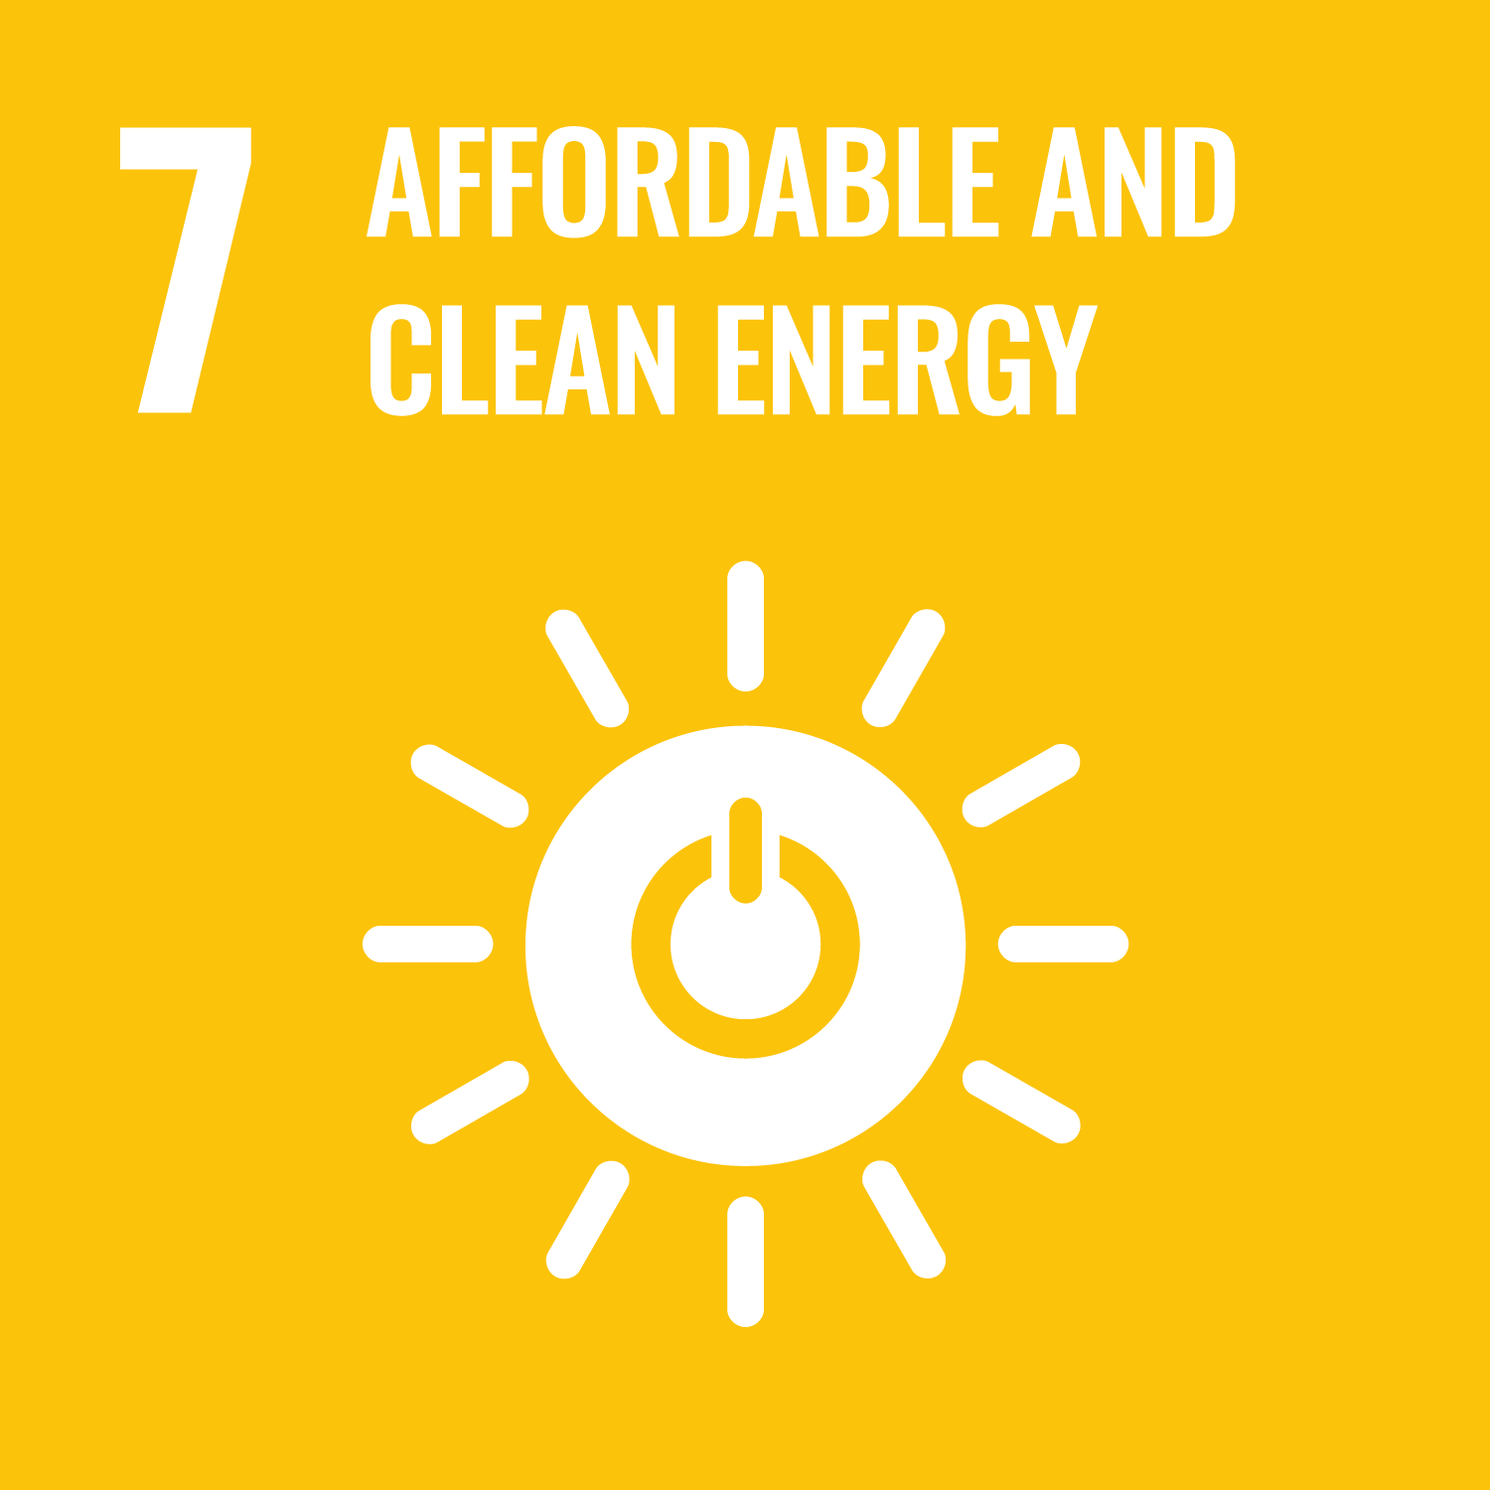



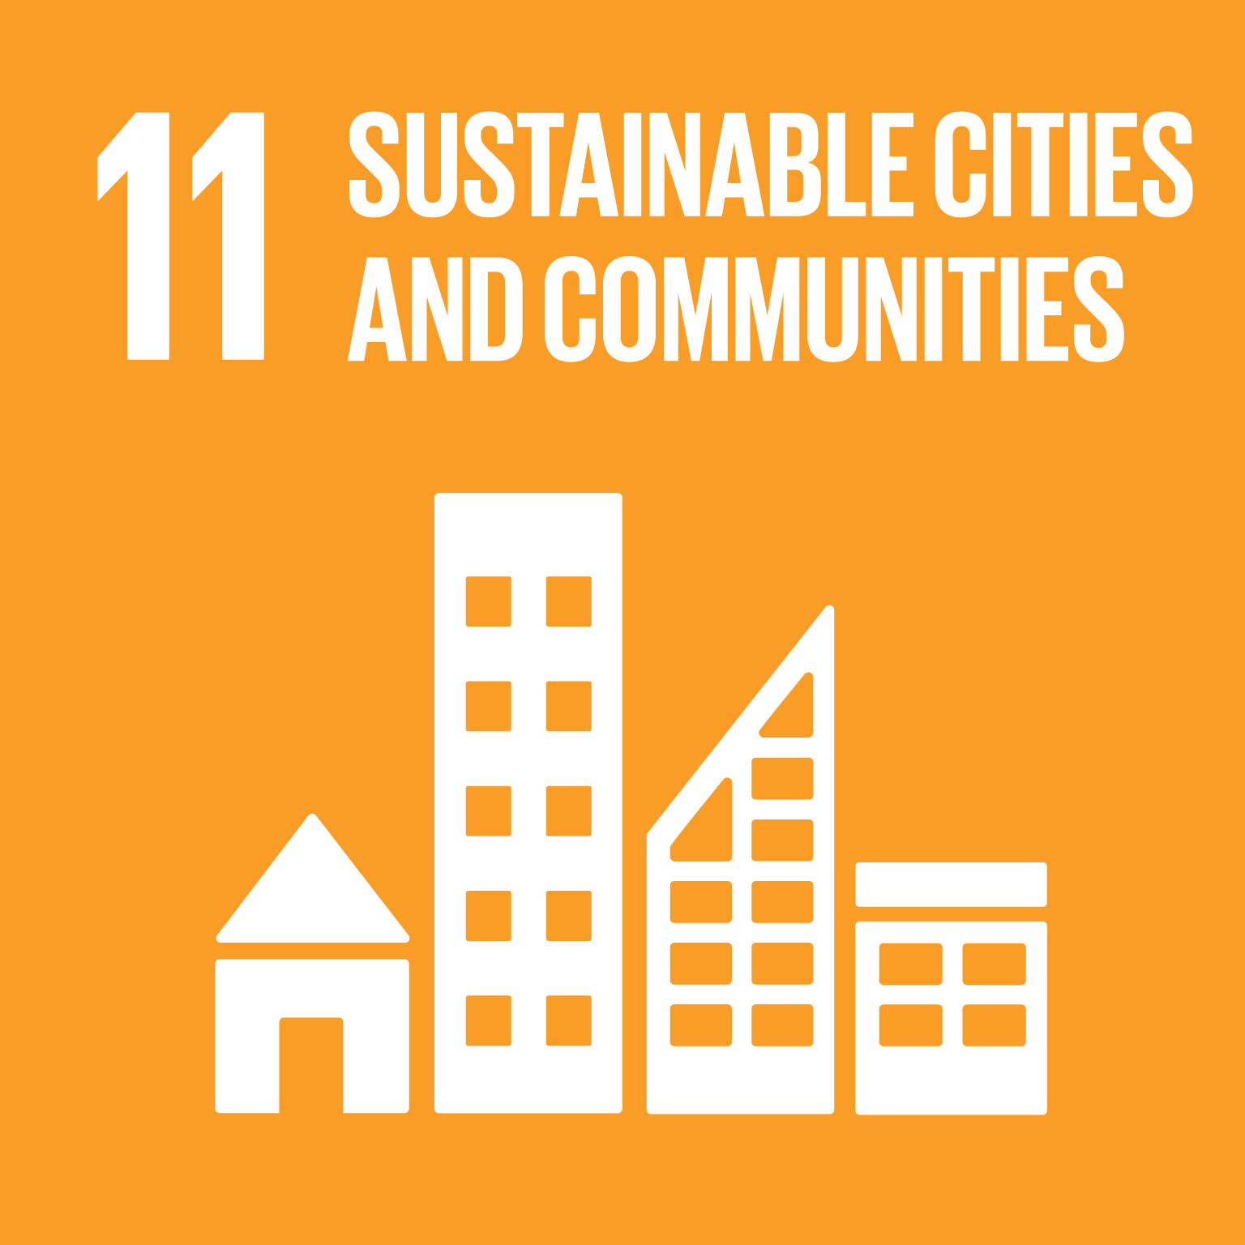
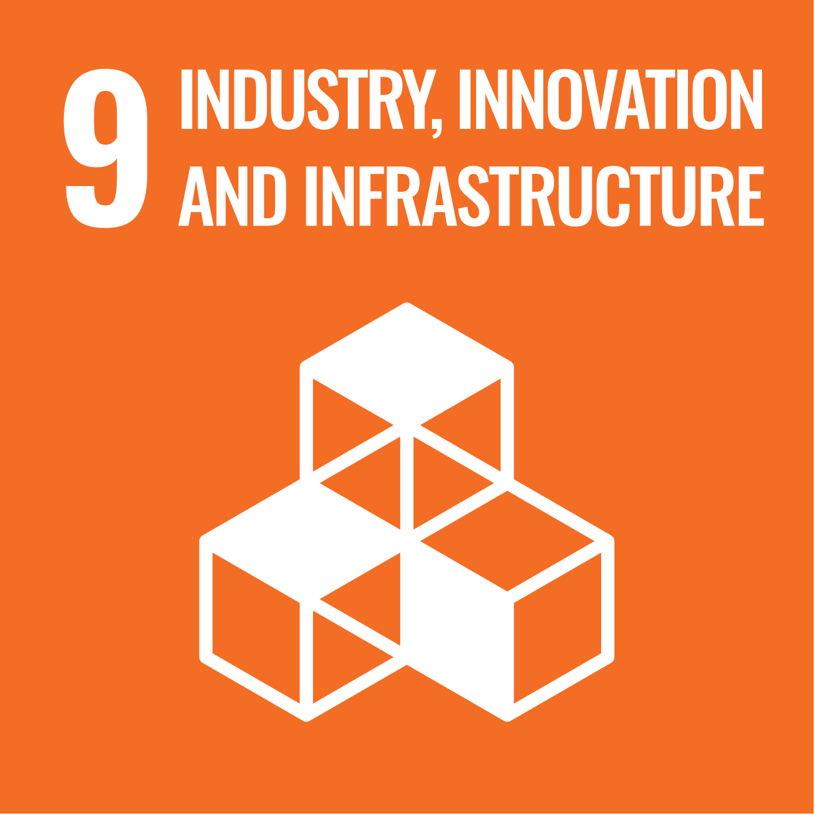
Links to the United Nations Sustainable Development Goals
Building and Construction

Slide 6
Introductory Questions
Which factors are responsible for the strong growth in residential floor area in Switzerland over the past 40 years?
Which other factors also determine the ecological footprint of housing?
What is the situation regarding the recycling of construction materials in Switzerland?
Sources of knowledge:
Improving the use of the housing stock to reduce its environmental impact (Policy Brief)
«Sustainable housing should integrate the needs of tenants in its design» (Podcast, 25:45)

Slide 7
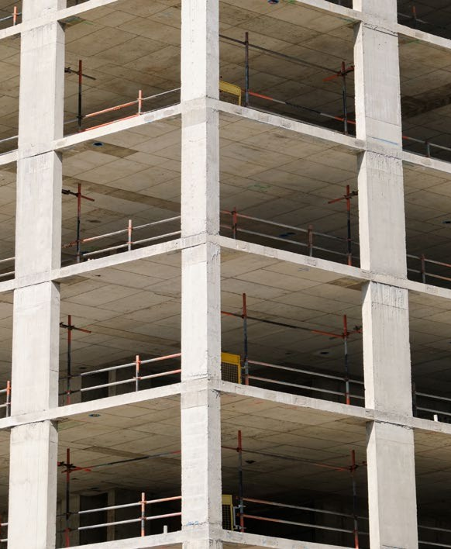
Pathways to sustainable construction and housing – Background
Background
The impacts of climate change are becoming increasingly evident, and rising energy prices as well as supply shortages of energy and building materials show that our economic systems have vulnerabilities. Housing shortages are currently high on Switzerland’s political agenda.
The Co-Creation Lab (CCL) “Sustainable Living and Building” presents a vision for sustainable construction and housing: healthy residential developments that operate without fossil fuels in construction and maintenance, rely exclusively on secondary resources, and provide sufficient affordable housing for all people.

Slide 8

Pathways to sustainable construction and housing – Aim
Aim
The CCL aims to help close the gap between today’s situation and this vision and to drive the transition process forward. To this end, it provides knowledge and offers a space for debate, mutual learning, and creative thinking. The focus lies on topics in which the research team can demonstrate success in both scientific and applied research. The goals are
  to provide guidance for stakeholders and interested organisations, and
  to help set an agenda and pave the way for concrete actions.

Slide 9
Sustainable construction 2050 – Results I
This collaborative project showed that the transition toward sustainable living and building must address both demand and supply. The focus should be on
reversing the trend of increasing per-capita demand for residential floor area (demand side), and
improving energy and material efficiency in the operation and construction of buildings (supply side).

Slide 10
Sustainable construction 2050 – Results II
Material cycles in construction
Strategies to influence demand are central, as Switzerland is expected to see population growth of around 20% by 2050 and an increasing share of older people (over 65). Nevertheless, we can achieve our climate targets by 2050 if we fully exploit all opportunities to phase out fossil fuels. By contrast, we will not be able to close material cycles in the construction sector by 2050, because infrastructure will still need to be built to serve a growing population. The transition is only feasible if all involved actors work toward it:
  industry (energy supply, building materials, construction, real estate, financial services),
  public authorities (municipalities, cantons, federal government),
  planners (architectural and engineering firms), and
  households (building owners and tenants).
Collaboration should focus on shared learning processes that foster innovation and help manage and share risks. We are convinced that urgent action is required simultaneously in several areas.

Slide 11
Sustainable construction 2050 – Results III
Initiating transformation processes with a long-term horizon:
forest management to increase the production of construction timber, and
design and development of circular buildings, components, and materials for disassembly, reuse, and recycling.
Accelerating transformation processes already underway:
replacing fossil fuels in building energy supply and in the production of construction materials, and
increasing the share of biomass-based materials (e.g., wood) as well as reused/recycled materials.

Slide 12
Sustainable construction 2050 – Results IV
Promoting social innovation and institutional development
The role of these factors in the transformation process is not yet sufficiently recognised. They could
increase residential mobility among households, and
foster collaboration and mutual learning among actors in the planning process (clients, architectural and engineering firms, construction companies, material manufacturers, etc.) as well as among different professionals in the housing and construction sectors.

Slide 13
Overview of Research Projects
In this focus area, there were two research projects:
Ecological footprint in the housing sector
Aligning resource policy and business strategies in the construction sector

Slide 14
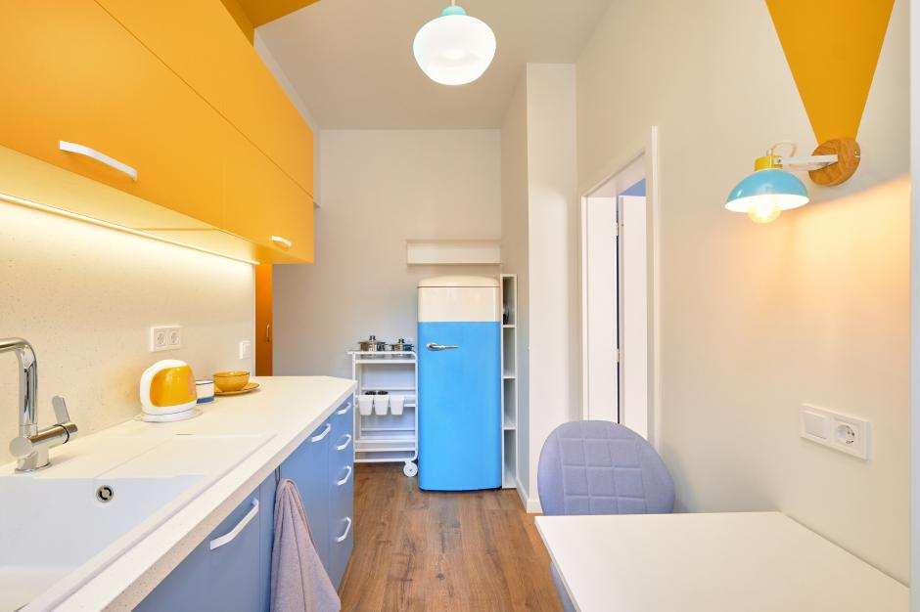
Ecological footprint in the housing sector
«The subject of this project was measures to reduce resource consumption in the housing sector during the construction, use, and renovation phases of residential buildings. In doing so, we developed different approaches for residents (which functions do they associate with housing?), building owners (e.g. rental management), and public authorities (e.g. support for housing cooperatives).»
Prof. Dr. Philippe Thalmann, Project lead, Ecological footprint in the housing sector

Slide 15
Ecological footprint in the housing sector –
Assignments
Which aspects of housing have the strongest influence on the ecological footprint?
What does “sufficiency” mean — in general and in the context of housing?
Why do many people not want to move into a smaller appartment when their life circumstances change (e.g. when children move out)?
Which solution approaches are proposed?
Sources of knowledge:
Improving the use of the housing stock to reduce its environmental impact (Policy Brief)
«Sustainable housing should integrate the needs of tenants in its design» (Podcast, 25:45)
Ecological footprint in the housing sector (scientific lecture, 6:45)

Slide 16

Ecological footprint in the housing sector –
Background
Background
The project combined methods from the natural and social sciences. A key feature was the involvement of two housing cooperatives—ABZ (Zurich) and SCHL (Lausanne)—as well as the insurance company and asset manager Swiss Mobiliar, whose housing portfolios, totalling around 10,000 apartments, were analysed in depth. Together with these partners, we developed measures to improve resource efficiency and simulated the impact of these measures on the ecological footprint of the housing stock.

Slide 17
Ecological footprint in the housing sector – Aim
Aim
The aim of this project was to better understand by what means, and to what extent, the environmental footprint of buildings can be reduced. We discussed the project’s results with a range of building owners and tenants, together with whom we developed effective and consensus-based recommendations whose impacts on comfort, costs, returns and resource consumption were modelled and made transparent. In this way, it is possible to present viable paths for sustainable living.

Slide 18
Ecological footprint in the housing sector – Results I
We carried out a detailed assessment of the current situation and the historical development of the building, apartment, and tenant portfolios of our three collaboration partners: the two housing cooperatives
ABZ (Zurich)
SCHL (Lausanne), as well as
the Swiss Mobiliar Insurance Company.
Using a mass and energy flow model, we quantified resource demand and environmental impacts. On the one hand, we collected data on determining factors influencing relocation decisions (how often?) and housing choices (where? how large?). On the other hand, we analysed resource efficiency in construction and the key factors influencing renovation or demolition (when and how often?). Based on these data, we developed agent-based models that link the decisions of tenants with those of building owners. Through this dynamic modelling, we simulated different development and resource-efficiency pathways.

Slide 19
Ecological footprint in the housing sector – Results II
Increasing resource efficiency through restrictive letting practices
In a first scenario, property owners apply a relatively restrictive letting rule: an apartment is rented to a household with at least as many people as it has rooms, but no more people than the number of rooms plus two. Even though this rule is applied only when the lease is signed and its later compliance is not monitored, the increase in per-capita living space over the next thirty years slows from 11% in the reference scenario to 5.7%.
Increasing resource efficiency through restrictive building development
In a second scenario, the ability of property owners to construct new residential buildings is reduced by a factor of five in order to encourage densification of existing housing stock. As a result, the increase in average residential floor area over the next thirty years declines from 6.3% in the reference scenario to 3.2%.

Slide 20
Ecological footprint in the housing sector – Results III
Increasing resource efficiency through greater sustainability awareness
In a third scenario, we assume growing environmental awareness among households, leading them to increasingly seek homes whose size better matches household size. This also includes tenants moving out of apartments that are too large for their needs. Without additional supply-side changes, the growth in average per-capita residential floor area decreases from 11% to 6.4%.
The best results can be achieved through a combination of the measures described above.

Slide 21
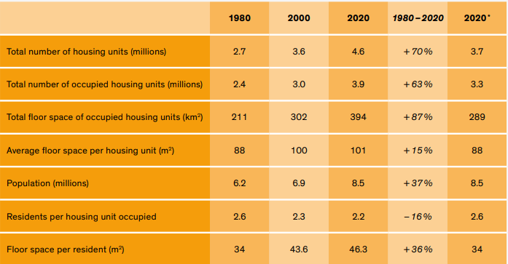
Ecological footprint in the housing sector
Housing stock and population. FSO data. * Housing stock in 2020, assuming population growth had been the only factor driving the increase in the number of housing units and total residential floor area.. Source: Improving the use of the housing stock to reduce its environmental impact (Policy brief)

Slide 22
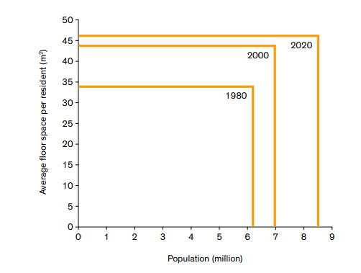
Ecological footprint in the housing sector
Total residential floor area in Switzerland. The area of the rectangles corresponds to the total residential floor area. Source: Improving the use of the housing stock to reduce its environmental impact (Policy brief)

Slide 23
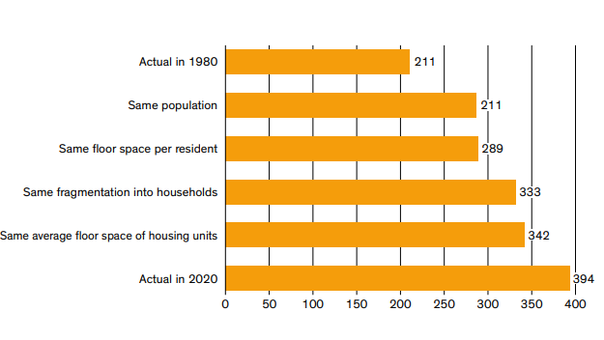
Ecological footprint in the housing sector
Total floor area of residential properties occupied in 2020 with characteristics of 1980 (km²) Source: Improving the use of the housing stock to reduce its environmental impact (Policy brief)

Slide 24

Co-evolution of business strategies and resource policies in the building industry
«Since large quantities of materials arise in the construction sector, policymakers are creating a variety of incentives to promote the reuse of construction waste. In reality, however, material cycles in construction cannot currently be fully closed, as the amount of construction waste generated is significantly smaller than the demand for construction materials. In the future, the gravel and concrete industry will therefore be particularly challenged, and policymakers must establish appropriate framework conditions.»
Prof. Dr. Susanne Kytzia, Project lead, Co-evolution of business strategies and resource policies in the building industry

Slide 25
Co-evolution of business strategies and resource policies in the building industry – Assignments
Why is a circular economy also needed in the construction sector?
Why are many mineral raw materials from construction waste still not recycled in Switzerland? What are the main barriers?
Which approaches could promote the recycling of construction waste?
In which direction should business models develop in this context?
Sources of knowledge:
Co-evolution of business strategies and resource policies in the building industry (scientific lecture, 7:05)

Slide 26
Co-evolution of business strategies and resource policies in the building industry – Background
Background
Mineral construction materials such as gravel are an important domestic resource, but their use leads to substantial material flows and transport volumes. Closing material cycles offers a solution to reduce both. Construction companies can thus become service providers in material management, making their revenue and profits less dependent on raw material consumption.
The current transition toward a circular economy in the construction sector presents an opportunity in this regard. It is being driven by changes in political and regulatory framework conditions across various policy areas, particularly in waste management.

Slide 27
Co-evolution of business strategies and resource policies in the building industry – Aim
Aim
The project demonstrates how economic transformation and changes in legal and political framework conditions can be aligned more effectively. In doing so, we aim to show policymakers and public administrators which measures and instruments can promote a circular economy in the construction sector and support the efficient use of mineral resources. Our findings are intended to help construction companies further develop their business models in line with a sustainable economy

Slide 28
Co-evolution of business strategies and resource policies in the building industry – Results I
The analysis of regional value chains for gravel and concrete identifies construction planning and execution as key processes
This is where the greatest value creation occurs, where environmentally relevant decisions are made, and where economic risks are highest. Many construction companies are therefore expanding their business strategies to include material management activities (production, logistics, recycling, and disposal).
In densely built regions with high construction activity, this trend is most pronounced, as construction increasingly expands vertically and in depth. As a result, the volume of material requiring disposal (excavated material and mineral construction waste) in these regions exceeds the demand for mineral construction materials. However, this opportunity to develop a circular economy in the construction sector has so far only been partially realised.

Slide 29
Co-evolution of business strategies and resource policies in the building industry – Results II
Overview of development barriers
Limited disposal capacity lowers gravel prices :
Since uncontaminated excavated material is currently deposited in depleted gravel pits, limited disposal capacity leads to low gravel prices. As a result, there are hardly any economic incentives to produce recycled gravel by washing uncontaminated excavated material or through construction waste recycling. At the regional level, a circular economy for mineral construction materials therefore offers no economic advantages.
Interregional trade complicates governance :
Regional shortages of gravel or disposal capacity are compensated by imports from other regions. Without political incentives, a circular economy does not emerge in regions with scarce raw materials or limited land reserves. Improved coordination across cantons could significantly increase policy effectiveness. Cantons or regions that currently have economically strong gravel, cement, and concrete industries could thus play a key role in establishing a circular economy.

Slide 30
Co-evolution of business strategies and resource policies in the building industry – Results III
High risks hinder learning processes:
The construction sector already achieves high recycling rates today. If the volume of mineral construction waste grows more strongly in the future than the demand for mineral resources, the recovery of construction waste will become more challenging and more expensive. To prevent declining recycling rates in such a scenario, currently fragile markets for secondary resources must be actively supported

Slide 31
Final Discussion
Discuss in pairs or small groups at the end:
Which measures would I take to improve the ecological footprint of housing?
Which forms of housing would I promote? And how?
How would I increase the share of recycled materials in construction?
What can I personally contribute to solving the problem—both now and in the long term?

Slide 32
Appendix

Slide 33
Further sources for in-depth study on the topic

Slide 34
Use of the learning module
Suitable for use in Bachelor’s degree programmes at Swiss higher education institutions
Also suitable as an introduction for Master’s and continuing education programmes at Swiss higher education institutions
Suitable for self-study; can also be used in face-to-face teaching
Scope: 3–4 hours of learning time, with an additional 3–4 hours for further in-depth study

Slide 35
NFP 73 Sustainable Economy: resource-efficient, future-oriented, innovative
The aim of NFP 73 is to generate scientific knowledge on a sustainable economy that uses natural resources sparingly, increases prosperity, and enhances the competitiveness of Switzerland as a business location.
Framework:
29 research projects in 9 priority areas
Duration: 2016–2023
Research period: 5 years
Funding volume: CHF 20,000,000
Acknowledgement:
The development of this learning module was made possible by SNSF / NFP 73.

