Slide 1


Cities and Mobility
A learning module for the tertiary level

Slide 2
Focus Cities and Mobility
«Key elements of a planned sustainable city include low energy consumption, sustainable land use, building structures that are kept in circular use, and social justice. With the continuing trend toward urbanisation, both the demand for residential and commercial space and energy consumption are increasing. In addition, more waste is being generated. A sustainable economy requires a major transformation of the infrastructure of urban areas as well as of private and public transport. To become sustainable, cities must confront these challenges. The topic of ‘sustainable mobility’ has been a focus of Swiss policy for years. Nevertheless, mobility continues to grow and contributes significantly to greenhouse gas emissions. In the long term, Swiss mobility is intended to be environmentally friendly (net zero), economically efficient, and at the same time accessible to all population groups and regions of the country.»
NFP 73, Cities and Mobility

Slide 3
Learning Objectives
The learner …
knows the major challenges facing cities and their mobility systems,
understands approaches and measures for more sustainable mobility,
knows how much different approaches and combinations of approaches contribute to achieving the net-zero goal, and
recognises the potential of serious games for understanding sustainability strategies.

Slide 4
Introductory Questions
Please try to answer the following questions using your prior knowledge and experience. Ideally, discuss your answers with a colleague:
How can cities become more sustainable?
How can cities become “post-fossil cities”?
Which approaches seem promising to me for achieving the net-zero goal in passenger mobility?
Which sustainability goals are particularly relevant here, and what are they?

Slide 5
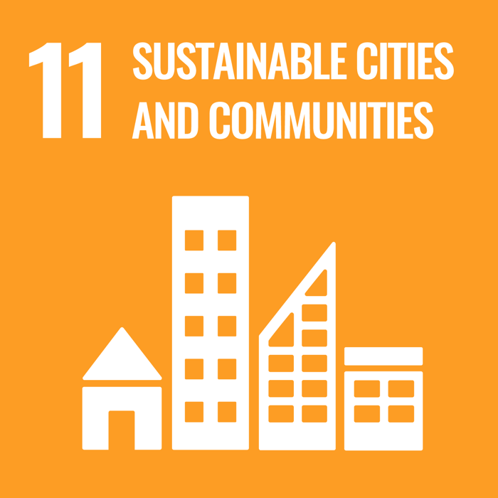




Links to the United Nations Sustainable Development Goals
Cities and Mobility

Slide 6
Introductory Questions
What does a “push & pull” mix of measures in mobility mean?
How is sustainable mobility policy connected to energy policy?
Is climate-neutral passenger mobility possible without a loss of prosperity?
Source of knowledge:
Decarbonising the transport sector (Policy Brief)

Slide 7
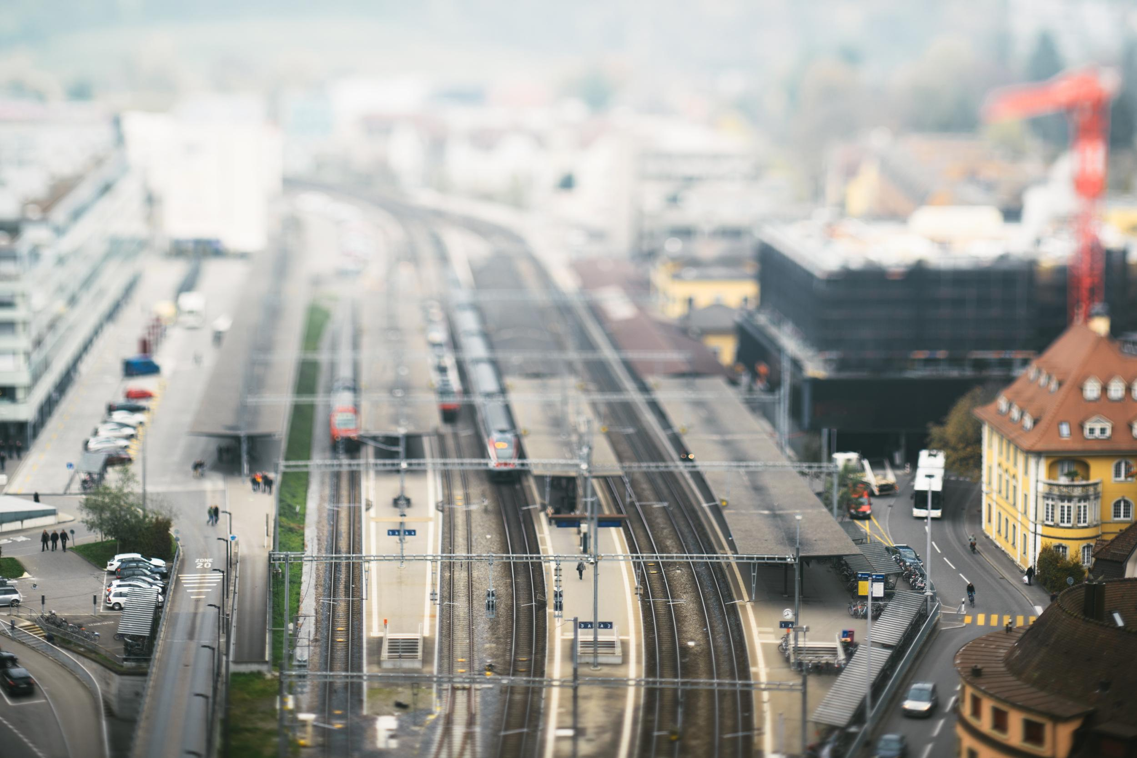
Overview of Research Projects
In this focus area, there were two research projects:
Post-fossil cities
Climate-neutral mobility without economic losses

Slide 8

Post-fossil cities
«The simulation game “postfossilCities” provides an experimental space for exploring the transformation toward climate-neutral, post-fossil cities. The game is aimed especially at current and future decision-makers, but is suitable for anyone interested. postfossilCities can be played in facilitated workshops that are held either in person or virtually.»
Dr. Patrick Wäger, Project lead, Post-fossil cities

Slide 9
Post-fossil cities – Assignments
What does “post-fossil cities” mean?
What are the goals of simulation games such as “Post-fossil Cities”?
Which aspects should one pay particular attention to when playing?
Sources of knowledge:
Post fossil cities (scientific lecture, 7:25)
The “postfossilCities” simulation game
Project website Empa

Slide 10

Post-fossil cities – Background
Background
To achieve the climate goals of the Paris Agreement, it is essential to actively reflect on the process of transforming cities through an inter- and transdisciplinary approach. This requires methods and tools such as system modelling and games that enable a systems perspective on change. Games foster experiential learning and personal engagement among participants, and system models allow them to test how effective policy measures might be.

Slide 11
Post-fossil cities – Aim
Aim
The main goal of this project was to develop and apply a versatile simulation game that enables relevant stakeholders to identify and evaluate transformation pathways toward the city of the future while taking ecological and social conditions into account. In addition to elements such as roles, a game board, and action cards, the game includes a model of the socioeconomic metabolism of the Swiss economy (with a focus on housing and transport) as well as a software program to simulate this and supplementary models. In this way, players can test potential pathways toward a post-fossil city from a systems perspective.

Slide 12
Post-fossil cities – Results I
Playing through the transformation to a post-fossil city
With this simulation game, climate-change mitigation measures can be tested in a collaborative, experimental environment, allowing players to experience synergies and trade-offs among societal actors. It is aimed at current and future decision-makers and informs them about key aspects of the transformation toward post-fossil cities, but can be played by anyone interested. The game is available in English and German and is suitable for facilitated workshops lasting 3 to 8 hours, held either in person or virtually, and designed to make participants aware of climate change and the urgency of climate action. Players learn how to prioritise mitigation measures based on their effectiveness and time horizon. This can lead them to reconsider existing mental models—for example, their perceived influence on climate targets.

Slide 13
Post-fossil cities – Results II
Sector-specific scenarios illustrate the effects of climate measures I
To simulate transformation pathways for the city of the future—as well as to analyse climate measures in the housing sector and private car transport in Switzerland—several models of socioeconomic metabolism were developed. The scenario analysis for the two sectors showed that technology-oriented measures to reduce greenhouse gas emissions are very efficient, such as phasing out fossil fuels, higher energy standards and renovation rates, or the electrification of vehicles. However, in many cases their full effect only unfolds with significant delays, because replacing existing technologies takes a long time. By contrast, behavioural measures were found to reduce direct energy consumption very effectively and immediately. These include, for example, lower indoor temperatures, reducing heated living space per person, or using carpooling.

Slide 14
Post-fossil cities – Results III
Sector-specific scenarios illustrate the effects of climate measures II
The analysis also showed that a combination of technological and behavioural measures can help achieve energy and emissions targets in the two sectors of residential buildings and private car transport, provided that their scale and timing are well coordinated. Integrating and experimenting with these and other models is made easy in the postfossilCities game. For this purpose, a simulation engine based on the newly developed agent-based “Agent Using Models” approach was designed and implemented.

Slide 15
Decarbonisation of the transport sector
«We examine the economic impacts and the potential for reducing greenhouse gas emissions in the Swiss transport sector on the basis of three scenarios and a combination of these scenarios:
  improved fuel and drivetrain technologies and promotion of electric vehicles,
  better utilisation of private vehicles, and
  a stronger shift toward public transport.
In the optimal scenario up to 2050, prosperity increases slightly while CO₂ emissions fall to 1.7 million tonnes, compared with 6 million tonnes of CO₂ in the reference scenario. Achieving full climate neutrality requires, in addition to economic measures, a ban on vehicles powered by fossil fuels. This not only accelerates the spread of electric cars but also provides planning and investment certainty for vehicle production and purchases.»
- Markus Maibach, Project lead, Decarbonisation of the transport sector

Slide 16
Decarbonisation of the transport sector – Assignments
What share does transport account for in CO₂ emissions in the country?
Which approaches contribute most to climate-neutral mobility?
What concrete measures are included in the individual approaches?
Which combination of approaches makes climate neutrality by 2050 possible?
What effects on GDP would implementing this combination of measures have?
Would social prosperity (GDP, leisure time) increase or decrease?
Sources of knowledge:
Decarbonising the transport sector (Policy Brief)
Decarbonisation of the transport sector (scientific lecture, 5:40)

Slide 17
Decarbonisation of the transport sector – Background
Background
In Switzerland, transport contributes significantly to greenhouse gas emissions, and unlike other sectors, no downward trend can be observed. To mitigate the impacts of climate change, emissions in this sector must be substantially reduced. This project closes a research gap by developing and analysing various scenarios for reducing climate-damaging emissions from transport in Switzerland, with a focus on passenger transport. Three general approaches to reducing such emissions are distinguished:
  Optimised technology: improved fuel and drivetrain efficiency toward climate-neutral technologies
  Better vehicle efficiency: higher occupancy and utilisation rates
  Modal shift: shifting to and multimodal use of other, less CO₂-intensive modes of transport such as rail, new mobility systems, bicycles, etc.

Slide 18
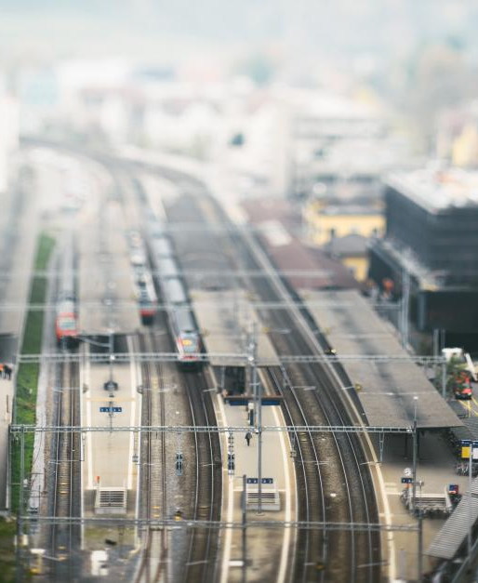
Decarbonisation of the transport sector – Aim
Aim
The project within the NFP73 framework examines this pathway in more detail and aims to answer the following questions:
What economic effects do the different approaches to reducing climate-damaging emissions in passenger transport have in Switzerland?
Which mix of reductions has the most favourable economic impacts in Switzerland?
Which policy instruments are needed to reduce emissions in passenger transport in order to achieve an optimal balance between economic and environmental outcomes?

Slide 19
Decarbonisation of the transport sector – Results I
Conclusions based on three scenarios:
Reducing emissions from transport with positive economic effects is possible. External transport costs decline as emissions fall, because adjustment costs are lower and fewer mitigation measures are required.
The technological approach of vehicle electrification is very important, but on its own it will clearly not be sufficient to achieve the targeted emission reductions. Additional efforts in the form of efficiency gains and optimisation through an optimal combination of the three approaches mentioned above are needed.
Even the optimal combination of the three analysed approaches would not lead to full climate neutrality in Swiss transport. The target contribution by 2050 would be 80%.
More stringent measures are therefore required. To accelerate achievement of the most important element of the emission-reduction strategy—the promotion of electric vehicles—a ban on vehicles with fossil-fuel engines is needed. This would provide investment certainty for vehicle production and purchases and speed up market saturation of electric vehicles. The 2050 climate target can be achieved with a combination of the three approaches.

Slide 20
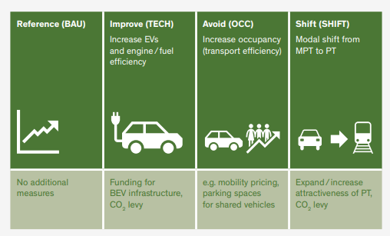
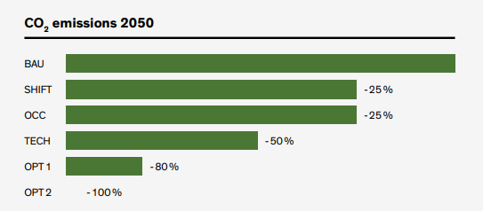
Decarbonisation of the transport sector – Results II
Three strategic directions for decarbonising passenger transportBEV: battery-electric vehicles.OPT1 combines the specific approaches of the scenarios; OPT2 includes a ban on fossil fuels to achieve the CO₂ target. Source: Decarbonising the transport sector (Policy Brief)

Slide 21
Decarbonisation of the transport sector– Results III
Indicator / Value 2050 | Reference | Scenario 1 | Scenario 2 | Scenario 3 | OPT 1 | OPT 2:
 | “BAU” | “CAPU” | “SHIFT” | “TECH” | Combination. | OPT 1 plus ban
Number of private cars | 5.2 Mio. | 3.7 Mio. | 3.8 Mio. | 5.2 Mio. | 2.7 Mio. | 2.7 Mio.
Share E (BEV) of total cars | 35% | 35% | 35% | 65% | 65% | 96%
Energy needs BEV (TWh)giebedarf Elektroautos (TWh) | 5.1 | 3.6 | 4.5 | 9.7 | 5.2 | 6.6
Net import of electricity (TWh) | 7.0 | 5.0 | 5.6 | 9.9 | 5.6 | 6.7
transport performance, motorised individual transport (pkm) | 110 Bn. | 110 Bn. | 86 Bn. | 106 Bn. | 76 Bn. | 74 Bn.
transport performance, public transport (pkm) | 37 Bn. | 38 Bn. | 60 Bn. | 38 Bn. | 63 Bn. | 47 Bn.
CO2 emissions in private | 5.4 | 3.9 (-28%) | 4.0 (-25%) | 2.7 (-50%) | 1.1 (-79%) | 0 (-100%)
Actual GDP compared to BAU |  | 0% | -0.2% | -0.2% | -0.3% | +0.2%
Actual social welfare comp. BAU |  | +0.7% | +0.3% | +0.4% | +1.0% | +1.4%
BAU | Business as usual
CAPU SHIFT | increase of capacity use, modal shift towards public transport
TECH | improved fuel/engine technology and fostered diffusion of battery electric vehicle
OPT1/ OPT2 | optimal scenarios. OPT1 combines the specific approaches of the scenarios; OPT2 includes a ban of fossil fuels in order to reach the CO2 target
BEV | Battery electric vehicles
Pkm | Passenger kilometres
TWH | terawatt hours
Main results of the model analyses on emission reductions in passenger transport up to 2050. Source: Website NFP 73

Slide 22
Final Discussion
Discuss in pairs or small groups at the end:
What would I decide, as a decision-maker, to turn my city into a “post-fossil city”?
What do you think—will we reach the net-zero goal by 2050? Justify your assessment.
How can I personally contribute to achieving the net-zero goal through my mobility choices?

Slide 23
Appendix

Slide 24
Further sources for in-depth study on the topic

Slide 25
Use of the learning module
Suitable for use in Bachelor’s degree programmes at Swiss higher education institutions
Also suitable as an introduction for Master’s and continuing education programmes at Swiss higher education institutions
Suitable for self-study; can also be used in face-to-face teaching
Scope: 3–4 hours of learning time, with an additional 3–4 hours for further in-depth study

Slide 26
NFP 73 Sustainable Economy: resource-efficient, future-oriented, innovative
The aim of NFP 73 is to generate scientific knowledge on a sustainable economy that uses natural resources sparingly, increases prosperity, and enhances the competitiveness of Switzerland as a business location.
Framework:
29 research projects in 9 priority areas
Duration: 2016–2023
Research period: 5 years
Funding volume: CHF 20,000,000
Acknowledgement:
The development of this learning module was made possible by SNSF / NFP 73.

