Slide 1


Governance
A learning module for the tertiary level

Slide 2
Focus Governance
« A sustainable economy requires the transformation of both the economy and society. Incentives for systemic innovations and their diffusion must therefore be promoted, among other things, through appropriate political and legal frameworks as well as exemplary practical initiatives. Five research projects in this focus area examined the challenges that must be addressed on the path toward a sustainable economy, including how states can:
    promote diversified food systems through sustainable trade relations,
    assess the impacts of voluntary environmental measures by the private sector,
    evaluate the effectiveness of policy instruments, and
    shape the legal frameworks for a sustainable circular economy. »
NFP 73, Governance

Slide 3
Learning Objectives
The learner …
understands the importance of legal frameworks for a resource-efficient circular economy
can assess the potential and limits of voluntary environmental initiatives by the private sector
understands the labor-market effects of a green economy
recognizes the influence of legal regulations on the sustainability of trade relations and food systems
is familiar with private and public sustainability standards and the challenges of their compliance with WTO law

Slide 4
Introductory Questions
Please try, using your prior knowledge and experience, to answer the following questions. Ideally, discuss your answers with a colleague:
What does this topic have to do with me and my surroundings?
In which direction should legal frameworks develop to enable a sustainable economy?
What role do legal frameworks play in global trade relations?
How could a sustainability transition of the economy change the labor market?
What do you think about companies’ voluntary environmental initiatives?
What do you know about the sustainability footprint of the Swiss economy?
Which sustainability goals are particularly relevant, and which ones are they?

Slide 5
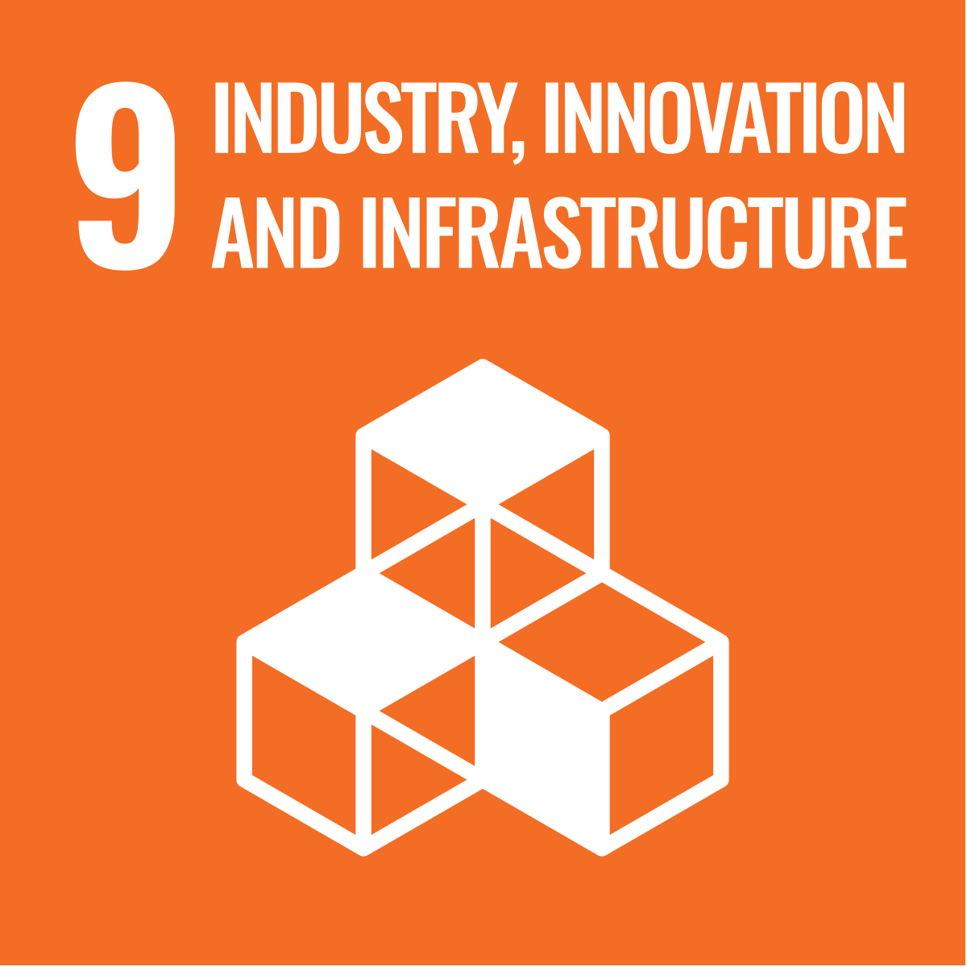
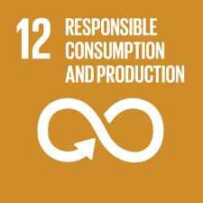
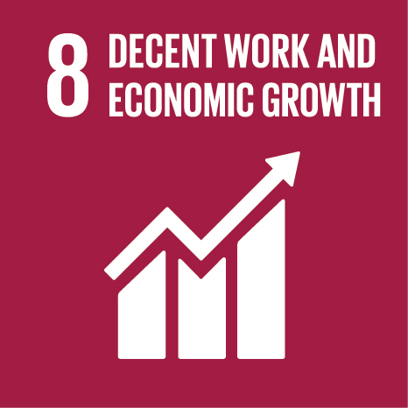
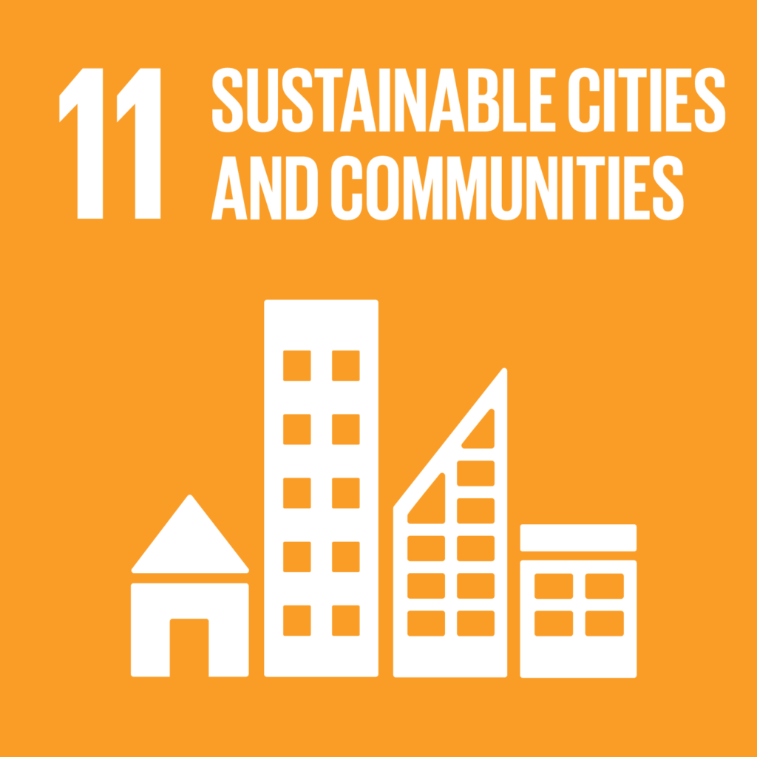

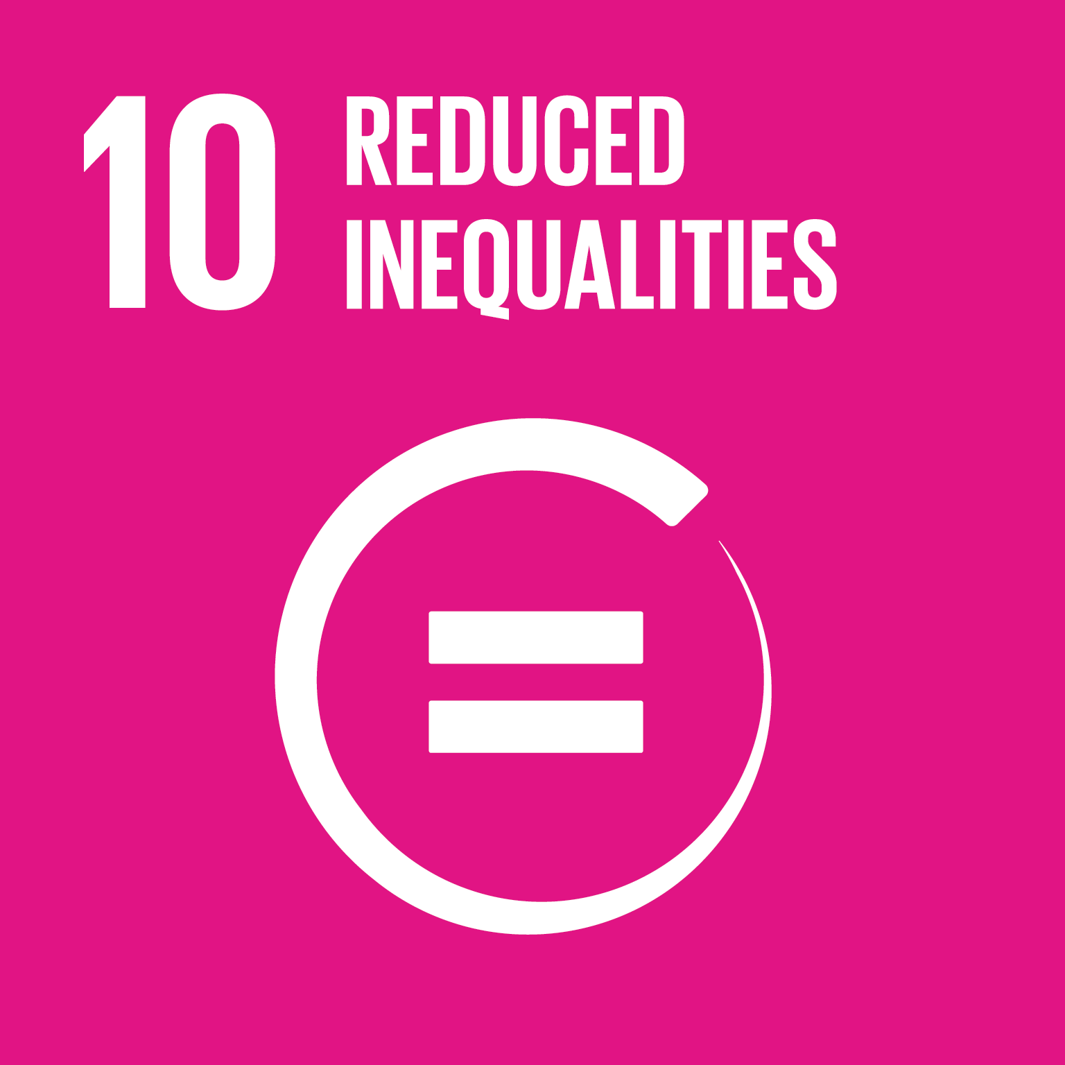

Links to the United Nations Sustainable Development Goals
Governance

Slide 6
Introductory Questions
What does “governance” mean in the sustainability context?
Which principles guide sustainability policy at the federal level in Switzerland?
Which policy instruments are generally available to promote a sustainable economy?
Source of knowledge:
IUCN (2008): Governance for sustainability : issues, challenges, successes
Sustainable Development Strategy (Website of the Swiss federal authorities)
https://nfp73.ch/en/topics/governance

Slide 7
Overview of Research Projects
In this focus area, there were five research projects:
Legal frameworks for a resource-efficient circular economy
Voluntary environmental initiatives by the private sector
Labor-market effects of a green economy
Diversified food systems through sustainable trade relations
Switzerland’s sustainability footprint

Slide 8

Legal framework for a resource-efficient circular economy
“The research project examines which legal instruments can combat food waste and extend the service life and useful life of products, thereby contributing to a resource-efficient circular economy.”
Prof. Dr. Sebastian Heselhaus, Project lead, Legal framework for a resource-efficient circular economy

Slide 9
Legal framework for a resource-efficient circular economy – Assignments
What does “food waste” mean, and where in the supply chain does it arise?
Which approaches can be used to reduce food waste?
Which aspects should legal frameworks target in order to promote a resource-efficient circular economy?
Source of knowledge
Legal framework for a resource-efficient circular economy (Website NFP 73)
Food Waste (Wikipedia)

Slide 10
Legal framework for a resource-efficient circular economy – Background I
Background I
In recent years, global demand for goods and food has intensified, and there is no end to this trend in sight.
At the same time, the service life and useful life of many goods have decreased, and a large share of food is being discarded.
This situation calls for measures to make the consumption of goods and food more sustainable. Appropriate legal frameworks and behavioral changes are needed—not only in the affected industries but also among consumers—to enable a resource-efficient circular economy.

Slide 11
Legal framework for a resource-efficient circular economy – Background II
Background II
The research project examines three questions:
First, legal barriers and incentives for reducing so-called “food waste” in the food sector are analyzed, taking into account both voluntary measures and regulatory approaches.
Second, the project looks at introducing legal incentives for manufacturers to produce durable goods and for consumers to keep using them for as long as possible.
Third, a synthesis analyzes whether common proposals for resource-conserving legislation can be derived from the two subprojects.

Slide 12

Legal framework for a resource-efficient circular economy – Aim
Aim
The goals are to develop concrete legal measures to support ongoing projects aimed at preventing “food waste” and promoting repairs.
In addition, we seek to create incentives for industry, manufacturers, and consumers to design goods to be more durable and to use them more carefully, as well as to label food products effectively in order to ensure the best possible use.

Slide 13
Legal framework for a resource-efficient circular economy – Results
Both parts of the project—food waste and repair—share certain research questions that require a combined analysis, such as issues of consumer behavior, warranties, labeling, consumer information, and legal actions by consumer organizations.
Therefore, a common approach is applied to both parts:
  development of the legal framework
  examination of practical issues with stakeholders
  identification of legal questions
  legal analyses of selected measures
  proposals for practice, such as regulations or industry agreements

Slide 14
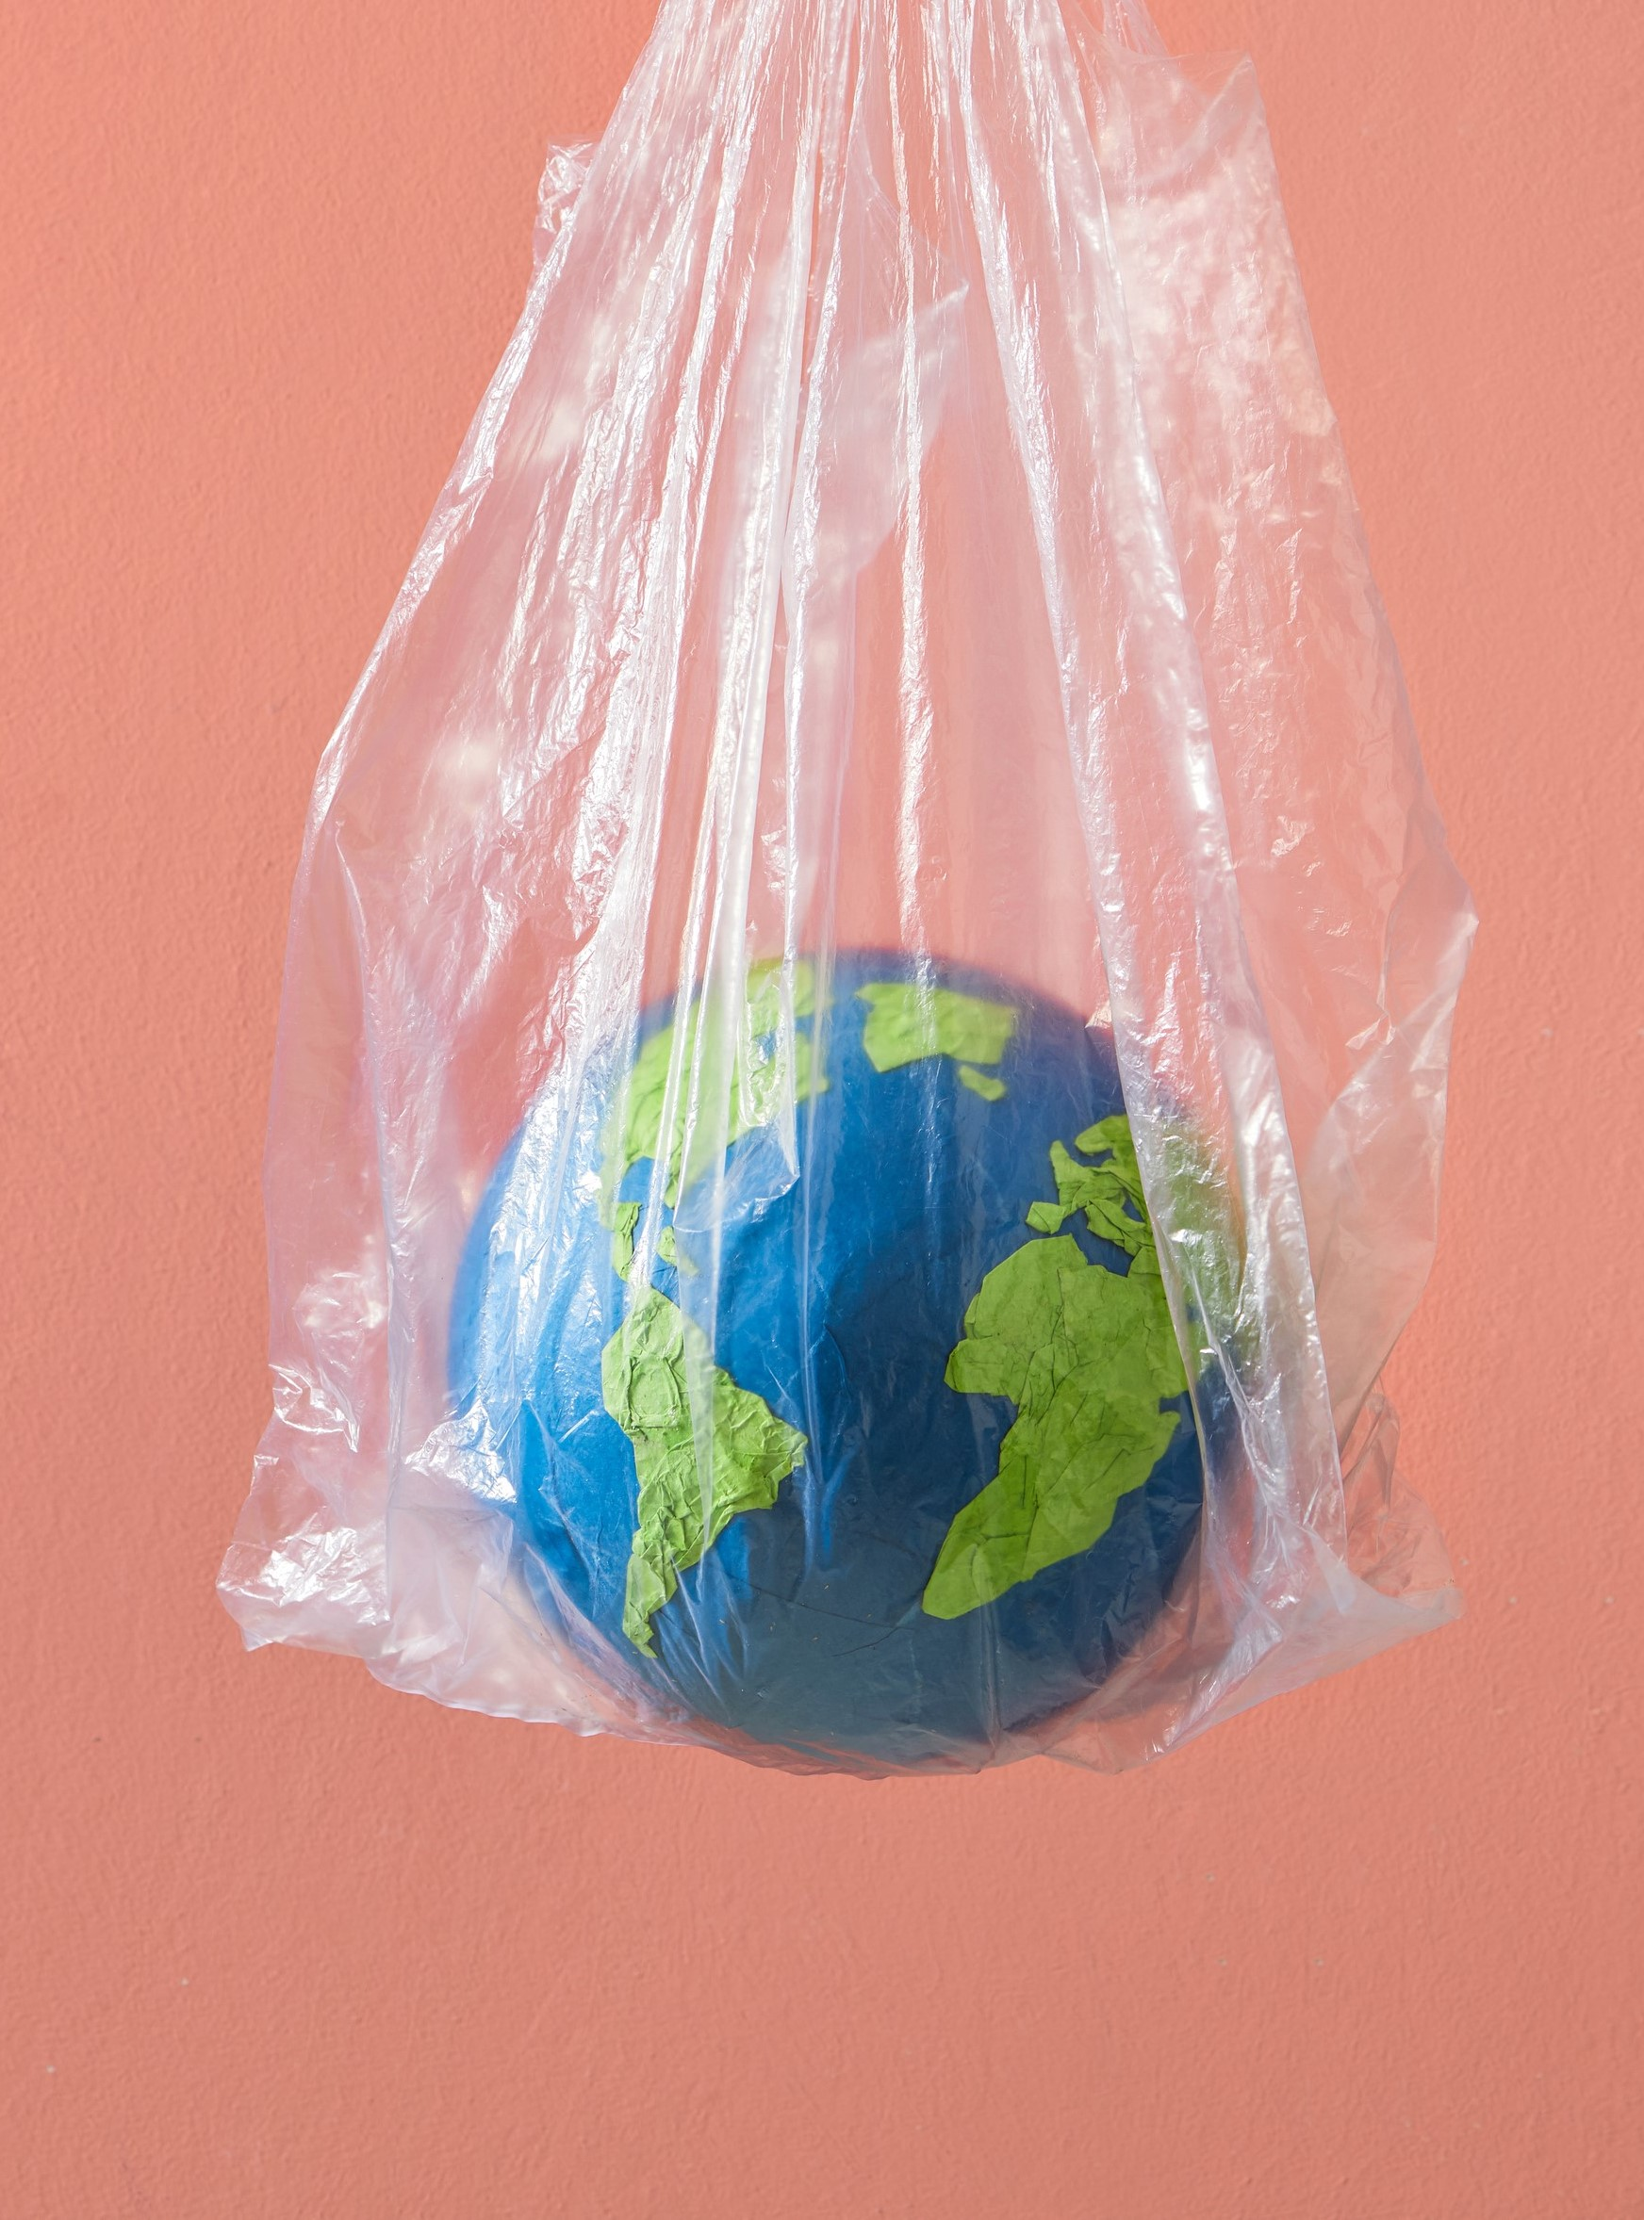
Voluntary corporate environmental initiatives
«This project examined the policy options available to democratic decision-makers in the Global North (especially in Switzerland) with regard to ‘green’ economic initiatives and activities. Our primary focus was on public opinion toward private-sector environmental initiatives during the transition to a sustainable economy.»
Prof. Dr. Thomas Bernauer, Project lead, Voluntary corporate environmental initiatives

Slide 15
Voluntary corporate environmental initiatives - Assignments
What impacts does trade liberalization have on the environment?
How can voluntary environmental initiatives by the private sector be promoted?
Which factors influence the acceptance of government regulation?
What does “hybrid governance” mean?
How can “greenwashing” be prevented?
Why is an environmental policy focused solely on Switzerland problematic?
Source of knowledge:
Public Acceptance of Voluntary Corporate Sustainability Measures (Policy Brief)

Slide 16
Voluntary corporate environmental initiatives – Background
Background
Political decision-makers can intervene at many points and have a wide array of policy instruments at their disposal to reduce the environmental impacts of economic activity. Their success depends to a large extent on how they address the following two questions:
How can policymakers deal with the geographic dispersion of environmental impacts through trade and corporate supply chains?
To what extent can they restrict or regulate companies’ efforts to reduce environmental impacts while taking public opinion into account?

Slide 17
Voluntary corporate environmental initiatives – Aim
Aim
We examined the political feasibility of measures for a sustainable economy that target various environmental problems. These included problems caused by economic activities at every stage of a stylized product life cycle—from cradle (i.e., during production in low-income countries), through trade, to grave (i.e., during final consumption or disposal).
The project used Switzerland as an “opinion laboratory” and provided well-founded insights into the levers that policymakers (in Switzerland and hopefully elsewhere) can use on their path toward a sustainable economy.

Slide 18
Voluntary corporate environmental initiatives – Results I
Impacts of trade liberalization on the environment
Our results suggest that trade liberalization can lead to increased environmental impacts of goods exported from low-income countries. The extent of this process interacts with countries’ political systems—that is, high-income and democratic countries are more likely to be able to “shift” environmental burdens through trade.
Acceptance of private-sector environmental initiatives
The importance of democratic institutions at the macro level supports our focus on public opinion at the micro level. In this regard, our findings show that individuals’ support (whether as citizens or consumers) for private-sector environmental initiatives depends on whether they perceive the interaction between business and government as synergistic. At the same time, our results indicate that voluntary environmental initiatives can pay off for companies if they are politically rewarded by citizens—for example, through less stringent enforcement of regulations.

Slide 19
Voluntary corporate environmental initiatives – Results II
Acceptance of political steering for greater sustainability
Regardless of support for political rewards, citizens overall favor robust government regulation of economic activity—both in national environmental policy and in the governance of global supply chains. However, there are some reservations.
First, the public is more tolerant of lenient environmental regulations when these are established through an inclusive decision-making process.
Second, our results show that an inclusive political process—because of the large number of actors involved and the complexity of decision-making—can reduce the accountability that the public expects from elected representatives.
Third, we find that normative signals (e.g., from international organizations) increase support for regulating a sustainable economy, while voluntary measures can reduce it if companies commit to external audits and succeed in maintaining cross-sector cooperation.

Slide 20

Green labour market effects
«The creation of a green economy requires the development of more environmentally friendly production processes and products. This transformation will affect the labor market, and its success will depend on whether enough workers with the skills needed for this transition are available.»
Prof. Dr. Rolf Weder, Project lead, Green labour market effects

Slide 21
Green labour market effects – Assignments
Which occupational fields show high and which show low “green potential”?
What challenges does the labor market face if environmental legislation becomes stricter?
What measures can companies and governments take to address these challenges?
Wissensquellen:
Green labor markets effects (NFP Website)
Green labor markets effects (scientific lecture, E, 6:45)

Slide 22
Green labour market effects – Background
Background
To better understand labor-market aspects of the green transition, it is necessary to focus on occupational groups rather than entire industries.
By analyzing the skill profiles of different professions, it is then possible to assess which occupations have a high potential to take on green tasks. This “green potential” of occupations is crucial for determining how well a country and its labor market are prepared for the transition to a green economy.

Slide 23
Green labour market effects – Aim
Aim
The aim of the project was to determine the “green potential” of different occupations and of the workforce in Switzerland and in other countries.
To achieve this goal, we estimated which occupations and skill profiles are likely to be in greater or lesser demand in the future as a result of the green transition. This ultimately allowed us to derive implications for education and economic policy with regard to transforming an economy into a green economy.

Slide 24
Green labour market effects – Results I
Green potential varies by occupational group
In our analysis, occupations with a relatively high share of technical and natural-science skills tend to exhibit the highest green potential. By contrast, the lowest values are found in occupations such as those in healthcare or the arts. For Switzerland, we can additionally note that workers in occupations with high green potential are on average younger, more often male, more frequently migrants, and have higher levels of education than those in occupations with low green potential.
In international comparison, Switzerland has a relatively high share of employees in occupations with high green potential. The Swiss labor market therefore appears generally well positioned to meet the challenges of a green transformation. However, occupations with high green potential show higher vacancy rates and lower unemployment rates. This suggests that such workers are already relatively scarce in today’s labor market.

Slide 25
Green labour market effects – Results II
Influence of environmental policy measures on the labor market
This scarcity could become even more pronounced in the future. A tightening of environmental policy measures shows a positive relationship with the demand for occupations with high green potential. In the industrial sector, a negative relationship emerges between environmental policy measures and the demand for occupations with low green potential, while no relationship is evident with overall employment in the industrial sector. A relocation of many Swiss industries abroad seems unlikely, since industries with a high share of the (relatively scarce) workers with high green potential display relatively low greenhouse-gas emissions (exception: chemical industry).
The transformation to a green economy is likely to lead to structural changes in the labor market, which will mainly produce winners and losers across occupations. In the future, companies are likely to increasingly demand workers who have a “high green potential.” Here, there is a risk of so-called “mismatches” in job placements. Authorities and sectors should counter this problem through the certification of “cross-cutting skills.” The state should communicate well the rising demand for technical skills and support companies in building these skills through tax relief or subsidies.

Slide 26
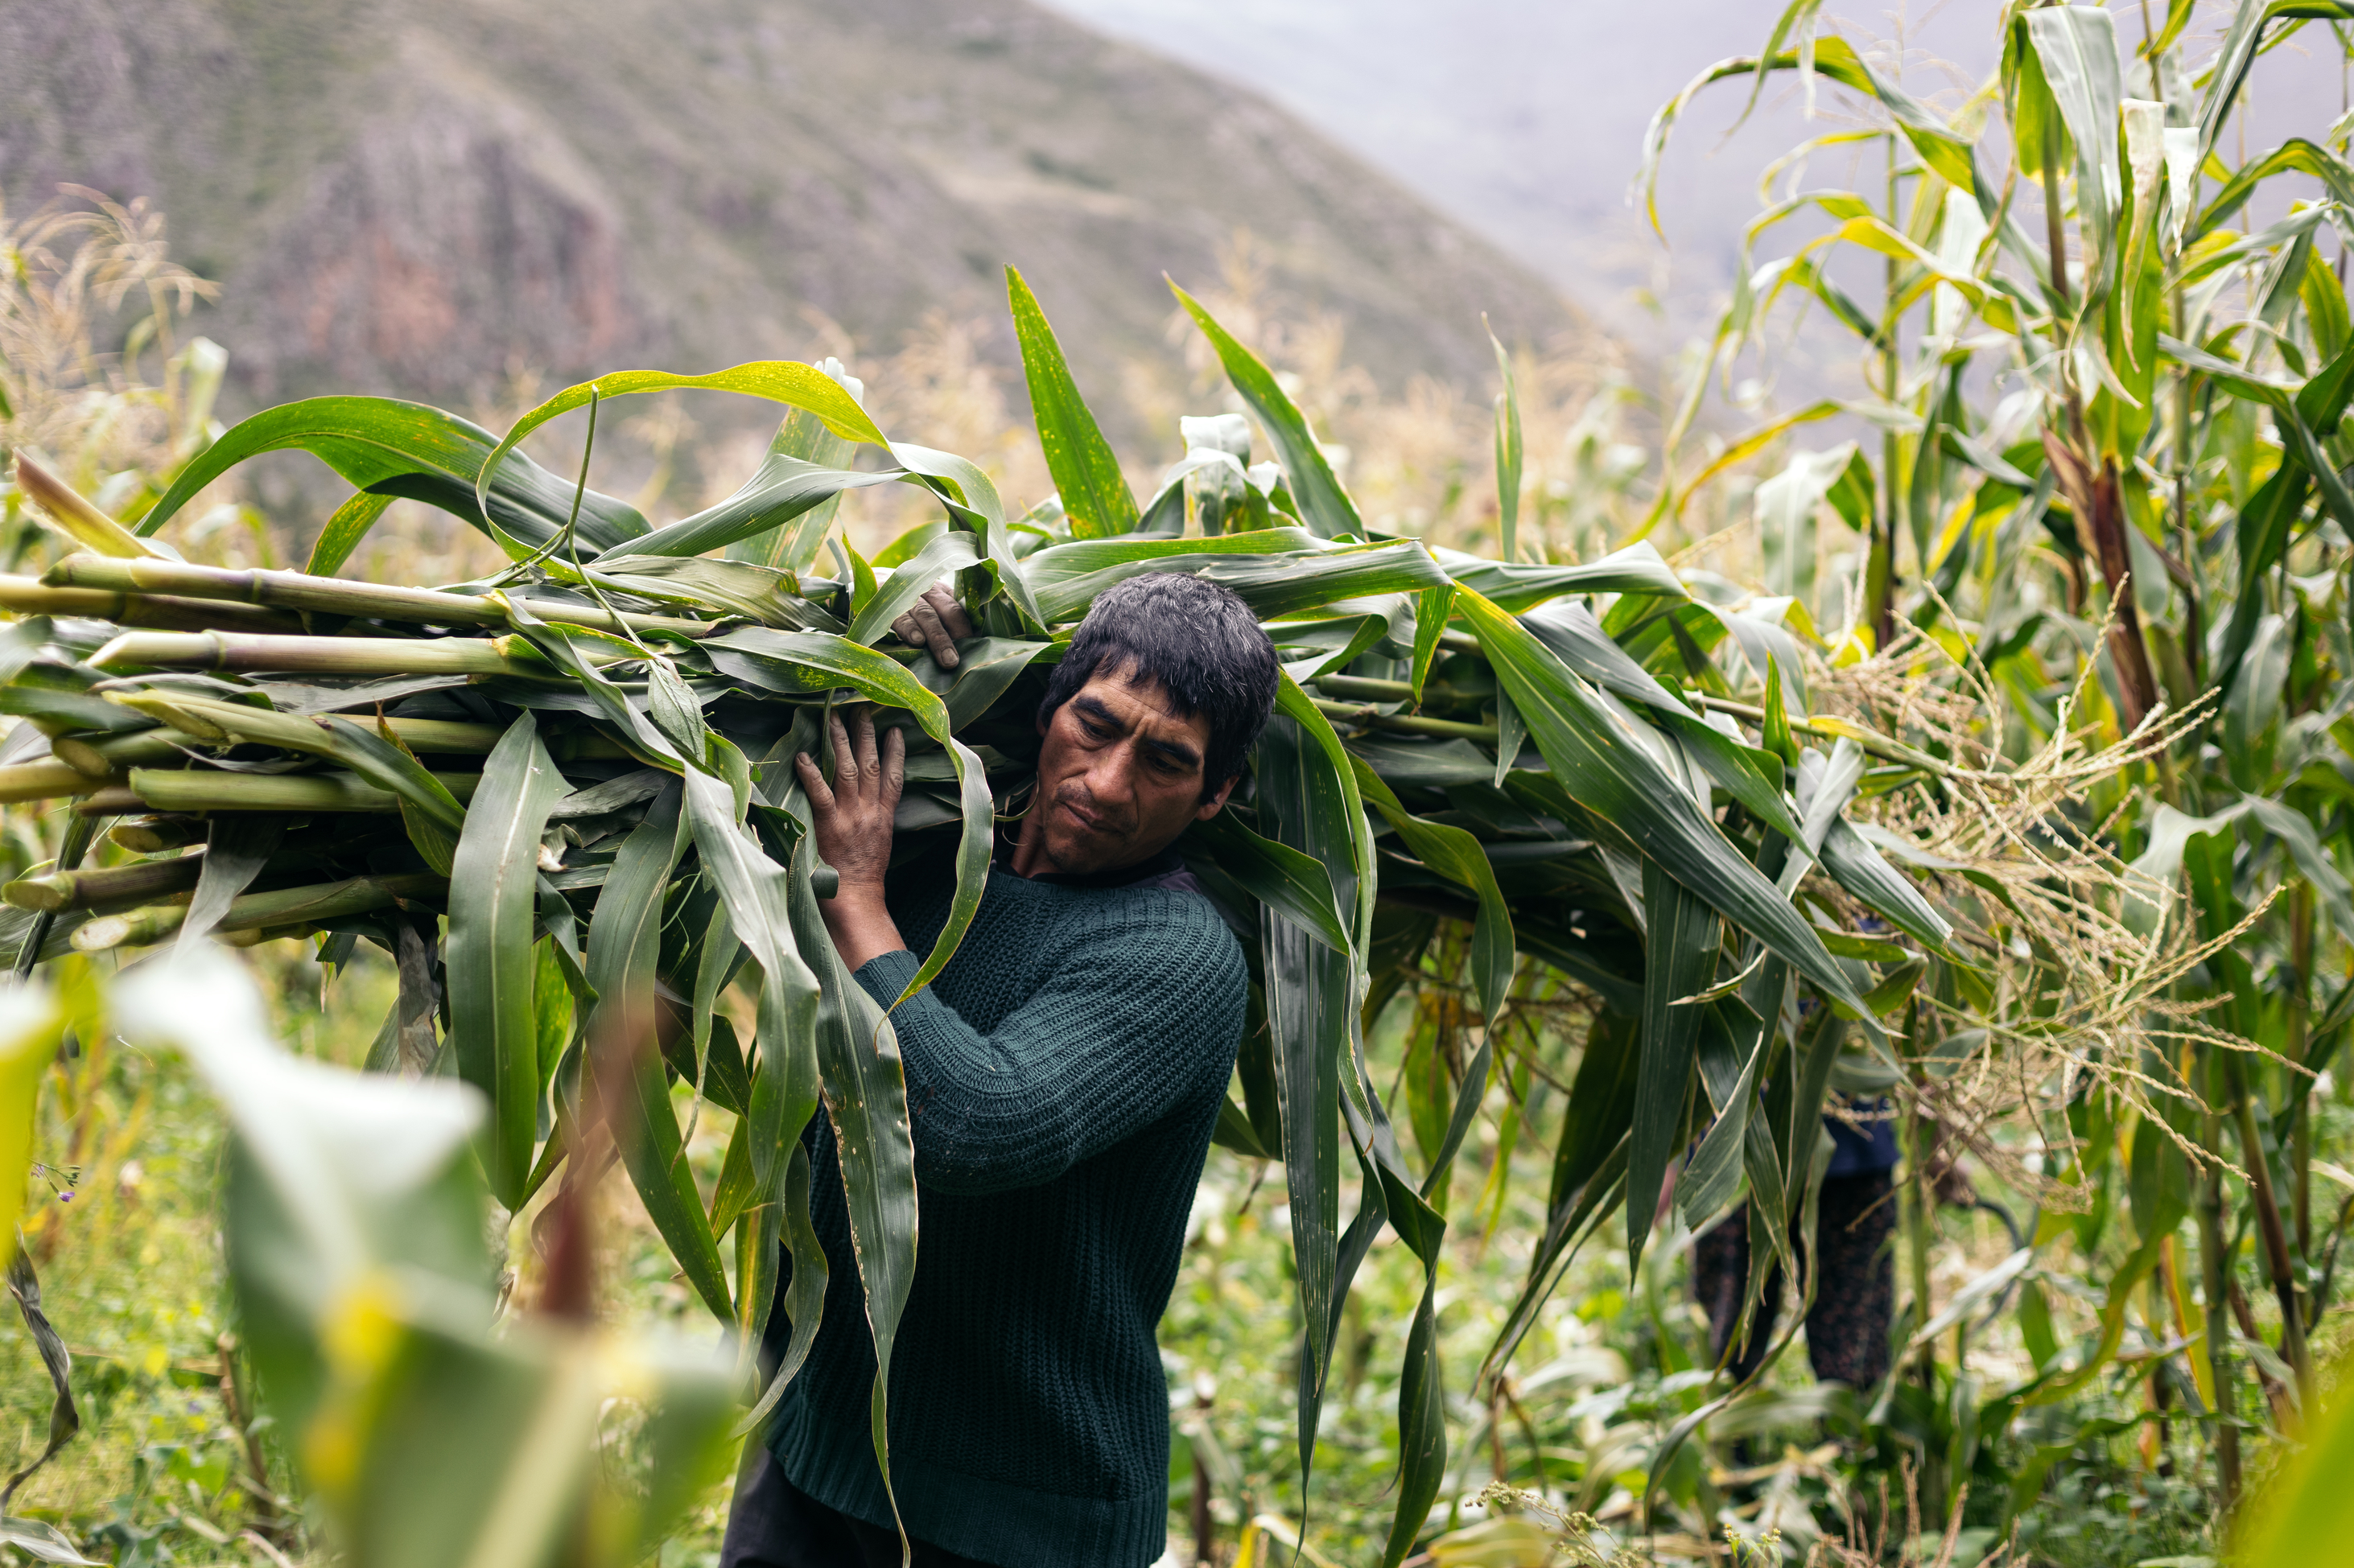
Sustainable Trade Relations for Diversified Food Systems
«The transformation of food systems requires addressing both domestic production and trade. We developed a concrete legislative proposal to show how governments can create more differentiated and sustainable trade relationships by supporting vulnerable but particularly sustainable food systems and preventing especially harmful ones.»
Dr. iur. Elisabeth Bürgi Bonanomi, Project lead, Sustainable Trade Relations for Diversified Food Systems

Slide 27
Sustainable Trade Relations for Diversified Food Systems - Assignments
Why is a diversified food system being proposed?
What all belongs to the food system?
What are the most important aspects of legal regulation aimed at sustainable agricultural trade?
Sources of knowledge
Sustainable Trade Relations for Diversified Food Systems (Website NPF 73)
How a Swiss federal law on sustainable agricultural trade could be formulated – a concrete example

Slide 28

Sustainable Trade Relations for Diversified Food Systems – Background
Background
Diversified food systems are more sustainable than specialized food systems. They promote ecological and economic diversity, distribute social benefits more fairly, and contribute to a diversified food basket.
However, their products are often displaced by products from specialized systems. Governments are therefore looking for ways to create incentives for sustainable food production and to make harmful, unsustainable production more difficult, by complementing and strengthening private-sector approaches in a balanced and appropriate way.

Slide 29

Sustainable Trade Relations for Diversified Food Systems – Aim
Aim
The aim of the project was to operationalize Article 104a letter d of the Federal Constitution. This provision obliges the Confederation to create the conditions for “cross-border trade relations that contribute to the sustainable development of agriculture and the food system.” By developing sustainability-oriented trade-regulation models, the project sought to generate knowledge and inspiration for both national and international policymaking in support of sustainable and diversified food systems worldwide.

Slide 30
Sustainable Trade Relations for Diversified Food Systems – Results I
The project influenced the debate through engaged discussions, several papers (academic publications), and a concrete legislative proposal. A targeted synthesis process led to a proposal for a “Federal Act on Sustainable Agricultural Trade,” intended to inform the Swiss government and other relevant actors. The draft legislation incorporates the findings from the project’s analytical component. A “storyline” of the results is available on the project website, with links to scientific publications.
Key findings:
Article 104a letter d of the Federal Constitution obliges the Confederation to create the conditions for cross-border trade relations that contribute to the sustainable development of agriculture and the food system.
An optimal legal framework combines enabling and constraining measures.
Assessment procedures should be trust-based, knowledge-based, and context-sensitive, and partnership-based approaches should be prioritized.

Slide 31
Sustainable Trade Relations for Diversified Food Systems – Results II
The existing WTO rules do not make it easy for states to distinguish between sustainable and unsustainable products. Nevertheless, states do have some room for maneuver. The agreement between EFTA and Indonesia offers an inspiring regulatory innovation regarding tariff preferences for sustainably produced palm oil, which should be further developed.
In the past, entrenched assumptions in trade law made it difficult to use this policy space to promote sustainability.
Although there is no single international standard for sustainable food systems, a certain “shared understanding of sustainable food systems” does exist. However, some issues remain contested.

Slide 32
Sustainable Trade Relations for Diversified Food Systems – Results III
Private-sector sustainability labels, for example in the fisheries sector, are not sufficient to promote the import of sustainable goods. Voluntary industry alliances for “responsible” sourcing—such as the sectoral agreement on soybean imports—are also only partially effective. The state must complement these approaches in a balanced and appropriate manner.
Context-sensitive solutions presuppose the recognition of affordable, bottom-up certification systems and “home-grown” landscape approaches. However, there are also other ways of building trust besides certification schemes—for example, relationship-based, short value chains.
The domestic agricultural policy framework in Switzerland contains various inconsistencies that must first be resolved before trade relations can be coherently linked to production processes.

Slide 33

Switzerland’s sustainability footprint
«In this project, we are generating new data on global sustainability stocks. The focus is on gaining a better understanding of the effectiveness and limitations of alternative policies aimed at sustainable consumption patterns and their associated socio-economic impacts.»
Prof. Dr. Joseph Francois, Project lead, Switzerland’s sustainability footprint

Slide 34
Switzerland’s sustainability footprint – Assignments
What does WTO compliance mean, and what does it have to do with sustainability standards?
In which sectors are there private sustainability standards in Switzerland?
Which private sustainability standards must be WTO-compliant?
Which government sustainability measures for agricultural products are particularly relevant for trade?
Sources of knowledge:
Private sustainability standards in Switzerland and the World Trade Organization (Policy Brief)
Switzerland’s sustainability footprint (scientific lecture, E, 4:25)

Slide 35

Switzerland’s sustainability footprint –
Background
Background
National resource-use targets usually focus on domestic or local production. However, not only producers but also consumers bear responsibility. Through international trade, local consumption also puts pressure on the environment in other geographic regions. Careful analysis of cross-border production linkages and the associated impacts on local consumption and global sustainability is an important step toward understanding the effectiveness and limits of long-term sustainability policy.

Slide 36
Switzerland’s sustainability footprint – Aim
Aim
Our aim with this project is to quantify the sustainability situation of the Swiss economy, identify future challenges, and assess Switzerland’s policy options. The four key elements are:
the development of sustainability indicators
the preparation of projections of Switzerland’s future emissions and resource use
the analysis of the economic and legal design of sustainability-policy instruments for Switzerland
the assessment of the potential for environmental labeling

Slide 37
Switzerland’s sustainability footprint – Results
Public database of measures to reduce the sustainability footprint
In this project, we are developing new measures that are intended to become part of a public database aimed at achieving sustainability-footprint targets for the Swiss economy. In connection with these goals, we are also examining the effectiveness of alternative tax-based and voluntary instruments. This includes a projection analysis of usage trends and an investigation of contractual constraints on the use of alternative instruments arising from Switzerland’s membership in the World Trade Organization (WTO). The latter is also intended to help identify potential scope for international action and initiatives by Switzerland.

Slide 38
Final Discussion
Discuss in pairs or groups of three at the end:
Which relationships or connections were new to me?
In which areas do I see the greatest potential for legal regulations to promote a sustainable economy?
What are the advantages of voluntary measures and private sustainability standards? What are the disadvantages?
Is the transition to a green economy more of an opportunity or a risk for the labor market? Why?
Under what conditions can the Swiss population be persuaded to support legal regulations to promote a sustainable economy?

Slide 39
Appendix

Slide 40
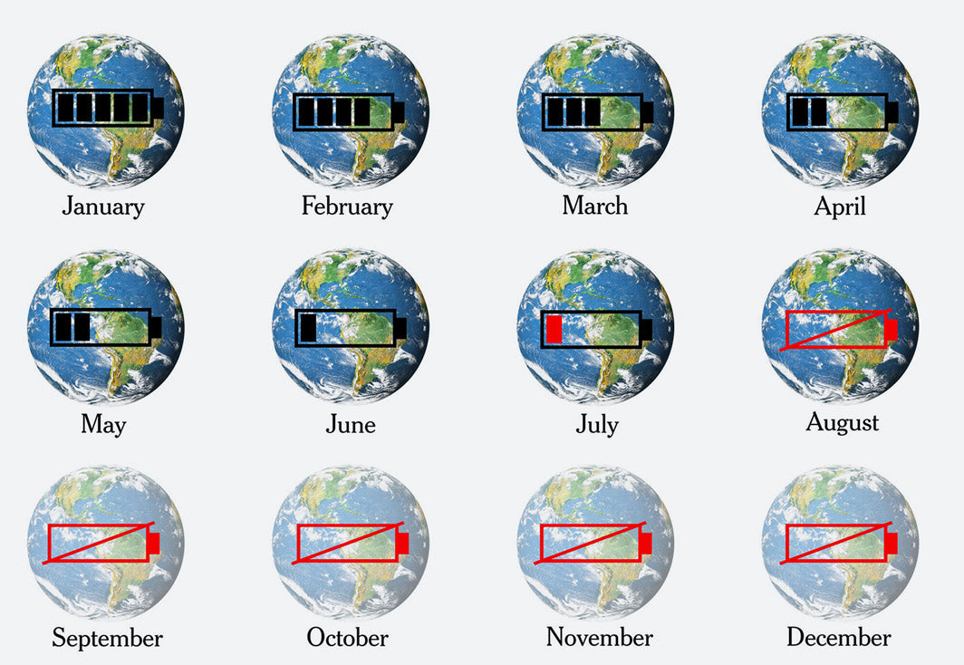
Earth Overshoot Day in der New York Times
In August, the ecological budget for the year is used up. After that, resource use exceeds the Earth’s planetary boundaries.
Source: New York Times (2020)

Slide 41
Use of the learning module
Suitable for use in bachelor’s programs at Swiss universities
Also suitable as an introduction for master’s and continuing-education programs at Swiss universities
Suitable for self-study; can also be used in classroom teaching
Scope: 3–4 hours of learning time, with an additional 3–4 hours for in-depth study

Slide 42
NFP 73 Sustainable Economy: resource-efficient, future-oriented, innovative
The aim of NFP 73 is to generate scientific knowledge on a sustainable economy that uses natural resources sparingly, increases prosperity, and enhances the competitiveness of Switzerland as a business location.
Framework:
29 research projects in 9 priority areas
Duration: 2016–2023
Research period: 5 years
Funding volume: CHF 20,000,000
Acknowledgement:
The development of this learning module was made possible by SNSF / NFP 73.

