Slide 1



Synthesis : Policy Recommendations
A learning module for the tertiary level

Slide 2

Synthesis: Policy recommendations
Extreme weather, rising sea levels, and the loss of biodiversity threaten our well-being and livelihoods worldwide. We must adapt our resource consumption to what nature can provide. This applies both to consumption behaviour and to production processes. The necessary transition to a sustainable economy affects both present and future generations and therefore requires a long-term perspective. The aim of the synthesis is to present the key findings from the 29 research projects of the NFP 73, with a particular focus on policy recommendations.

Slide 3
Learning Objectives
The learner …
knows the basic policy instruments for promoting a sustainable economy,
understands how policy recommendations can be derived from research projects,
can name and explain the eight general policy recommendations of NFP 73,
can name and explain five focus-area or sector-specific policy recommendations, and
reflects on the possibilities and limits of policy recommendations made by researchers.

Slide 4

Overview of focus areas
In the NFP 73, there were nine research focus areas:
Agriculture and nutrition
Forestry
Building and construction
Cities and mobility
Supply chains
Circular economy
Finance
Sustainable behaviour
Governance

Slide 5
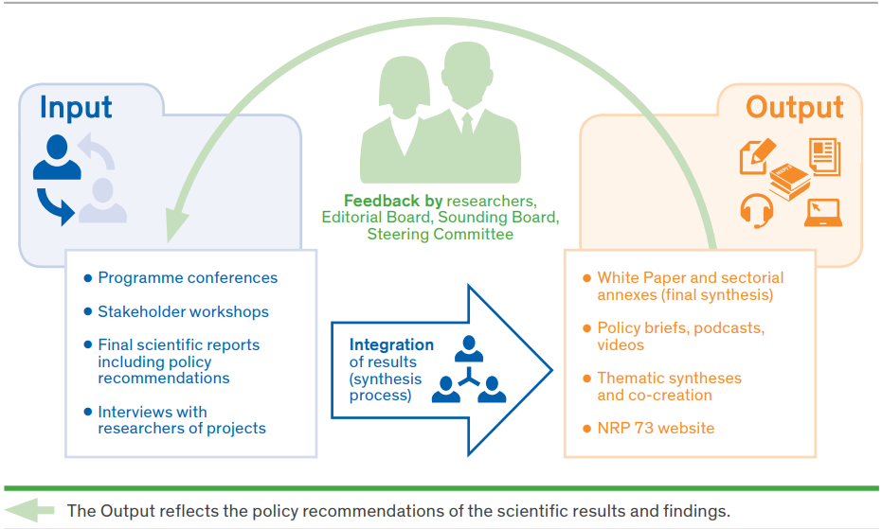
Policy recommendations derived from research findings
SNF (2023): Policy recommendations, White Paper

Slide 6
Introductory Questions
Please try to answer the following questions using your prior knowledge and experience. Ideally, discuss your answers with a colleague:
Which policy instruments do you know that are used in promoting sustainable economic development?
Which general policy recommendations would you derive from the research projects in the nine focus areas?
Which specific policy recommendations would you derive for the focus areas or for individual economic sectors?
Which sustainability goals would these contribute to?

Slide 7
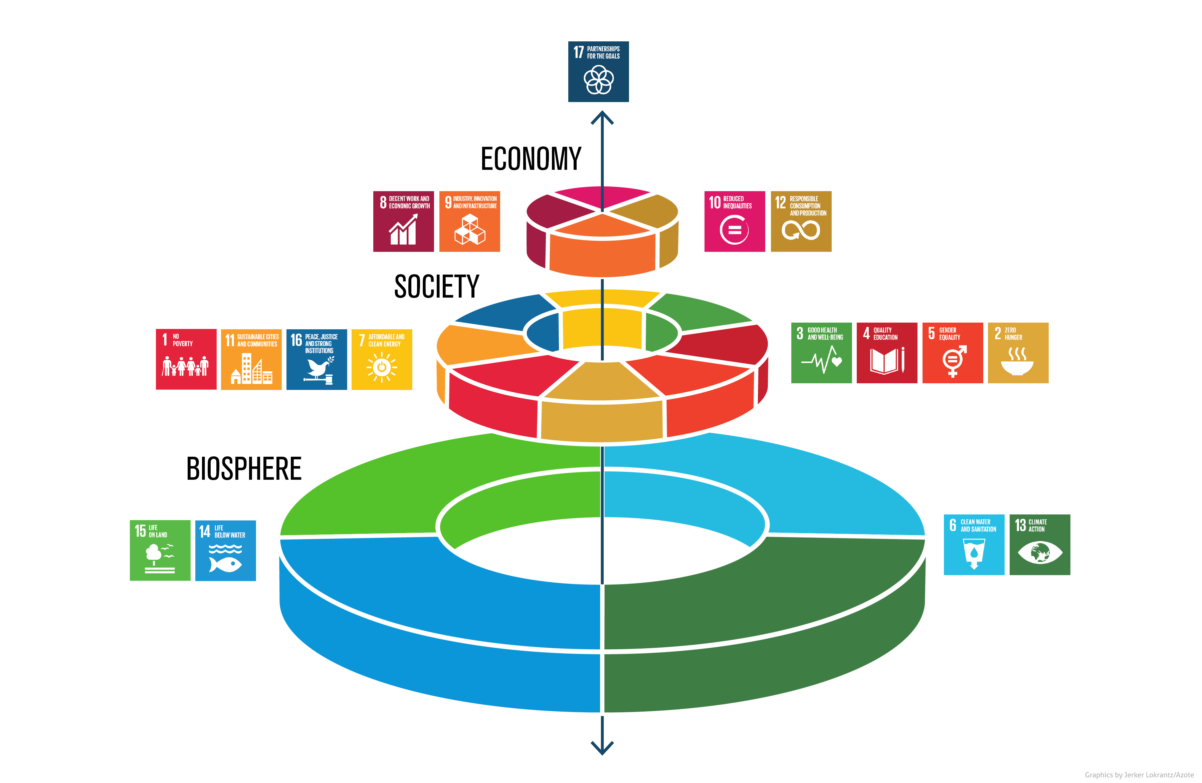
Links to the United Nations Sustainable Development Goals
Stockholm Resilience Centre

Slide 8
Principles
The measures are guided by the following principles:
Regeneration: renewable resources should be used efficiently;
Substitutability: non-renewable resources should be used efficiently and their use should be limited to a level that can be offset (i.e., replaced) by renewable resources or other forms of capital;
Assimilation: the release of hazardous or environmentally harmful substances into the environment should not exceed its capacity to assimilate them, and concentrations should be kept below critical thresholds. Once assimilation capacity is reached, the release of such substances must be reduced to zero in order to prevent their accumulation in the environment;
Avoidance of irreversibility: irreversible negative impacts of human production and consumption activities on areas such as ecosystems and biogeochemical and hydrological cycles should be avoided. Climate-system tipping points, for example, must not be crossed.
.

Slide 9
Policy instruments
Three types of policy instruments are available
… which can also be used in combination:
Market-based instruments such as taxes and fees put a price tag on environmental resources that were previously treated as free goods. This is intended to lead to less environmentally harmful production methods, while the higher costs of environmentally damaging products are passed on to end consumers.
Regulatory instruments directly influence consumption behaviour by restricting choice—for example by mandating technologies or banning certain activities.
Behavioural interventions, which include incentives, voluntary agreements, or nudging.

Slide 10
Policy recommendations I
Based on the results of NFP 73, eight recommendations were developed for the Swiss government:
Sustainable technologies and innovations should be supported through sustainable financial instruments such as green bonds, which NFP 73 research has shown to be effective. This could help position Switzerland as one of the leading knowledge and infrastructure hubs for sustainable finance.
Innovations also require long-term investment and policy incentives, as well as engagement from and trust in public authorities. However, if these innovations increase resource efficiency and lead to higher disposable incomes, this can in turn generate greater demand for resources, creating the risk of rebound effects. This would cancel out the environmental benefits achieved through higher efficiency (for example, energy-saving building renovations). Rebound effects were identified in many NFP 73 projects, and the government must be aware of them and seek to counteract them.

Slide 11
Policy recommendations II
It must pay off to develop and use environmentally friendly technologies. Market prices are often too low and do not reflect ecological reality: neither the benefits we derive from ecosystem services nor environmental damage are included in market prices. First of all, subsidies that create perverse incentives should be abolished. Then new taxes on resources or environmental impacts should be introduced, and the revenues should either be redistributed or used to reduce existing taxes.
Trade-offs should be made transparent, and integrated assessment approaches should be introduced (for example, mixes of regulatory, social-policy, and tax measures) in order to deal with conflicts and compromises between social, environmental, and economic goals. The situation becomes even more complex when responsibilities are spread across different levels of government, which can lead to gaps and inconsistencies in regulations.

Slide 12
Policy recommendations III
Political coordination is needed across sectors such as housing, energy, waste and resources, land use and transport, or cultural heritage and historic preservation. To improve coordination, “roadmaps” that define intermediate targets and the involvement of all relevant stakeholders would be appropriate approaches. In any case, the consequences of failing to meet established goals must be clearly defined from the outset.
The government should lead by example, as several NFP 73 projects show. Sustainable public procurement plays an important role in this regard. This requires setting targets, testing measurement methods, and continuously reviewing and improving standards. In addition, the government should strengthen the labour market to ensure that the development of required skills and the adaptation of academic and vocational education are supported.

Slide 13
Policy recommendations IV
The government must set minimum standards in order to stop the race toward ever lower environmental standards. As many research projects show, Switzerland lacks binding definitions and regulations for sustainable products and sustainable investments. Marketing and pressure for product differentiation have led to a proliferation of labels, which in turn has increased greenwashing. Other countries and institutions such as the EU have introduced their own labelling systems to reduce consumer confusion. Switzerland has done this on a private basis with organic food labels (Bio Suisse), but there is still no regulation for ICT and sustainable finance

Slide 14
Policy recommendations V
8. “Hybrid governance” approaches should be used for sustainable transformation, as they go beyond the remit of legislative bodies. Several research projects recommend introducing multi-track strategies for a sustainable economy that make it possible to consider environmental impacts along entire supply chains. Voluntary measures by companies will not be sufficient and must be supported by binding ones. This is particularly important for global supply chains—for example through binding national measures combined with voluntary cooperative commitments (such as trade agreements), voluntary private action plans, and voluntary agreements that should be backed by legal sanctions in cases of non-compliance.

Slide 15

Specific policy recommendations
Specific policy recommendations were formulated for five focus areas:
Agriculture and nutrition
Circular economy
Housing and construction
Behaviour and consumption
Ecosystem services of forests

Slide 16

Agriculture and Nutrition
Agriculture and food systems are responsible for a significant share of humanity’s ecological footprint, and efforts to reduce their impacts are essential for achieving sustainable development. The value chain in the food system includes agricultural production—including agricultural service and product suppliers—followed by processing, distribution, retail (including restaurants and other food services), consumption, and disposal.
NFP 73, Agriculture and Nutrition

Slide 17

Agriculture and Nutrition – Assignment
Assignment
Which specific recommendations would you derive from the research findings (see the learning module “Agriculture and Nutrition”), and to whom would you address these recommendations?
Then compare your recommendations with those of the researchers.

Slide 18
Agriculture and Nutrition – Recommendations I
Adoption of the European definition of food waste and its measurement methodology into Swiss law, as this would provide legal certainty and a legal basis for measures and obligations.
Relaxation of aesthetic marketing standards for fruits and vegetables (mostly private standards).
Clarification of the definition of the “best before” date and permission to sell products past this date, provided safe consumption is ensured and consumers are informed about the expiry.
Introduction of binding reduction targets if voluntary measures are insufficient, for each branch of the food industry—for example, criteria for reducing food waste in canteens.
Introduction of a law on food donations into Swiss food legislation (Art. 7 para. 4 LMG). Supermarkets would be required to conclude contracts with food banks or other charitable organisations. Shops could be penalised for violations of the law.
Tax relief to simplify distribution.

Slide 19
Agriculture and Nutrition – Recommendations II
No or reduced VAT on donated food.
Introduction of a meal-ordering system in hospitals that (i) automatically cancels meals when patients leave the hospital or cannot eat for medical reasons, and (ii) allows flexible selection of portion sizes and meal components.
Interventions or information campaigns should focus on nutrition-related and environmental sustainability issues linked to food waste.
Well-defined regulations are more effective in reducing household food waste than tax-based or economic incentives.
The use of smart nutrition and environmental indicators at a global level can increase the perceived value of wasted food. Showing the true value of wasted food is a first step toward motivating consumers, businesses, and governments to take action to curb waste

Slide 20

Circular ecnonomy
In Switzerland, there is strong public support for recycling. In 2019, Switzerland reached a recycling rate of 53%, placing it among the leading countries in Europe. However, a sustainable circular economy involves more than just recycling. According to the widely used definition of the Ellen MacArthur Foundation (2015), a circular economy is “an economy that is restorative and regenerative by design and aims to keep products, components, and materials at their highest utility and value at all times, distinguishing between technical and biological cycles. This innovative economic model ultimately seeks to decouple economic growth from resource consumption.”
NFP 73, Circular economy

Slide 21
Circular Economy – Assignment
Assignment
Which specific recommendations would you derive from the research findings (see the learning module “Circular Economy”), and to whom would you address these recommendations?
Then compare your recommendations with those of the researchers.

Slide 22
Circular economy – recommendations I
Since merely keeping materials in circulation is not inherently sustainable, ecological and economic indicators must be used to identify sustainable loops (the “Retained Environmental Value” indicator).
Framework conditions need to be adjusted by introducing market-based instruments that aim to internalise the external effects of all goods and services within the Swiss market, and by applying border-adjustment mechanisms for imports.

Slide 23
Circular economy – recommendations II
Incentives for corporate responsibility must be created, since circular solutions can be tackled and successfully implemented through collaboration between companies and other stakeholders. This should be recognised in general legislation through a comprehensive review of existing laws and regulations and the removal of barriers to systemic change.
In the construction sector, learning processes should be promoted to increase the use of secondary materials across the entire value chain, including building design and planning, new technologies for demolition, sorting, and recycling, and new concepts in supply-chain management.

Slide 24

Building and Construction
Material use in construction accounts for 71.3%, while 28.3% of our CO₂ footprint comes from this sector. To achieve a climate-neutral and resource-efficient construction industry by 2050, policy measures are needed at all levels to create incentives for more resource-efficient building and living. A combination of demand-side and supply-side strategies is recommended.
NFP 73, Building and Construction

Slide 25

Building and Construction – Assignment
Assignment
Which specific recommendations would you derive from the research findings (see the learning module “Building and Construction”), and to whom would you address these recommendations?
Then compare your recommendations with those of the researchers.

Slide 26
Building and Construction – recommendation I
Deploy new technologies for the demolition and recycling of buildings, components, and construction materials.
Replace fossil fuels in the operational energy use of buildings and in the production of building materials, supported by economic incentives.
Increase the share of biomass-based materials (e.g., wood) as well as reused/recycled materials in construction in order to change the material mix in housing. This includes making better use of local forests.

Slide 27
Building and Construction – recommendation II
Use built residential floor space more efficiently. The focus should be on approaches that stimulate demand for smaller dwellings, especially among households aged over 50.
Increase residential mobility among households.Promote stronger collaboration, shared learning, and innovation among actors in the planning phase, with greater involvement of experts in sustainable construction and building management.
Consider banning building demolitions until a sufficient circular economy framework is in place.

Slide 28

Sustainable Behaviour
Public measures as well as technological and organisational innovations, together with promoting a culture of sharing, play a crucial role in the transition of the current economy toward a more sustainable model.
However, the success of this strategy depends heavily on the behaviour of companies and individuals. In doing so, influencing factors such as intrinsic and extrinsic motivation for the behaviour of firms and individuals should be taken into account.
NFP 73, Sustainable Behaviour

Slide 29

Sustainable Behaviour – Assignment
Assignment
Which specific recommendations would you derive from the research findings (see the learning module “Sustainable Behaviour”), and to whom would you address these recommendations?
Then compare your recommendations with those of the researchers.

Slide 30
Sustainable Behaviour – Recommendation I
Citizens’ environmental identity should be strengthened through long-term, nature-based education programmes starting as early as possible, so that they develop a close connection to the natural environment.
Environmentally friendly messages that prompt citizens to take action should be repeated as often as possible and placed as close as possible to consumers’ decision points.
Policymakers should support platform providers by promoting a culture of sharing and clearly communicating environmental benefits.
Political decision-makers should encourage consumers to reflect on their (often unconscious) moral licensing behaviour—for example, when someone who regularly uses public transport feels less uneasy about taking a long-haul flight.

Slide 31
Sustainable Behaviour – Recommendation II
Providers of peer-to-peer exchange platforms should adapt their services in order to attract more users and reduce rebound behaviour.
Promote the use of natural resources by private households through measures that ensure sustainable goods and services are no more expensive than unsustainable ones, and by providing information about sustainable goods and services and the impacts of behavioural changes and policy measures.
Ensure that measures are effective in the target behavioural domain and activate consumers’ social and environmental identities. It would therefore be useful to carry out careful ex ante analyses of the most suitable pathways for behavioural change in both the target and secondary domains. Measures should be designed so that several perceived-as-similar domains are addressed, the effort required for environmentally friendly behaviour is perceived as low, and relevant information about the environmental impacts of behavioural changes is available.

Slide 32

Forest Management
Forests provide a wide range of ecosystem services (FES): they produce timber, mitigate climate change, protect against natural hazards, conserve biodiversity, and offer recreational opportunities.
Forests therefore deliver ecological, economic, and social benefits. However, current global challenges such as climate change, biodiversity loss, the energy crisis, and the transition to a sustainable economy are increasing demand for forest ecosystem services. Appropriate policy instruments are required to ensure the sustainable provision of a wide range of these services.
.
NFP 73, Forest Management

Slide 33

Forest Management – Assignment
Assignment
Which specific recommendations would you derive from the research findings (see the learning module “Forest Management”), and to whom would you address these recommendations?
Then compare your recommendations with those of the researchers.

Slide 34
Forest Management – Recommendations
Awareness of forest ecosystem services (FES) and their complex interactions must be raised among the general public, political decision-makers, forest owners, and forest managers. This requires making the benefits of FES and their trade-offs more visible—for example by increasing cost transparency, clarifying property rights, and strengthening the polluter-pays principle.
Forest policy should set ambitious targets for all key forest ecosystem services and provide guidelines for prioritisation in order to actively address conflicts and exploit synergies. This requires cross-sectoral coordination of objectives.
Forest-policy instruments should be based on a policy mix and coordinated with other sectors. Within a legal framework, clear rules must be established for certifying carbon-reduction projects, and market-based coordination could be promoted—though within limits and to varying degrees depending on the ecosystem service in question.

Slide 35
Final Discussion
Discuss in pairs or small groups at the end:
Do my recommendations point in a similar direction to those of the researchers, or are there only a few commonalities?
How realistic and politically feasible do I consider my recommendations?
How realistic and politically feasible do I consider the researchers’ recommendations?
Where are the opportunities and strengths—and where are the limits and risks—when researchers make policy recommendations?
Where are the opportunities and strengths—and where are the limits and risks—when researchers make policy recommendations in the field of a sustainable economy?

Slide 36
Appendix

Slide 37
Sector-specific recommendations 874605
Im White Paper with policy recommendations
Additional recommendations were formulated for eleven sectors. These can be consulted starting on page 30:
1. Agriculture | 6. Health & Healthcare
2. Housing and Construction | 7. Households & Consumers
3. Food Sector | 8. Industry
4. Forest | 9. Mobility sector
5. Green Finance | 10. Waste and Packaging
 | 11. (Waste) Water

Slide 38
Further sources for in-depth study on the topic
Conclusion of the national research program "Sustainable Economy“ (Video)

Slide 39
Use of the learning module
Suitable for use in Bachelor’s degree programmes at Swiss higher education institutions
Also suitable as an introduction for Master’s and continuing education programmes at Swiss higher education institutions
Suitable for self-study; can also be used in face-to-face teaching
Scope: 3–4 hours of learning time, with an additional 3–4 hours for further in-depth study

Slide 40
NFP 73 Sustainable Economy: resource-efficient, future-oriented, innovative
The aim of NFP 73 is to generate scientific knowledge on a sustainable economy that uses natural resources sparingly, increases prosperity, and enhances the competitiveness of Switzerland as a business location.
Framework:
29 research projects in 9 priority areas
Duration: 2016–2023
Research period: 5 years
Funding volume: CHF 20,000,000
Acknowledgement:
The development of this learning module was made possible by SNSF / NFP 73.

